Slide 1
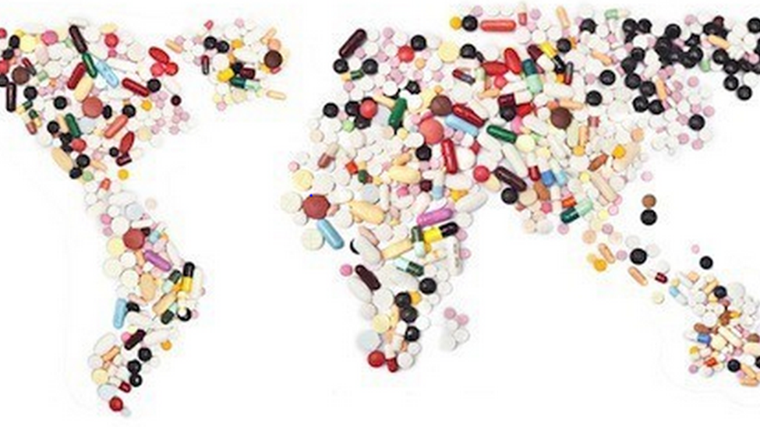


Training package on active tuberculosis drug safety monitoring and management (aDSM)
2023

Slide 2
3.4. Overview on risk communication and new knowledge integration

Slide 3
Learning objectives
By the end of this presentation, the participant is expected to be able to:
Define TB medicine risk
Understand the aDSM role in risk reduction
Describe risk communication methods
Describe new risk knowledge communication and integration for TB drugs

Slide 4
TB medicine risk (1)
Basics
A risk is the probability that an unwanted or unexpected medical event could result from a medical procedure or the use of a medical product
The risk could be known or unknown
  some may have already been identified from clinical studies and some may not have been identified before approval for public use

Slide 5
TB medicine risk (2)
All anti-TB medicines have inherent risk to the patients
  some are avoidable whereas others are not
Most clinical trials for medicines are tested only in limited populations
  there are many unknowns regarding how a wider population (elderly, children, pregnant females, patients with comorbidities, ethnic variations, etc.) will react to the same medicine

Slide 6
aDSM and medicine risk (1)
WHO Global TB Programme
The overall objectives of aDSM are to
  Reduce risks from drug-related harms in patients on second-line treatment for drug-resistant TB
  Generate standardized TB drug safety data to inform future policy updates on the use of such medicines

Slide 7
aDSM and medicine risk (2)
National Tuberculosis Programmes
The objectives of aDSM are to
  Data are collected, reported and analyzed; and decisions are made on the basis of new knowledge gained

Slide 8
Communicating new knowledge on risk
Before communicating a signal (e.g. newly suspected drug-related harm), a thorough ascertainment is needed to avoid the needless blaming of a drug
The reputation of a drug or a regimen could be easily damaged if attribution of risk is not carefully conducted and communicated
This could also have repercussions on the whole treatment programme

Slide 9
Communicating techniques & media (1)
  Visual aids such as tables, charts, graphs, and photographs can be used effectively to summarize information and add a visual aspect to a written report or oral presentation
  Update policies and procedures
  Provide education and training on updated policies and procedures

Slide 10
Communicating techniques & media (2)
  The most common means of dissemination of new information include:
    Health care provider letters or e-mails
    Safety alerts
    Press releases (e.g. via Internet, TV,…)
    Oral presentations at technical meetings
    Fact sheets, posters, flyers
    Peer-reviewed publications
    Revised product inserts

Slide 11
Integrating new knowledge (1)
One important result of the communication of risk is to incorporate the new knowledge into different material used to guide practice. These include
  National TB guidelines
  Essential medicines lists, national formularies
  Product inserts
  Textbooks
  Training materials

Slide 12
Integrating new knowledge (2)
Updated training materials would be oriented to different audiences, including
  formal health care providers
  community health workers
  informal carers
  peer support groups
  expert patients
  community champions
They can be supplemented by information-sharing sessions to educate patients, their families and communities

Slide 13
Communicating approaches (1)
Accept and involve the public as a legitimate partner
  Involve the community early, before important decisions are made
Plan carefully and evaluate performance
  Different goals, audiences and media require different risk communication strategies
  Risk communication will be successful only if carefully planned
  Carefully evaluate your efforts and learn from your mistakes

Slide 14
Communicating approaches (2)
Listen to your audience
  If you do not listen to people, you cannot expect them to listen to you
  Communication is a two-way activity
  Do not make assumptions about what people know, think, or want, done about risks
Be honest, frank and open
  State your credentials; but do not ask or expect to be trusted by the public
  If you do not know an answer or are uncertain, say so
  Get back to people with answers.
  Admit mistakes
  Disclose risk information as soon as possible

Slide 15
Communicating approaches (3)
Coordinate and collaborate with other credible sources and try to issue communications jointly with other trustworthy sources such as
    regulatory bodies
    authoritative university scientists
    physicians
    trusted local officials
    opinion leaders

Slide 16
Communicating approaches (4)
Meet the needs of the media
  Be open with and accessible to reporters
  Respect their deadlines
  Provide information tailored to the needs of each type of media, such as graphics and other visual aids for TV
  Provide background material for the media on complex risk issues
  Follow up on stories with praise or criticism
  Try to establish long-term relationships of trust with editors and reporters

Slide 17
Communicating approaches (5)
Speak clearly and with compassion
  Use simple, non-technical language
  Always try to include a discussion of actions that are under way or can be taken
  Promise only what you can do, and be sure to do what you promise

Slide 18
Conclusions
Risk communication and integration of new knowledge justify much of the efforts and resources devoted to aDSM
Before communicating a drug-related risk, a thorough ascertainment is needed to avoid the needless blaming of a drug
Different methods and approaches can be used to communicate a message clearly, taking advantage of the diversity of means available today

Slide 19
Acknowledgements
The development of the aDSM training material was funded by TDR as part of the Access and Delivery Partnership (ADP) with funding from the Government of Japan.
These training materials were put together in 2016 the WHO Task Force on aDSM with technical partners KNCV Tuberculosis Foundation, Management Sciences for Health (SIAPS), MSF, WHO GTB, and TDR.
The materials were updated in 2022-23 by Mahamadou Bassirou Souleymane (TDR consultant) with Marie-Eve Raguenaud (TDR), Branwen J Hennig (TDR), and Corinne Merle (TDR), and reviewed by Linh Nhat Nguyen (WHO/GTB), Medea Gegia (WHO/GTB), and Fuad Mirzayev (WHO/GTB).
We thank all members of the WARN/CARN-TB working group on aDSM who contributed to the development of the aDSM generic guidelines as well as the secretariat, particularly Dr Christ Houessinon: Disadidi Ambrioso, Esse Marius, Adomou Jamal Rouamba Ruffine, Haro Sougrimani, Koumbem Boureima, Nsanzerugeze Josélyne, Tollo Tollo Daniel Alphonse Désiré, Mpaba Minkat Théophile Mistral, Julie Abessolo, Ursule IDOKO, Tijan Baldeh , Wandifa Samateh, Tida S Kinteh, Alieu Wurie, Mardemn Yeasuen, Benjamin K. Quenneh, Cheick Oumar Bah, Kane El Hadj Malick, Aw Idriss, Mamoudou Hama Rachida, Gagara I. M. Assiatou, Katambé Balkissa, Seiyabatou Elh Saidou, Liombo Anastasie, Lunganyu Junior, Kitambala Sentime, Lula Yves , Habimana-Mucyo Yves, Migambi Patrick, dos Santos Brigite, Castro Vânia, Wadson Cruz, Gueye Aminata, Mukeh Fahnbulleh, Bailor Samuel, Manjo Lamin, Saleh Mahareb Abdoulaye, Haroun Saleh Naima, Mouhoudine Yerima, Kpelafia Silifa

