Slide 1



Training package on active tuberculosis drug safety monitoring and management (aDSM)
2023

Slide 2
3.1. Records Management &
Quality Assurance of Data

Slide 3
Learning objectives
By the end of this presentation, the participant is expected to be able to:
Recognize the importance of methodical and organized documentation
Describe fundamental elements of data quality
Define continuous quality improvement and how it applies to medical records

Slide 4
Documentation Practices (1)
In drug safety monitoring and management, the accurate recording of the details of an event and the action taken is crucial
If these details are not documented, then the episode is as good as if it did not happen! The knowledge and lessons learnt will be lost
The details need to be recorded in a standardized manner
  Remember they need to be used by someone else
  They should be recorded in a way to minimize misunderstandings, allow duplicate reports to be identified, allow pooling …

Slide 5
Documentation Practices (2)
Source documentation should be “ALCOA”:
Attributable
  It should be clear who has documented the data
Legible
  Readable and signatures identifiable
Contemporaneous
  The information should be documented in the correct time frame along with the flow of events
  If a clinical observation cannot be entered when made, chronology should be recorded
  Acceptable amount of delay should be defined and justified

Slide 6
Documentation Practices (3)
Source documentation should be “ALCOA”:
Attributable
Legible
Contemporaneous
Original
  Original, if not original should be exact copy; the first record made by the appropriate person
Accurate
  Accurate, consistent and real representation of facts

Slide 7
Documentation Practices (4)
examples of source documents
Adverse Event Form
TB treatment card, registers, medical records created during treatment
Laboratory results, ECG, audiogram, X-ray, etc.
Medical records supplied by the patient
Informed Consent Forms
Correspondence (email…)

Slide 8
Documentation Practices (5)
common problems
Missing data/documentation
Missing dates
No attribution
Missing subject identifiers
Non standard recording of variables
Inaccurate/erroneous transcription of values
Corrections (white out, scribbling)
Illegible
Use of checklists (in place of notes)

Slide 9
Documentation Practices (6)
ALL records should be:
  Dated
  Signed/Attributed
  Secured
Sign/initial and date entries at the time they are made
Data entries must be dated on the date of entry – contemporaneous
Data entries must be signed or initialed by the person entering the data – attribution
Never sign anybody else’s name – falsification
Do not post- or pre-date

Slide 10
Documentation Practices (7)
When records need correction…
  Do not obliterate previous data
  Date the change
  Identify the person making the change
  State reason for the change
  Do not use whiteout
  Do not change data without knowledge that the change is correct

Slide 11
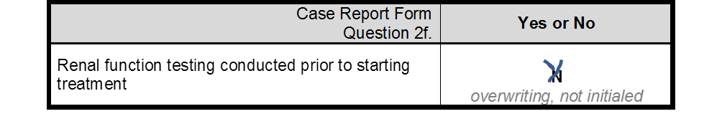
Documentation Practices (8)
correction techniques
Correct Technique
Incorrect Technique

Slide 12
Documentation Practices (9)
“Not a problem – we keep everything on computers”!
  Requirements for electronic records
  At least as secure as paper records
  Paper records: keep safe from fire, water/humidity, theft of hardware…
  Maintain data security and integrity
  Controlled access
  Reliable, validated, adapted software
  Ability to copy, backup and retrieve
  Time stamped audit trails
  Staff training
  Standard Operation Procedures

Slide 13
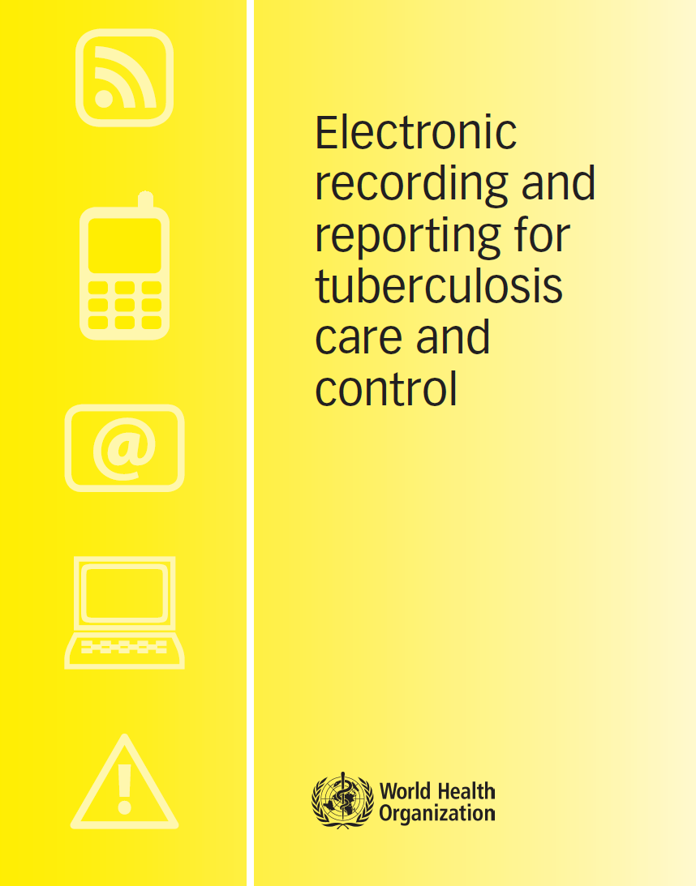

Electronic data systems
WHO/HTM/TB/2011.22
Adopting electronic recording and reporting is not simply about choosing a piece of software: it is also about changing how people work.
This is not a simple undertaking.
This document indicates key questions to be considered and illustrates what the questions, options and recommendations mean in practice by drawing on examples of recent experience from a variety of countries.
It is useful for those planning to introduce electronic recording and reporting systems for TB care and control, or to enhance existing systems
whqlibdoc.who.int/publications/2012/9789241564465_eng.pdf
https://apps.who.int/iris/bitstream/handle/10665/259832/9789241513456eng.pdf?sequence=1&isAllowed=y

Slide 14
Continuous quality improvement (CQI) - (1)
basics of data quality assurance
Medical record review should include careful training and quality assurance methods to enhance the reliability and validity of data obtained from the records
Because of time and budget constraints, comprehensive assessments of data quality and reliability are not always possible
Measures are taken when planning systems, entering data, reviewing them, handling and analyzing them to guarantee quality

Slide 15
Continuous quality improvement (CQI) - (2)
A quality management process that encourages all health care team members to continuously ask the questions,
  How are we doing? and
  Can we do it better?
(Edwards, 2008)

Slide 16
Continuous quality improvement (CQI) - (3)
Documentation of patient care should be one of the many functions addressed in CQI efforts
CQI efforts in the programmatic management of drug-resistant TB should include the development of quality indicators that can be used to evaluate health care provider documentation practices

Slide 17
Continuous quality improvement (CQI) - (4)
Other CQI efforts might analyze and improve system-wide policies and procedures for documenting medication use, adverse events and their management
Periodic review of organizational policies and procedures will allow for their revision in response to changes in health care and advances in technology, including the availability of an electronic medical records

Slide 18
Conclusion (1)
All TB drug safety related documentation - paper and electronic - should be organized, identified and retained so that it can be accurately interpreted without benefit of an interpreter
Can I reconstruct what happened?
Can I identify who did what and when?
Am I confident in the accuracy and authenticity of the data?
Without the documentation, there is no evidence for decision making

Slide 19
Conclusion (2)
The documentation should narrate the medical journey of the patient as it happened to an independent observer and thus form a strong foundation for good drug safety monitoring and management practices
Data quality assurance should be a continuous, inbuilt process at different stages to allow users to understand how their performance is doing and how it can be improved

Slide 20
Acknowledgements
The development of the aDSM training material was funded by TDR as part of the Access and Delivery Partnership (ADP) with funding from the Government of Japan.
These training materials were put together in 2016 the WHO Task Force on aDSM with technical partners KNCV Tuberculosis Foundation, Management Sciences for Health (SIAPS), MSF, WHO GTB, and TDR.
The materials were updated in 2022-23 by Mahamadou Bassirou Souleymane (TDR consultant) with Marie-Eve Raguenaud (TDR), Branwen J Hennig (TDR), and Corinne Merle (TDR), and reviewed by Linh Nhat Nguyen (WHO/GTB), Medea Gegia (WHO/GTB), and Fuad Mirzayev (WHO/GTB).
We thank all members of the WARN/CARN-TB working group on aDSM who contributed to the development of the aDSM generic guidelines as well as the secretariat, particularly Dr Christ Houessinon: Disadidi Ambrioso, Esse Marius, Adomou Jamal Rouamba Ruffine, Haro Sougrimani, Koumbem Boureima, Nsanzerugeze Josélyne, Tollo Tollo Daniel Alphonse Désiré, Mpaba Minkat Théophile Mistral, Julie Abessolo, Ursule IDOKO, Tijan Baldeh , Wandifa Samateh, Tida S Kinteh, Alieu Wurie, Mardemn Yeasuen, Benjamin K. Quenneh, Cheick Oumar Bah, Kane El Hadj Malick, Aw Idriss, Mamoudou Hama Rachida, Gagara I. M. Assiatou, Katambé Balkissa, Seiyabatou Elh Saidou, Liombo Anastasie, Lunganyu Junior, Kitambala Sentime, Lula Yves , Habimana-Mucyo Yves, Migambi Patrick, dos Santos Brigite, Castro Vânia, Wadson Cruz, Gueye Aminata, Mukeh Fahnbulleh, Bailor Samuel, Manjo Lamin, Saleh Mahareb Abdoulaye, Haroun Saleh Naima, Mouhoudine Yerima, Kpelafia Silifa

