Slide 1



Training package on active tuberculosis drug safety monitoring and management (aDSM)
2023

Slide 2
2.2. National and international reporting of adverse events: mechanisms, routes and resources

Slide 3
Learning objectives
By the end of this presentation, the participant is expected to be able to:
  Describe the mechanisms for adverse event reporting within the country
  Describe the mechanism for adverse event reporting to the global aDSM database
  Identify the resources needed to ensure that the whole system works

Slide 4
Core package of aDSM
Basic principles
  All serious adverse events (SAEs) detected need to be monitored
  However, all adverse events (AEs) detected need to be clinically managed, regardless of seriousness
Treatment sites with additional resources may also monitor other AEs that are of clinical significance or of special interest to the programme

Slide 5
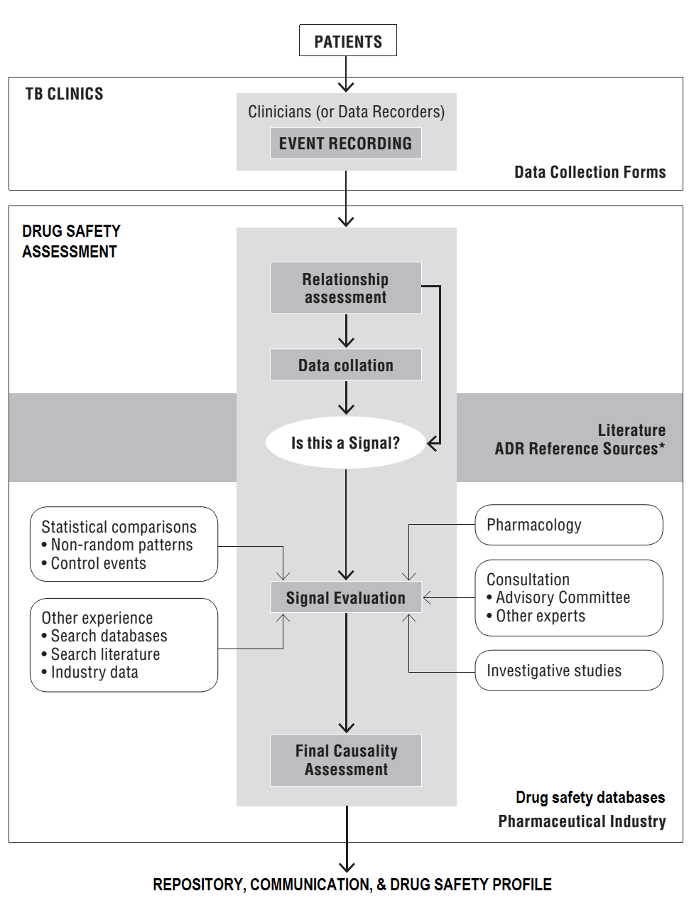
Data flow for aDSM
collection,
recording,
assessment,
storage,
transmission,
communication,
knowledge
Adapted from WHO 2012 (www.who.int/entity/medicines/publications/pharmacovigilance_tb/)

Slide 6
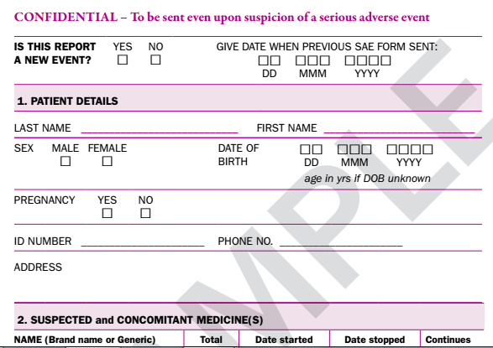
DATA ENTRY
PATIENT HISTORY
SAE
CLINICAL TESTS

Slide 7
Data collection
create data collection tools and database
Forms shown in subsequent slides are examples: national programmes can develop and adapt their own forms (electronic or paper)
When revising data collection tools and systems, programmes need to:
  Ensure where possible that new data elements needed for aDSM are built into existing system rather than creating new databases afresh, avoiding parallel systems, simplifying as much as possible
  Strive for interoperability with other registries (e.g. TB patients’ database, laboratory information system) for any new system created
  Apply usual 'healthy practices' in data entry & transfer

Slide 8
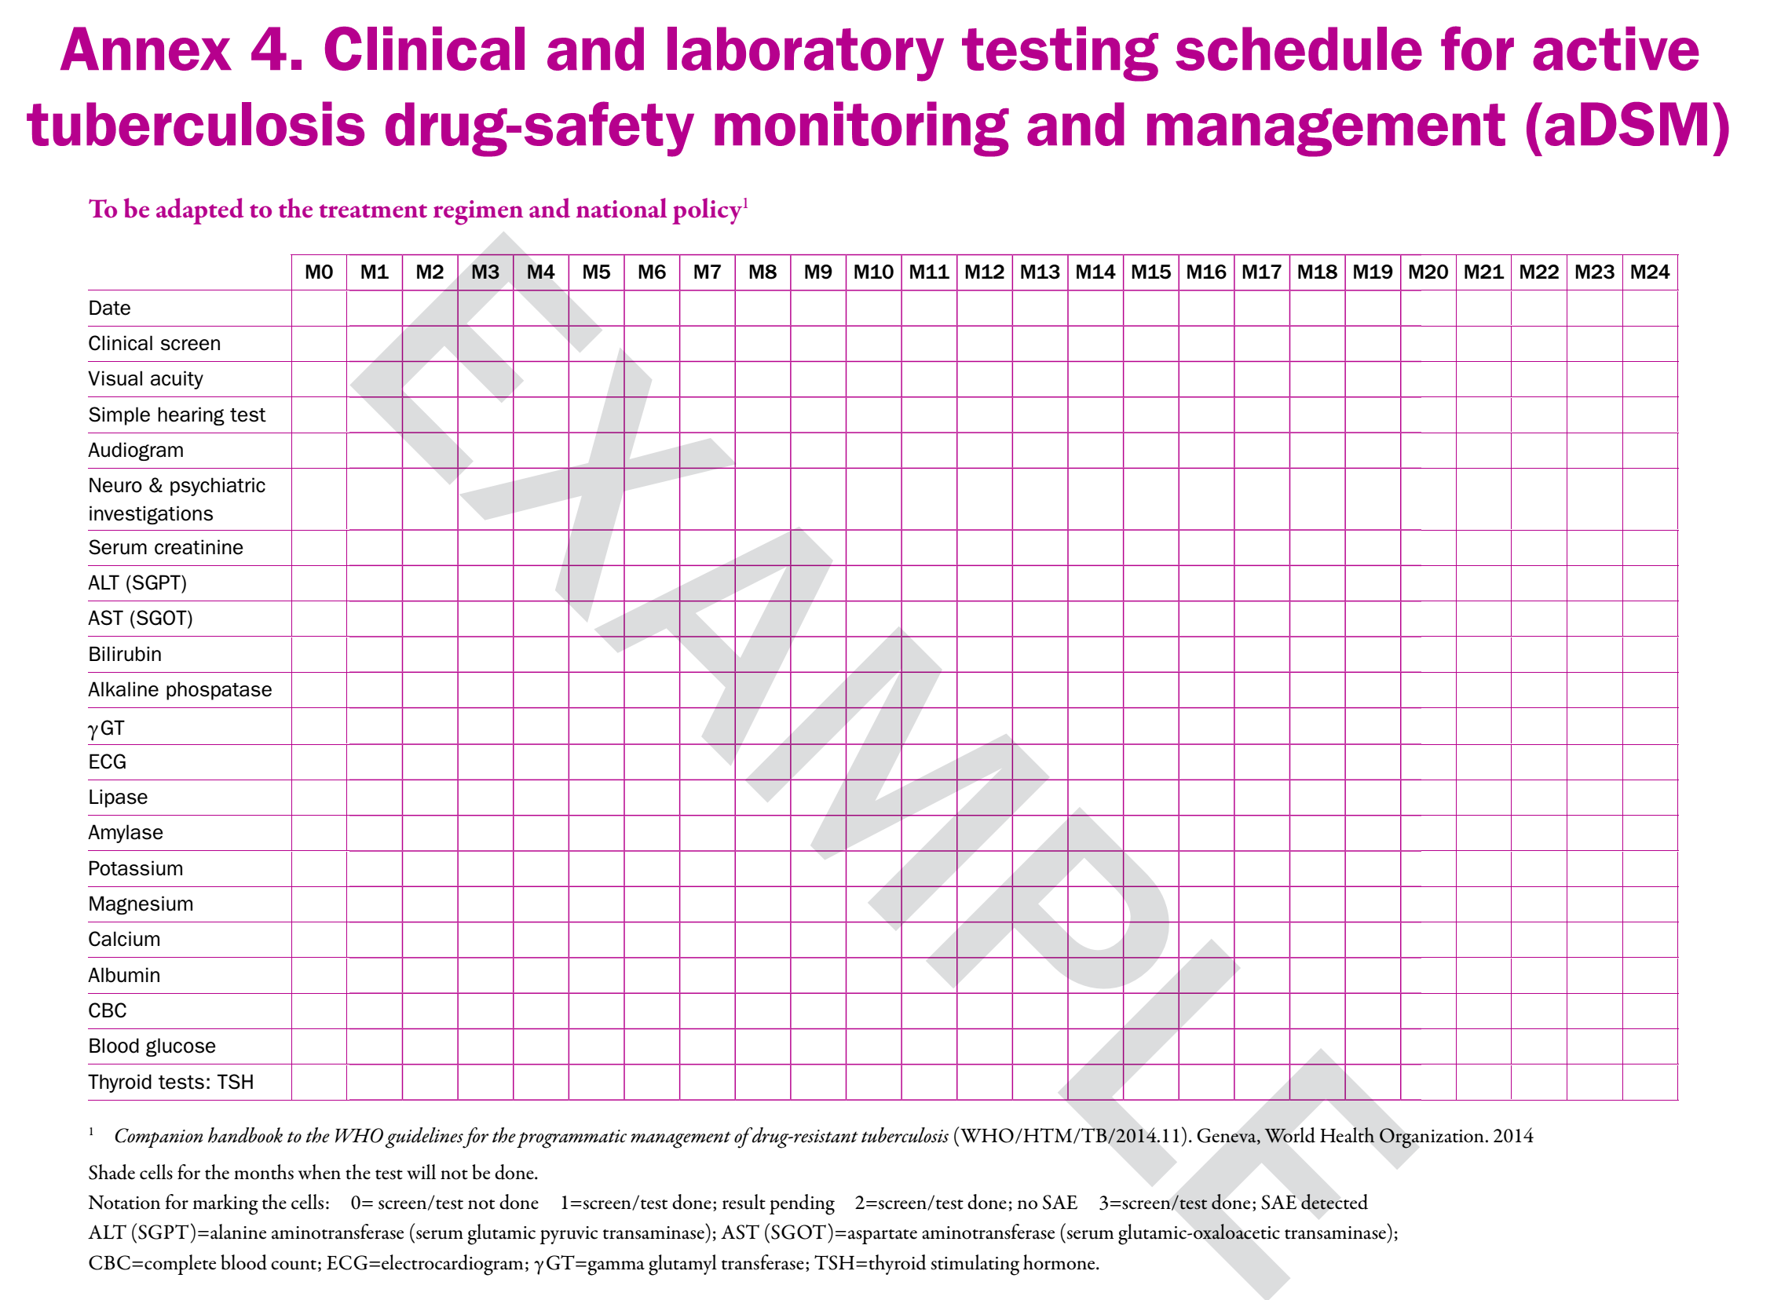
Update this slide using the national or NTP notification form

Slide 9
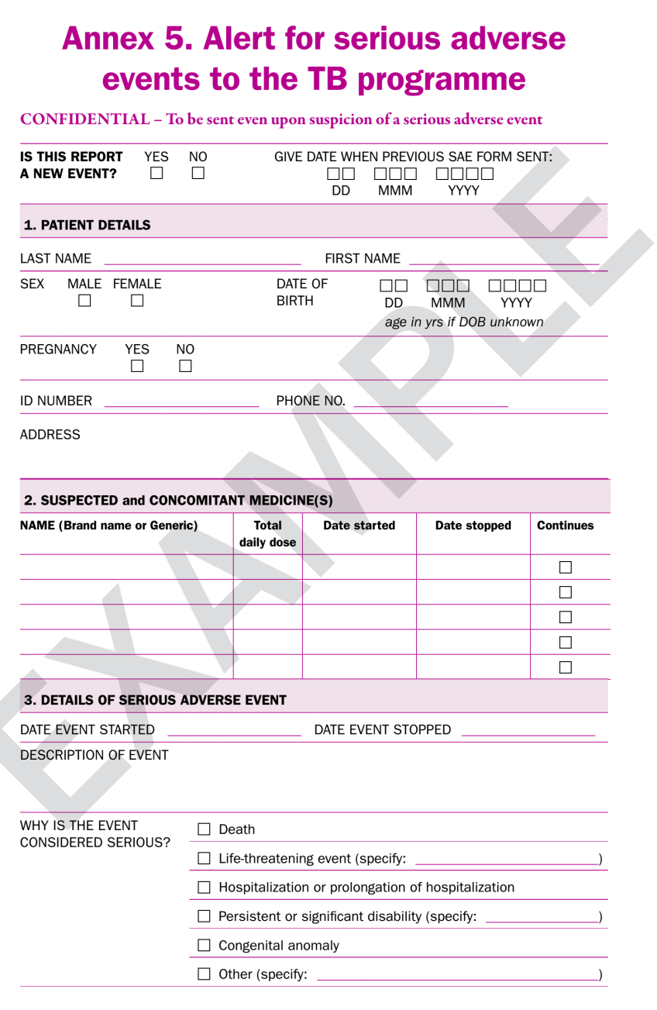
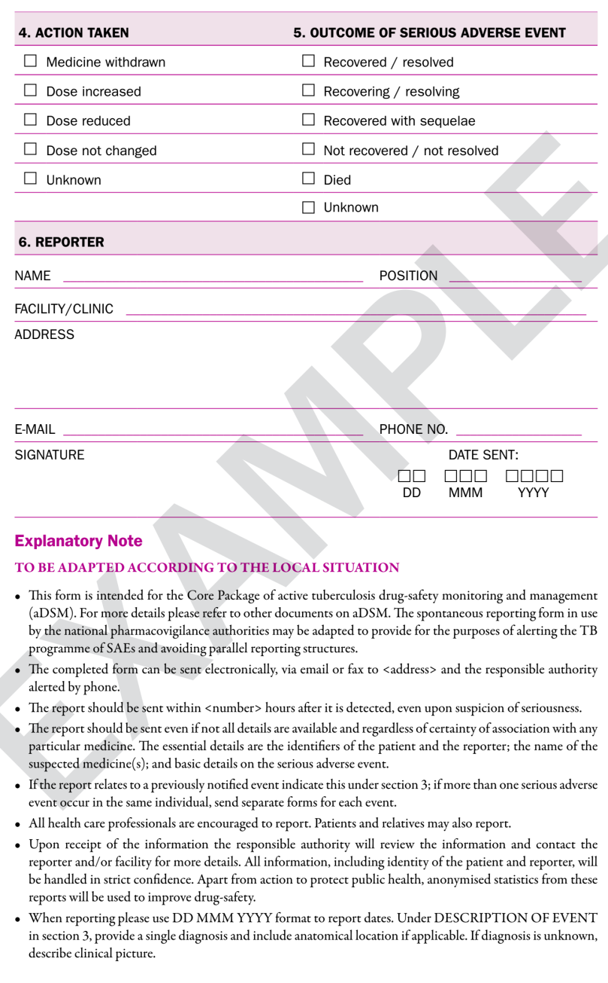
Alert form for SAE
http://apps.who.int/iris/bitstream/10665/204465/1/WHO_HTM_TB_2015.28_eng.pdf

Slide 10
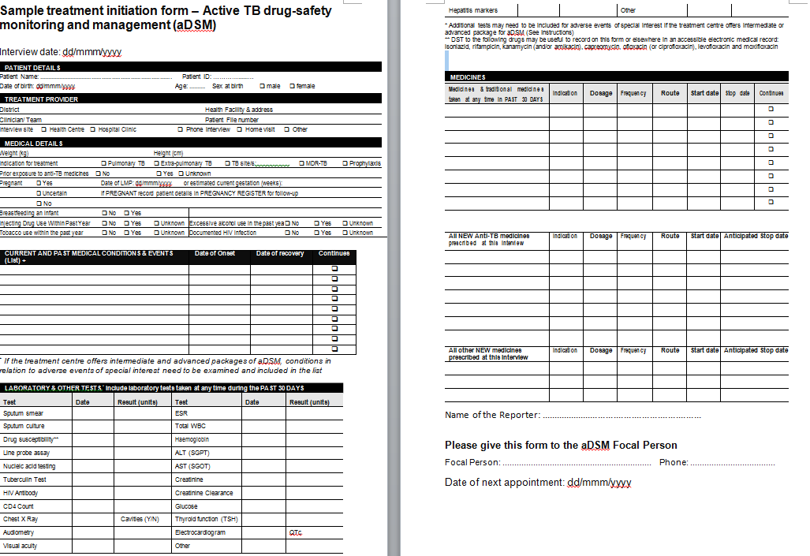
Data collection form - Initiation
Sample
To be adapted with the TB-MR treatment file used by the TNP

Slide 11
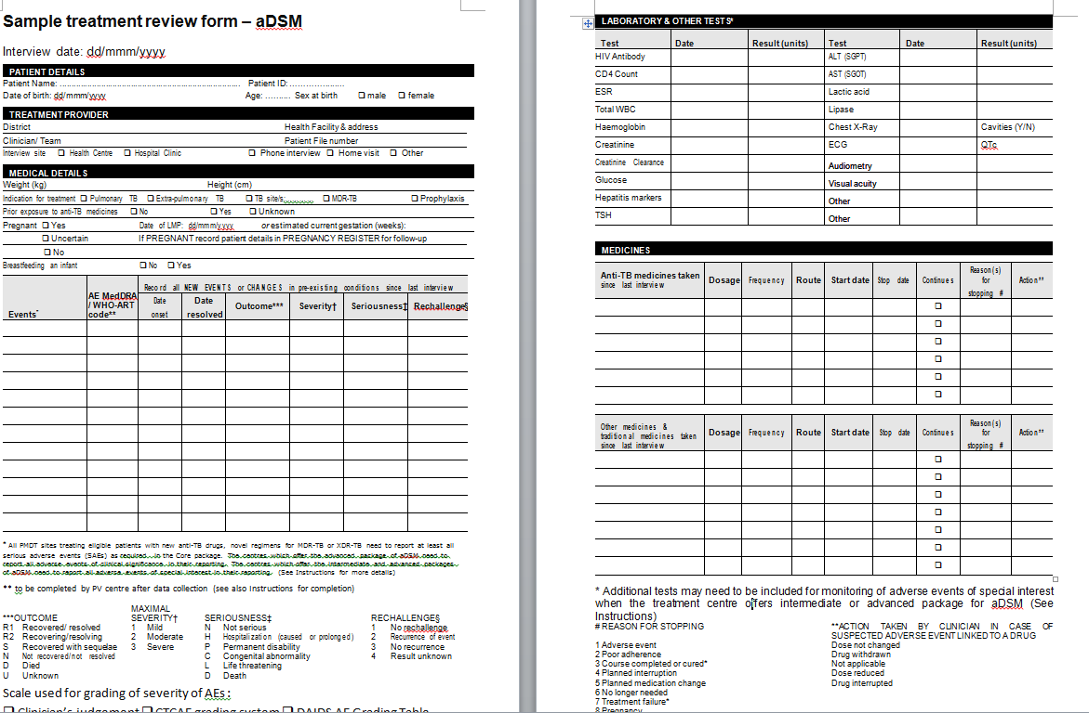
Data collection form - Review
Sample
To be adapted with the TB-MR treatment file used by the TNP

Slide 12
aDSM Report Forms
Instances where data are expected to be collected and reported:
  Alert of a suspected/confirmed SAE
  Initial detailed report following the alert SAE
  Review detailed report following initial report
  TB programmes may develop separate forms (paper or electronic) for the reporting at the above listed stages. Adaptation may be possible, e.g; initial detailed report doubles as an alert form, with full details on this form completed later, after the alert

Slide 13
Assigning severity (1)
  Simplest is a scale from
    mild (grade 1) -> moderate (grade 2) ->severe (grade ≥ 3)
    as determined by the clinician and/or patient
  Severity scales are available (e.g. DAIDS, CTCAE, ANRS…)
    They are useful to classify results of laboratory and other special tests
  Remember that these scales have been developed for conditions other than TB treatment (AIDS, cancer…)
  They often combine elements of seriousness with severity

Slide 14
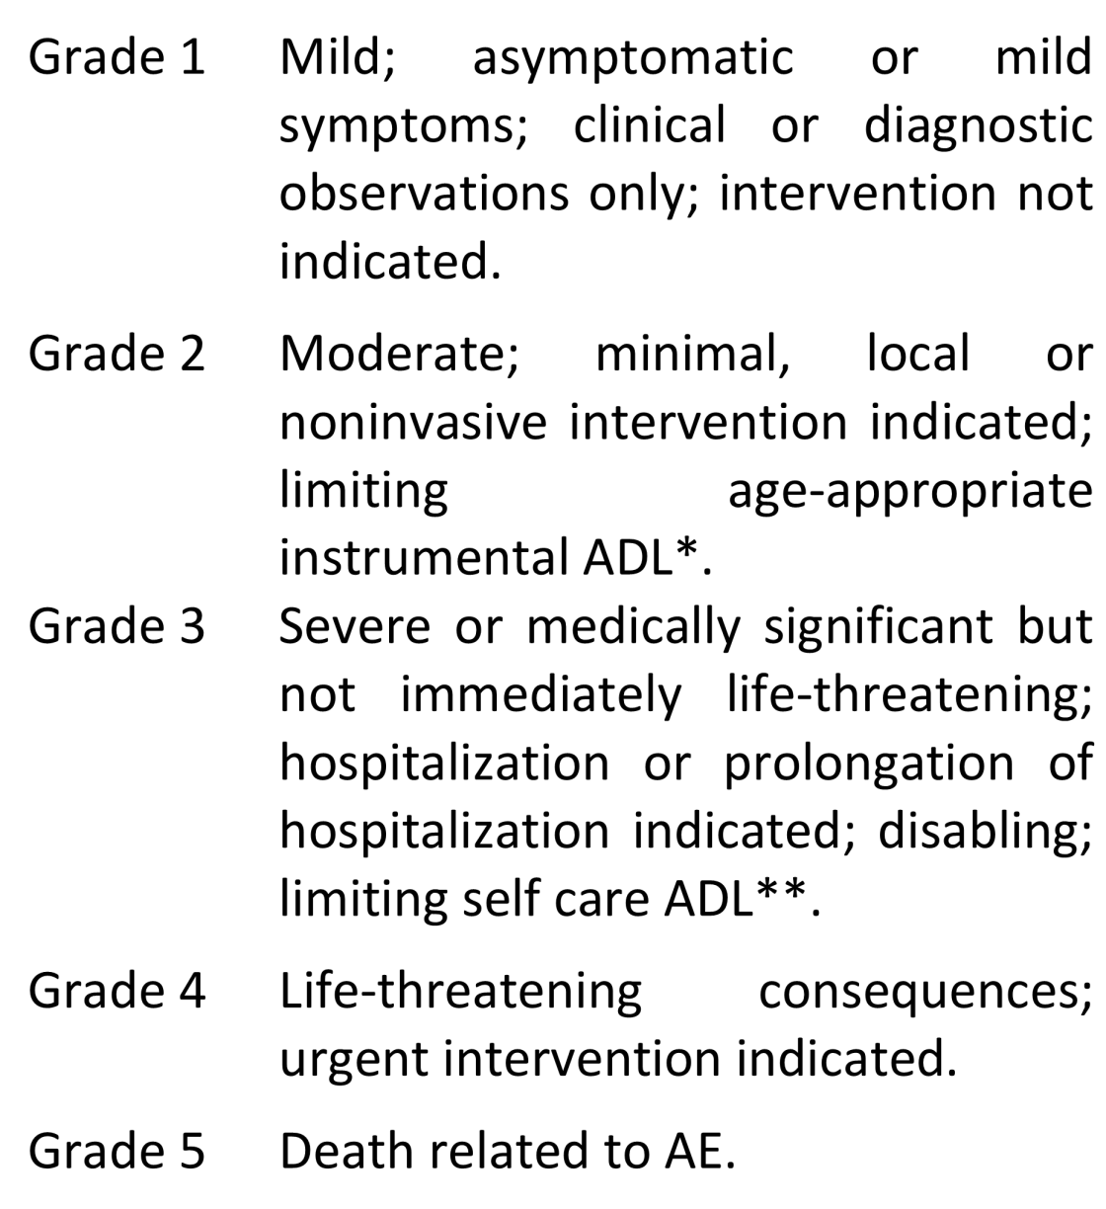
Assigning severity (2)
* Activities of Daily Living (ADL); instrumental ADL refer to preparing meals, shopping for groceries or clothes, using the telephone, managing money, etc.
** Self care ADL refer to bathing, dressing and undressing, feeding self, using the toilet, taking medications, and not bedridden.
  Source: CTCAE v4.0 (evs.nci.nih.gov/ftp1/CTCAE/CTCAE_4.03_2010-06-14_QuickReference_5x7.pdf)

Slide 15

Data production cycle
2. IDENTIFY COHORT & BUILD SYSTEM
1. TRAIN
6. GIVE FEEDBACK
3. ENTER DATA
4. SUPERVISE
5. ANALYSE

Slide 16


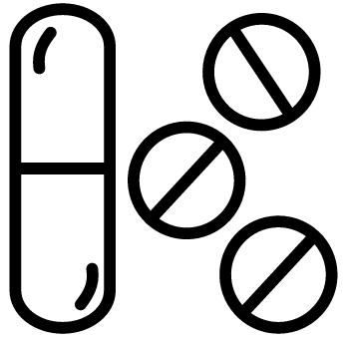



Coordination between NTP and National pharmacovigilance system (NPV) in implementing aDSM
National TB programme
Pharmaconvigilance
programme
Drug safety monitoring
(aDSM Component)
Further analysis for signal detection/causality assessment and communication
TB-MR treatment facility
Cohort-based follow-up of patients with
questionnaires to elicit symptoms; and
routine tests for TB drug safety monitoring
Recording of all SAEs in a national aDSM database (regularly transferred into the global database)
Signal detection/causality assessment by the NTP (if capacity is limited by national pharmacovigilance system (NPV))
Delivery of treatment
Management of adverse reactions
Reporting as required by local regulations
Support for signal detection and causality assessment
Inform update of
treatment policy
and patient care
practice
(as per PMDT guidance)
Inform updates of country and global drug safety profile
New
evidence

Slide 17
Resources for reporting
  Reporting functioning will depend on the mobilization of resources (funding, equipment, consumables, human resource capacity)
  Technical (KNCV, MSF, MSH, WHO, TDR…) and funding agencies (GF, USAID…) may support activities to put in place elements for training, development of normative tools, information systems etc.
  In the long run, aDSM needs to become part of routine monitoring and patient care structure of a TB treatment programme and necessary resources made available through domestic and external funds

Slide 18
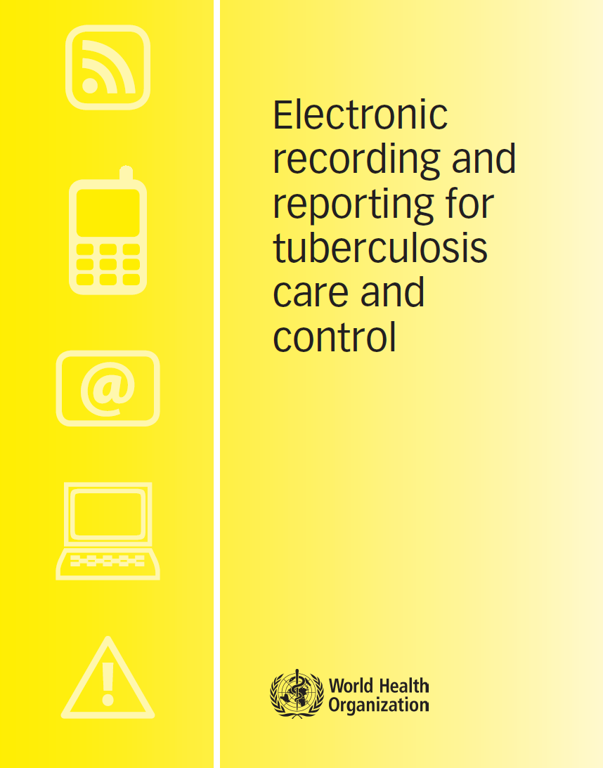
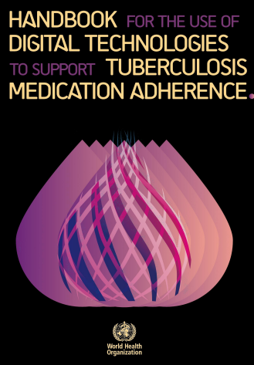
WHO/HTM/TB/2011.22
https://apps.who.int/iris/bitstream/handle/10665/259832/9789241513456eng.pdf?sequence=1&isAllowed=y
whqlibdoc.who.int/publications/2012/9789241564465_eng.pdf

Slide 19
Conclusions
AE monitoring and management relies heavily on a well-functioning and adequately-resourced system to collect and manage relevant data
Upstream of the data collection process are a series of enabling activities, including the establishment of a regulatory framework, the human resource element (roles, responsibilities, training), and the case definitions for reporting
Data flow needs to proceed uninterruptedly from the site where the event happens, to the national dataset, up to the international level
The process is also subject to quality checks at national and international level. Causality assessment and process indicators need to be done within the country; signal detection is a process best done at international level.

Slide 20
Acknowledgements
The development of the aDSM training material was funded by TDR as part of the Access and Delivery Partnership (ADP) with funding from the Government of Japan.
These training materials were put together in 2016 the WHO Task Force on aDSM with technical partners KNCV Tuberculosis Foundation, Management Sciences for Health (SIAPS), MSF, WHO GTB, and TDR.
The materials were updated in 2022-23 by Mahamadou Bassirou Souleymane (TDR consultant) with Marie-Eve Raguenaud (TDR), Branwen J Hennig (TDR), and Corinne Merle (TDR), and reviewed by Linh Nhat Nguyen (WHO/GTB), Medea Gegia (WHO/GTB), and Fuad Mirzayev (WHO/GTB).
We thank all members of the WARN/CARN-TB working group on aDSM who contributed to the development of the aDSM generic guidelines as well as the secretariat, particularly Dr Christ Houessinon: Disadidi Ambrioso, Esse Marius, Adomou Jamal Rouamba Ruffine, Haro Sougrimani, Koumbem Boureima, Nsanzerugeze Josélyne, Tollo Tollo Daniel Alphonse Désiré, Mpaba Minkat Théophile Mistral, Julie Abessolo, Ursule IDOKO, Tijan Baldeh , Wandifa Samateh, Tida S Kinteh, Alieu Wurie, Mardemn Yeasuen, Benjamin K. Quenneh, Cheick Oumar Bah, Kane El Hadj Malick, Aw Idriss, Mamoudou Hama Rachida, Gagara I. M. Assiatou, Katambé Balkissa, Seiyabatou Elh Saidou, Liombo Anastasie, Lunganyu Junior, Kitambala Sentime, Lula Yves , Habimana-Mucyo Yves, Migambi Patrick, dos Santos Brigite, Castro Vânia, Wadson Cruz, Gueye Aminata, Mukeh Fahnbulleh, Bailor Samuel, Manjo Lamin, Saleh Mahareb Abdoulaye, Haroun Saleh Naima, Mouhoudine Yerima, Kpelafia Silifa

