Slide 1



Training package on active tuberculosis drug safety monitoring and management (aDSM)
2023

Slide 2
2.1vii. Consolidate aDSM data electronically

Slide 3
Key steps in aDSM implementation
Create a national coordinating mechanism for aDSM
Develop a plan for aDSM
Define management and supervision roles and responsibilities
Create standard data collection materials
Train staff on the collection of data
Define schedules and routes for data collection and reporting
Consolidate aDSM data electronically
Develop capacity for signal detection and causality assessment

Slide 4
Learning objective
By the end of this presentation, the participant is expected to…
  Understand why and how to collect, manage and store aDSM data in an electronic format

Slide 5
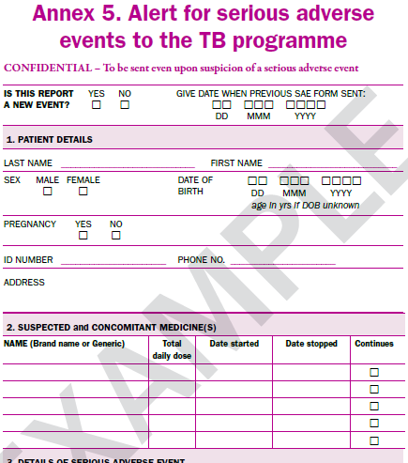
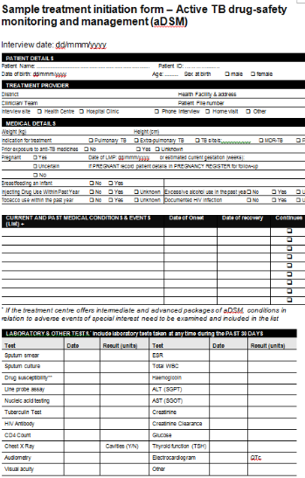
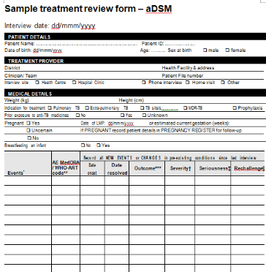
aDSM data & forms
Generally speaking, there are two sets of forms : (i) alert (initial notification) and (ii) collection of essential aDSM data elements
Initially aDSM data may be recorded in paper format. Efforts should be made to digitize the process (using electronic data capture) even at the earliest (alert) stage.

Slide 6


National TB electronic data register
In some countries, there may already be an electronic database for TB surveillance, case-management or drug-safety:
  National TB database
    Can accommodate data on treatment start and follow-up
    Not always good at capturing AE data
  National pharmacovigilance database
    Unfit for information on TB treatment initiation/follow-up; likely to be geared primarily for spontaneous rather than active drug-safety surveillance
    Well designed to allow for capture of SAE/AE, causality assessment, even for signal detection for some systems.

Slide 7
Adaptation of existing electronic surveillance databases
Creation of an electronic database – or preferably adaptation of an existing TB patient database to accommodate the additional data fields required – is an important step.
  Ensure standardization and safekeeping of data.
  facilitate sharing of data, as well as generation of indicators and analyses
A stepwise approach, for example starting with a simple standalone database pending the adaptation of a national TB database

Slide 8


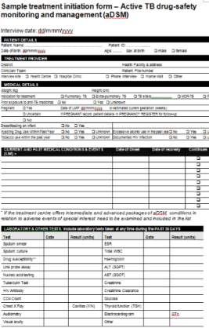


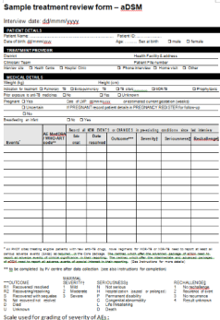
Summary scheme of data management see also module 2.1vi in this series
National TB database (inclusive of aDSM data)
Collection of added data post-alert (including updates on AE outcome)
Notes:
Usually TB doctors will send their forms via email to a designed recipient within aDSM coordination. There could be data managers involved to regularly capture the information from the forms into the electronic system.

Slide 9
Collaborative approach
Measures should be taken to avoid duplication of work by:
  Revising existing databases,
  Ensuring interoperability of data management systems
  Granting access rights to users for different data as needed
  Consulting with national pharmacovigilance authorities to satisfy reporting needs (active, spontaneous) from the same system and automate them as much as possible

Slide 10
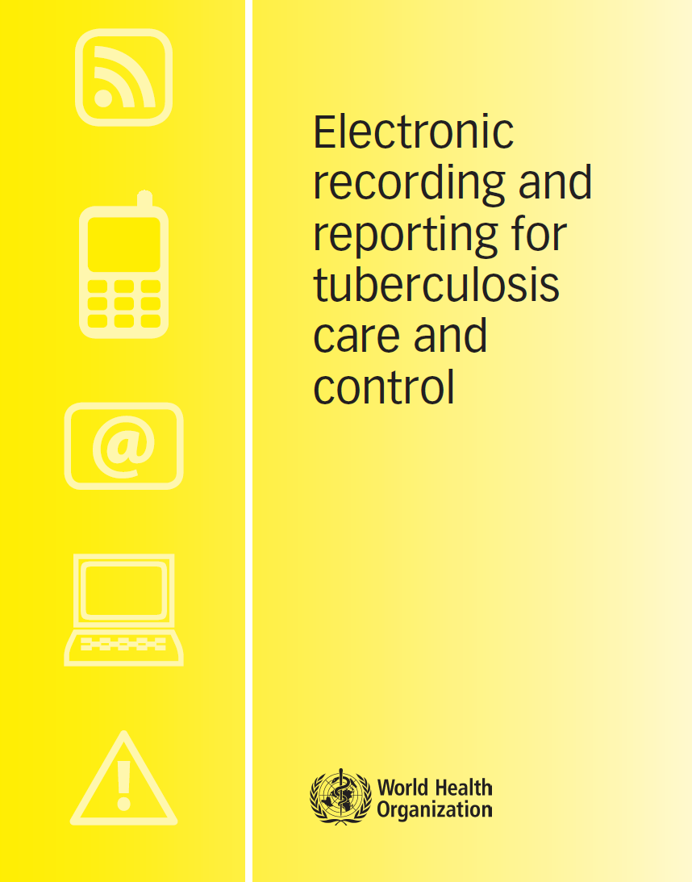

Electronic data systems
WHO/HTM/TB/2011.22
Adopting electronic recording and reporting is not simply about choosing a piece of software: it is also about changing how people work.
This is not a simple undertaking.
This document indicates key questions to be considered and illustrates what the questions, options and recommendations mean in practice by drawing on examples of recent experience from a variety of countries.
It is useful for those planning to introduce electronic recording and reporting systems for TB care and control, or to enhance existing systems
whqlibdoc.who.int/publications/2012/9789241564465_eng.pdf
https://apps.who.int/iris/bitstream/handle/10665/259832/9789241513456eng.pdf?sequence=1&isAllowed=y

Slide 11
Conclusions
The electronic consolidation of aDSM data is key to reach a stage where pooled analyses and reporting are possible
This process may take time and require technical support from partners. A stepwise, collaborative approach is recommended
Building on existing systems and in collaboration with local partners
  especially the national pharmacovigilance authorities is essential

Slide 12
Acknowledgements
The development of the aDSM training material was funded by TDR as part of the Access and Delivery Partnership (ADP) with funding from the Government of Japan.
These training materials were put together in 2016 the WHO Task Force on aDSM with technical partners KNCV Tuberculosis Foundation, Management Sciences for Health (SIAPS), MSF, WHO GTB, and TDR.
The materials were updated in 2022-23 by Mahamadou Bassirou Souleymane (TDR consultant) with Marie-Eve Raguenaud (TDR), Branwen J Hennig (TDR), and Corinne Merle (TDR), and reviewed by Linh Nhat Nguyen (WHO/GTB), Medea Gegia (WHO/GTB), and Fuad Mirzayev (WHO/GTB).
We thank all members of the WARN/CARN-TB working group on aDSM who contributed to the development of the aDSM generic guidelines as well as the secretariat, particularly Dr Christ Houessinon: Disadidi Ambrioso, Esse Marius, Adomou Jamal Rouamba Ruffine, Haro Sougrimani, Koumbem Boureima, Nsanzerugeze Josélyne, Tollo Tollo Daniel Alphonse Désiré, Mpaba Minkat Théophile Mistral, Julie Abessolo, Ursule IDOKO, Tijan Baldeh , Wandifa Samateh, Tida S Kinteh, Alieu Wurie, Mardemn Yeasuen, Benjamin K. Quenneh, Cheick Oumar Bah, Kane El Hadj Malick, Aw Idriss, Mamoudou Hama Rachida, Gagara I. M. Assiatou, Katambé Balkissa, Seiyabatou Elh Saidou, Liombo Anastasie, Lunganyu Junior, Kitambala Sentime, Lula Yves , Habimana-Mucyo Yves, Migambi Patrick, dos Santos Brigite, Castro Vânia, Wadson Cruz, Gueye Aminata, Mukeh Fahnbulleh, Bailor Samuel, Manjo Lamin, Saleh Mahareb Abdoulaye, Haroun Saleh Naima, Mouhoudine Yerima, Kpelafia Silifa

