Slide 1



Training package on active tuberculosis drug safety monitoring and management (aDSM)
2023

Slide 2
2.1vi. Define schedules and routes for data collection and reporting

Slide 3
Key steps in aDSM implementation
Create a national coordinating mechanism for aDSM
Develop a plan for aDSM
Define management and supervision roles and responsibilities
Create standard data collection materials
Train staff on the collection of data
Define schedules and routes for data collection and reporting
Consolidate aDSM data electronically
Develop capacity for signal detection and causality assessment

Slide 4
Learning objective
By the end of this presentation, the participant is expected to …
  Understand how aDSM test schedules are organised, data collected from them, and routed for reporting purposes

Slide 5
Three essential elements of aDSM (1)
  Patients targeted for aDSM should undergo active and systematic clinical and laboratory assessment during treatment to detect drug toxicity and AEs
      Proposed schedules have been developed for use in patients on shorter regimens or on new medications

Slide 6
Three essential elements of aDSM (2)
  2. All AEs detected should be managed in a timely manner in order to deliver the best possible patient care.
  Management of AEs is beyond the scope of this note and further details are provided in other implementation documents, such as the Programmatic management of drug-resistant tuberculosis (PMDT) Handbook
https://apps.who.int/iris/bitstream/handle/10665/365309/9789240065352-eng.pdf (update 2022)
http://apps.who.int/iris/bitstream/10665/130918/1/9789241548809_eng.pdf (2014)

Slide 7
Three essential elements of aDSM (3)
  3. Standardized data should be systematically collected and reported for any detected SAE
  These will eventually be used to characterize the types of SAEs, assess the safety of the treatment, and inform future policy on the use of these medicines

Slide 8
Eligible patients
  aDSM applies to patients on treatment with:
  new anti-TB drugs (bedaquiline, delamanid);
  novel MDR-TB regimens (e.g. shorter or oral MDR-TB regimen);
  regimens for extensively drug-resistant TB (XDR-TB)
  Once coverage of these patients groups is adequate, aDSM can extend to other MDR-TB patients on treatment

Slide 9
Eligible centres
  All health care facilities treating patients eligible for aDSM need to put in place at least the core package (surveillance for SAEs)
  These include public or private facilities; TB or general care centers; outpatients or inpatient centers
  The following slides give further detail on how the routing of data operates from the point of generation to the delivery to the global level

Slide 10
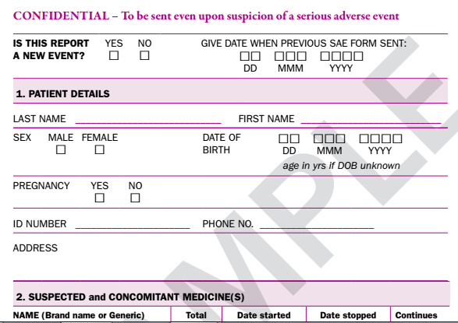
Overall scheme
DATA ENTRY
PATIENT HISTORY
SAE
CLINICAL TESTS
Update this slide using the SAE form

Slide 11
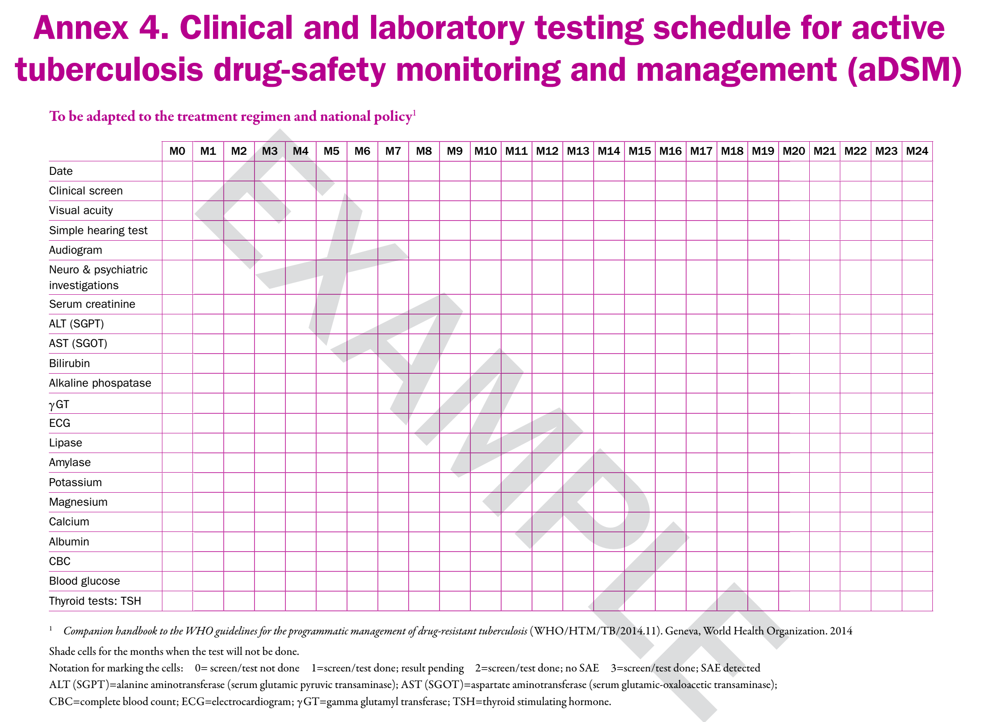
Update this slide using the clinical and laboratory testing schedule from the MDR-TB guide

Slide 12
Testing schedules for patients on shorter MDR-TB regimens developed by technical agencies
UNION multi-centre project
MSF centres (Uzbekistan, Swaziland)

Slide 13
Alert form for SAE (1)
If the clinician suspects or confirms a SAE, an alert form is completed and sent to the person responsible for aDSM in the programme
The alert form is meant to trigger rapid action : it does not include all the details needed for national or global surveillance
Upon receipt of the form, the programme needs to collect all other necessary details (see module 2.1iv. in this series)
A sample alert form is presented in the following slide

Slide 14
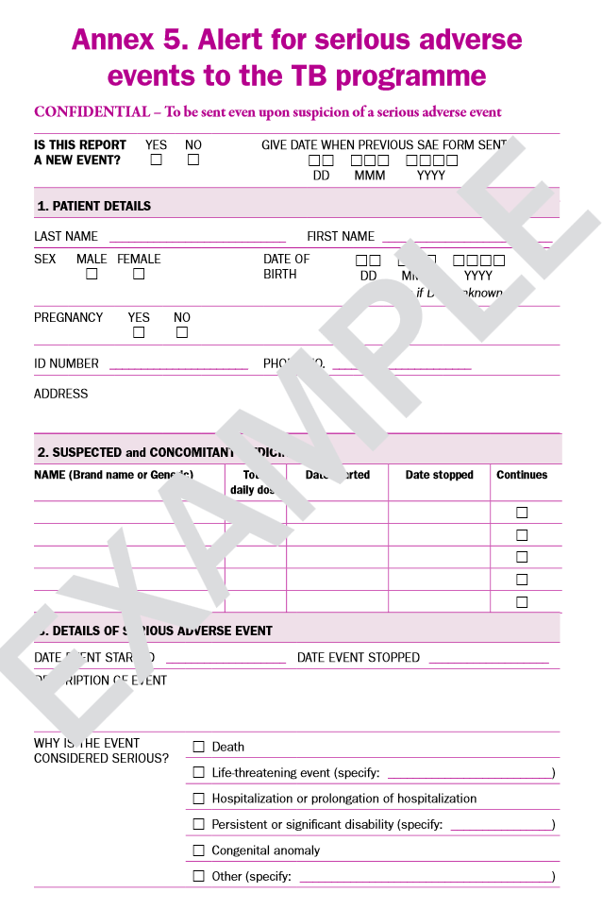
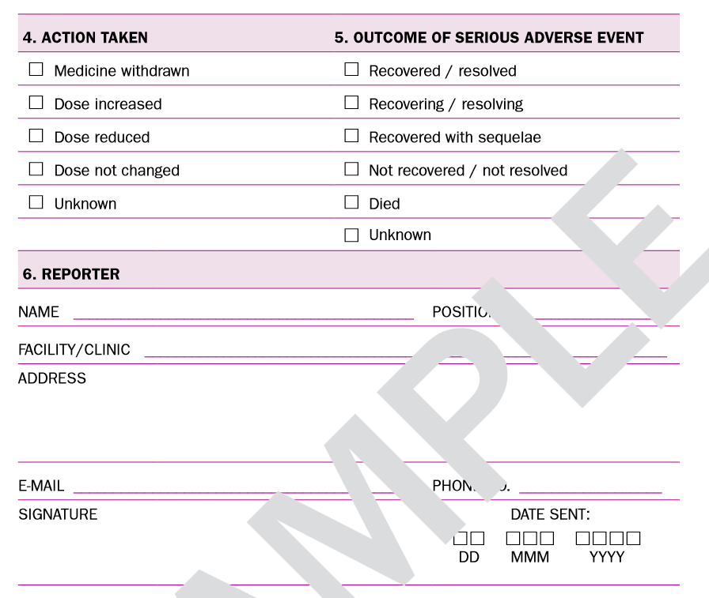
Alert form for SAE (2)
minimum contents of an alert form for SAE
From Active tuberculosis drug-safety monitoring and management (aDSM). Framework for implementation. (WHO/HTM/TB/2015.28). Geneva, World Health Organization; 2015
Show the alert form for SAEs used at local level

Slide 15
aDSM Essential Data Elements
The person managing the alert needs to check at source and collect the rest of the aDSM data elements concerning:
  Case & patient identifiers;
  Patient demographics;
  Facility details;
  Patient details at time of event;
  AE description (including action & outcomes);
  Medical treatment;
  Medical history;
  Laboratory assessment (see more in module 2.1iv in this series).
The data collection would best be done using a basic electronic system on a mobile device (cell phone, tablet computer or laptop) to enhance portability and easy transmission of the data towards the next reporting level

Slide 16
Electronic data systems 1
To avoid creating parallel systems it is helpful to:
  Revise existing databases where possible rather than create new ones,
  Grant access rights to users as needed
  Ensure the interoperability of data management systems
  Coordinate with the national pharmacovigilance authorities to satisfy reporting needs (active, spontaneous reporting) from the same source and to automate the systems as much as possible

Slide 17
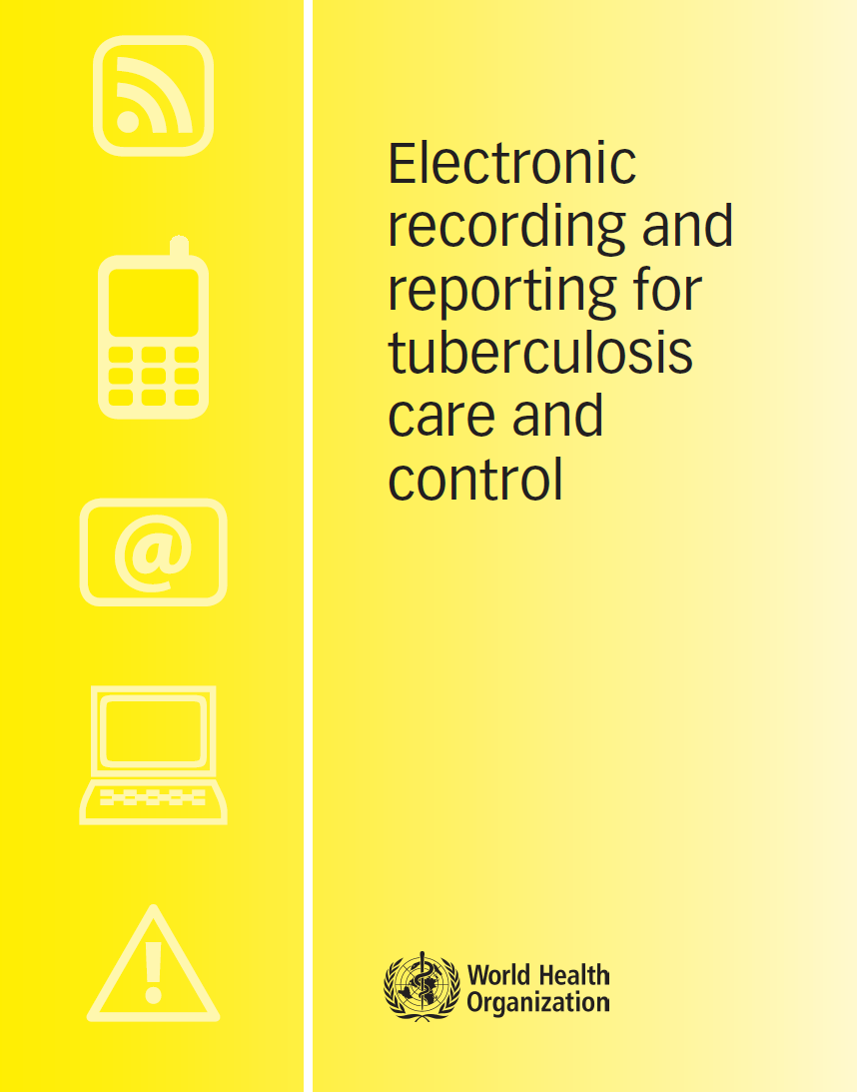
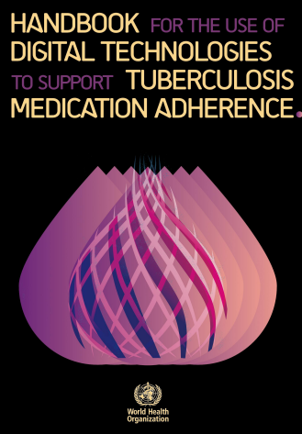
Electronic data systems 2
WHO/HTM/TB/2011.22
Adopting electronic recording and reporting is not simply about choosing a piece of software: it is also about changing how people work.
This is not a simple undertaking.
This document indicates key questions to be considered and illustrates what the questions, options and recommendations mean in practice by drawing on examples of recent experience from a variety of countries.
It is useful for those planning to introduce electronic recording and reporting systems for TB care and control, or to enhance existing systems
whqlibdoc.who.int/publications/2012/9789241564465_eng.pdf
https://apps.who.int/iris/bitstream/handle/10665/259832/9789241513456eng.pdf?sequence=1&isAllowed=y

Slide 18
Conclusions
  For aDSM data on AEs to serve their purpose, a streamlined pathway will be required, from the point where the event is generated at the patient interface, to the alerting of aDSM authorities about a suspected or confirmed AE, the collection of additional detail of that AE, and the proper consolidation of the data of the AE
  The electronic management of data is indispensable for the transfer and subsequent analysis; it should be encouraged from the very earliest stages of this pathway (alerts)
  The modification of existing data systems should aim at simplicity, but also avoid parallel systems and try to centralise all national reporting requirements into one process.

Slide 19
Acknowledgements
The development of the aDSM training material was funded by TDR as part of the Access and Delivery Partnership (ADP) with funding from the Government of Japan.
These training materials were put together in 2016 the WHO Task Force on aDSM with technical partners KNCV Tuberculosis Foundation, Management Sciences for Health (SIAPS), MSF, WHO GTB, and TDR.
The materials were updated in 2022-23 by Mahamadou Bassirou Souleymane (TDR consultant) with Marie-Eve Raguenaud (TDR), Branwen J Hennig (TDR), and Corinne Merle (TDR), and reviewed by Linh Nhat Nguyen (WHO/GTB), Medea Gegia (WHO/GTB), and Fuad Mirzayev (WHO/GTB).
We thank all members of the WARN/CARN-TB working group on aDSM who contributed to the development of the aDSM generic guidelines as well as the secretariat, particularly Dr Christ Houessinon: Disadidi Ambrioso, Esse Marius, Adomou Jamal Rouamba Ruffine, Haro Sougrimani, Koumbem Boureima, Nsanzerugeze Josélyne, Tollo Tollo Daniel Alphonse Désiré, Mpaba Minkat Théophile Mistral, Julie Abessolo, Ursule IDOKO, Tijan Baldeh , Wandifa Samateh, Tida S Kinteh, Alieu Wurie, Mardemn Yeasuen, Benjamin K. Quenneh, Cheick Oumar Bah, Kane El Hadj Malick, Aw Idriss, Mamoudou Hama Rachida, Gagara I. M. Assiatou, Katambé Balkissa, Seiyabatou Elh Saidou, Liombo Anastasie, Lunganyu Junior, Kitambala Sentime, Lula Yves , Habimana-Mucyo Yves, Migambi Patrick, dos Santos Brigite, Castro Vânia, Wadson Cruz, Gueye Aminata, Mukeh Fahnbulleh, Bailor Samuel, Manjo Lamin, Saleh Mahareb Abdoulaye, Haroun Saleh Naima, Mouhoudine Yerima, Kpelafia Silifa

