Slide 1



Training package on active tuberculosis drug safety monitoring and management (aDSM)
2023

Slide 2
2.1v. Train staff on the collection of data

Slide 3
Key steps in aDSM implementation
Create a national coordinating mechanism for aDSM
Develop a plan for aDSM
Define management and supervision roles and responsibilities
Create standard data collection materials
Train staff on the collection of data
Define schedules and routes for data collection and reporting
Consolidate aDSM data electronically
Develop capacity for signal detection and causality assessment

Slide 4
Learning objective
By the end of this presentation, the participant is expected to be able to…
  Organize training of key staff on the collection of aDSM data using the standard forms and treatment cards

Slide 5
Data collection
Systematic
Organized
Result-oriented
Efficient
Standard data collection forms
Roles & responsibilities defined; staff trained
What do we want to see from these data?
No duplicates!
Notes:
Systematic approach ensures harmonized data pool. Organisation is key to make sure a proper system is in place to perform the task and people are trained and know what they have to do. Safety data collection should tend to an objective – we need to know what is the question we want to answer by collecting (and afterwards analysing) those data. Duplication must absolutely be avoided; in some countries report forms for initiation and follow-up of treatment are already existing for example, we must absolutely avoid re-creating new ones (better to elaborate on the basis of what is existing).

Slide 6
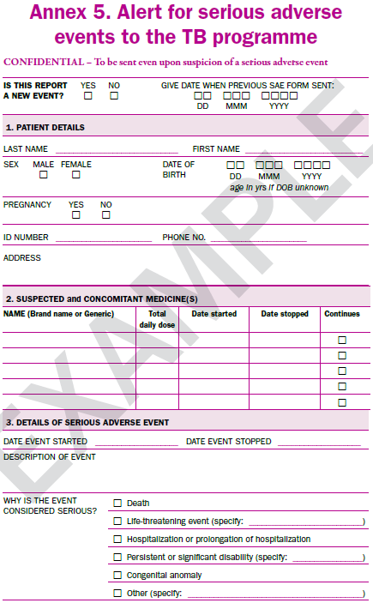
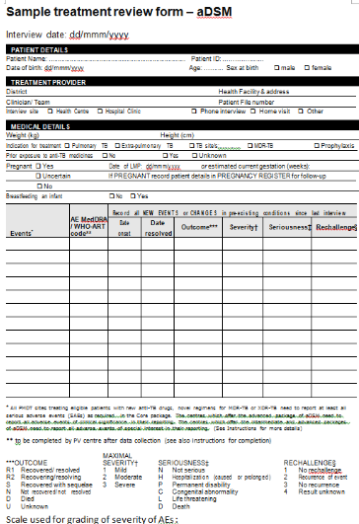
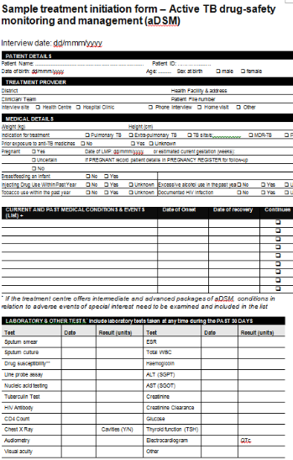
aDSM Report Forms alert, full report
AE or SAE Report Form
Treatment initiation
Patient review
Show the alert form for SAEs used at local level
Notes:
There are 3 forms that can be used. This presentation will focus on the only form that is mandatory from the beginning of any aDSM effort, the report form to collect safety data, adverse events and or serious adverse events. If minimum package is applied then the form is used only for SAEs. The logic is similar for any form, but the AE/SAE form may also contain some specific terminology not used a lot by TB doctors, that’s why it’s interesting to detail this one.

Slide 7
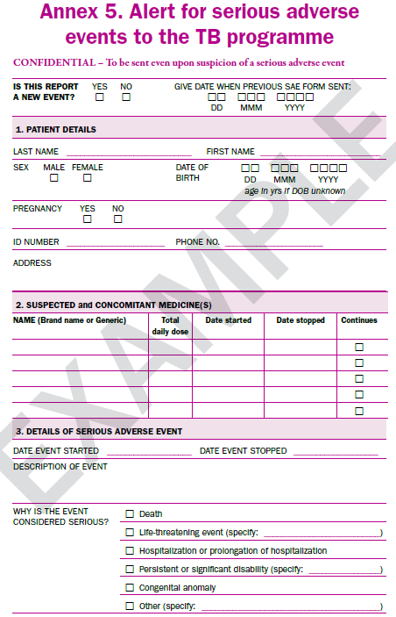
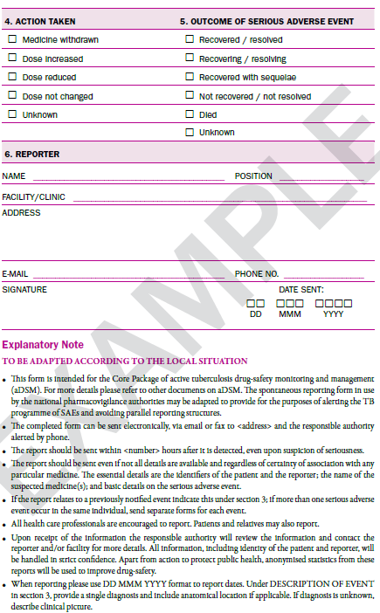
SAE Alert reporting
This specimen form includes the MINIMUM information to be collected for an alert

Slide 8
Some generalities when filling in an alert form
The form should be sent promptly after the doctor (or other healthcare professional per National Regulation) learns about an adverse event (AE) or a serious AE (SAE).
A written form is always needed
  Even if the Authority was alerted by phone, a written report should promptly follow.
When reporting please use DD MMM YYYY format to report dates.
  29th of June 2016 → 29 JUN 2016
Confidentiality must be ensured at all steps.

Slide 9
Minimum information for the alert report
If all details are not available at the time of 1st knowledge of the AE or SAE, the reporter should send what is known promptly and then send a follow-up report with more details.
  MINIMALLY 4 ELEMENTS
    Patient identifier,
    Reporter identifier,
    Drug’s name or substance,
    Basic information on AE/SAE.
Example:
TB patient (Lfx-Z-Cfz-Lzd-Bdq-Cs-PAS) died en route to another hospital. The patient’s mother is calling you to tell you her son had chest pain and she had called ambulance. You don’t have more information.
Notes:
Discuss the example – when do you report? What should you report ? Do you have the 4 minimal elements to report? What do you do next?

Slide 10
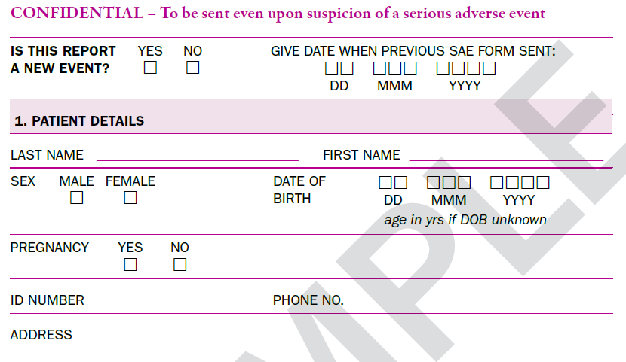
Completing the alert form (1)
New vs. follow-up information
Case reports evolve over time, every time you have new significant information, for example now the patient recovered, a new form will be sent with the new information only !
NO NEED TO REPEAT FULLY INITIAL INFO -> Just enter identifiers so that the recipient can identify which case is referred (patient’s name, diagnosis, reporter’s name)

Slide 11
Completing the alert form (2)
Patient information
Notes:
Patient info is straightforward. Patient’s pregnancy should be mentioned here. If they are other important details on the pregnancy that you would like to mention you can enter in the description part (e.g. patient would like to abort).

Slide 12
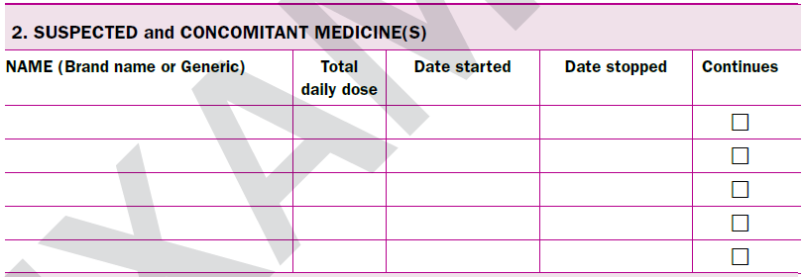
Completing the alert form (3)
Suspected and concomitant drugs
Enter the drugs you think are relevant to be evaluated for causal relationship with the event = SUSPECTED ≠ DRUGS CAUSING THE PROBLEMS; generally we advise to list all TB drugs ongoing at time of AE
Enter the other drugs you think are not relevant but were taken at the same time as the suspected drugs = CONCOMITANT
Example: TB patient (Lfx-Z-Cfz-Lzd-Bdq-Cs-PAS) died from cardiac failure; he also takes Vitamin B6.
Notes:
Ask the participants to classify the drugs in the example. Explain the difference between suspected drugs (we want to evaluate causality) and related drugs (we think it caused the event).

Slide 13
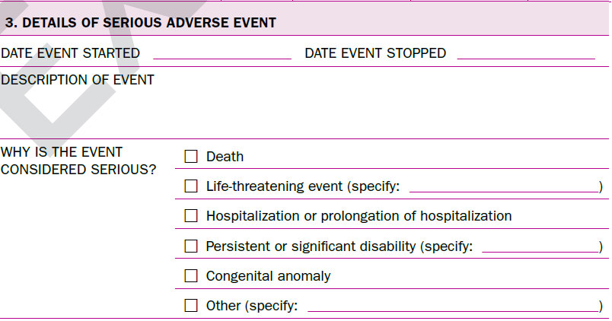
Completing the alert form (4)
AE information (1/2)
Event’s onset and stop date:
if the event is ongoing stop date can be left blank.
Description:
Provide diagnosis and explain what are the signs and symptoms.
Provide the course of event, therapy, summarized investigation results (e.g. CT scan), few key lab values, etc.
Can be used to mention elements you may not know where to enter (forms are never perfect!).

Slide 14
Completing the alert form (5)
AE information (2/2)
Seriousness criteria
Fatal
Immediately life threatening
Leading to hospitalisation or prolongation of hospitalisation
Leading to a significant disability / incapacity
Birth defect or congenital anomaly
Otherwise medically important, necessitating an intervention to prevent one of the above listed outcomes
Select as many as applicable
e.g. patient hospitalized due to acute renal failure, then dies.

Slide 15
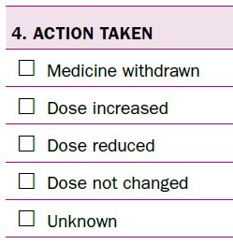
Completing the alert form (6)
Action taken
Did you stop a suspected drug? Lower the dose? Did not change anything?
If one or more drugs have been initially stopped and then re-introduced and no further change is expected:
  Select Dose not changed.
  Explain in the description that you stopped and resumed the drugs.
If only 1 drug was stopped:
  Select Medicine withdrawn.
  Explain in the description that Cs was stopped for example and the other drugs were maintained.
Notes:
Anything that cannot be appropriately reflected with the tick boxes can simply just be explained in 1 sentence in the description. Usually in TB we try very complicated scenarios, dechallenge and rechallenge plenty of drugs, so tick boxes may not reflect what happened perfectly, so go for an explanation in the description.

Slide 16
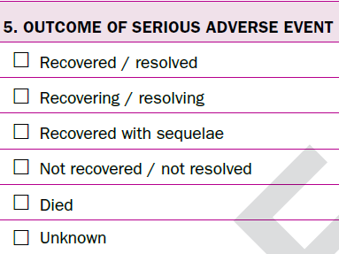
Completing the alert form (7)
Outcome of event
At the time of reporting, is the event:
Fully stabilized, back to baseline status → Resolved
Improving but still not back to baseline status → Resolving
Fully stabilized but some permanent condition will remain (e.g. hearing loss after permanent stop of injectable) → Resolved with sequelae
Still ongoing → Not resolved
Fatal → Died
Outcome is not known (e.g. patient lost to follow-up) → Unknown

Slide 17
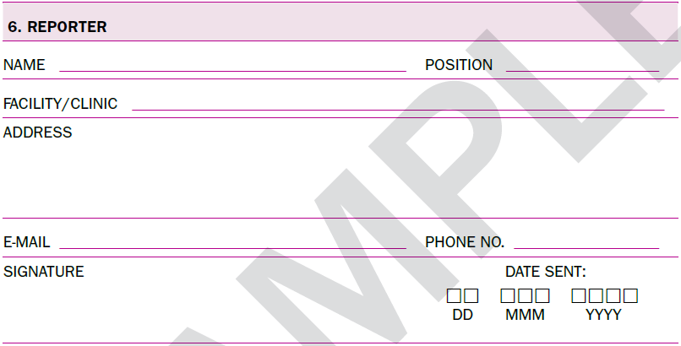
Completing the alert form (8)
Reporter
Easy to forget !

Slide 18
Completing the alert form (9)
Further notes
If >1 AE/SAE, which are distinct and unlinked (e.g., cardiac and neurological events) occur in the same individual, separate forms are completed and sent for each event
Most of the times the information needed to complete the form is available in the patient’s file, in the lab reports, in autopsy reports, etc.
  Usually, most systems allow you to append lab results or other docs directly to the form so that you don’t need to re-write everything.

Slide 19
What happens once the aDSM forms reach the national coordination?
Upon receipt of the information the responsible authority will:
  Review the information,
  Contact the reporter and/or facility for more details
  Assist with causality assessment
  Perform signal detection and other statistical analyses,
  Decide on any action to protect public health (if applicable)
  Use the data to improve overall drug-safety and knowledge on drugs (e.g. by cross-reporting to WHO to inform further guidance).

Slide 20
Train others on the use of the forms
Focus on the core requirements, here the 4 minimum criteria (patient, reporter, drug, SAE).
Explain the terminology (e.g. suspected vs. concomitant drug) and each field of your form.
Illustrate: use examples
Perform exercises with the doctors or other healthcare professionals that are expected to fill in the forms for the national aDSM.
  Case studies can be found in the presentation on AE monitoring and management.

Slide 21
Conclusions
It is the responsibility of healthcare professionals to promptly inform the national aDSM coordination of SAEs (or other AEs, depending on the package in use)
As soon as the 4 minimal elements are available, a form can be filled in and sent (depend on local regulations)
Report forms are “living” documents and important follow-up information can be sent at any time after sending an initial report
Staff need to be trained in the completion of the forms and feedback is helpful to ensure improved quality and completeness of reporting

Slide 22
Acknowledgements
The development of the aDSM training material was funded by TDR as part of the Access and Delivery Partnership (ADP) with funding from the Government of Japan.
These training materials were put together in 2016 the WHO Task Force on aDSM with technical partners KNCV Tuberculosis Foundation, Management Sciences for Health (SIAPS), MSF, WHO GTB, and TDR.
The materials were updated in 2022-23 by Mahamadou Bassirou Souleymane (TDR consultant) with Marie-Eve Raguenaud (TDR), Branwen J Hennig (TDR), and Corinne Merle (TDR), and reviewed by Linh Nhat Nguyen (WHO/GTB), Medea Gegia (WHO/GTB), and Fuad Mirzayev (WHO/GTB).
We thank all members of the WARN/CARN-TB working group on aDSM who contributed to the development of the aDSM generic guidelines as well as the secretariat, particularly Dr Christ Houessinon: Disadidi Ambrioso, Esse Marius, Adomou Jamal Rouamba Ruffine, Haro Sougrimani, Koumbem Boureima, Nsanzerugeze Josélyne, Tollo Tollo Daniel Alphonse Désiré, Mpaba Minkat Théophile Mistral, Julie Abessolo, Ursule IDOKO, Tijan Baldeh , Wandifa Samateh, Tida S Kinteh, Alieu Wurie, Mardemn Yeasuen, Benjamin K. Quenneh, Cheick Oumar Bah, Kane El Hadj Malick, Aw Idriss, Mamoudou Hama Rachida, Gagara I. M. Assiatou, Katambé Balkissa, Seiyabatou Elh Saidou, Liombo Anastasie, Lunganyu Junior, Kitambala Sentime, Lula Yves , Habimana-Mucyo Yves, Migambi Patrick, dos Santos Brigite, Castro Vânia, Wadson Cruz, Gueye Aminata, Mukeh Fahnbulleh, Bailor Samuel, Manjo Lamin, Saleh Mahareb Abdoulaye, Haroun Saleh Naima, Mouhoudine Yerima, Kpelafia Silifa

