Slide 1



Training package on active tuberculosis drug safety monitoring and management (aDSM)
2023

Slide 2
2.1iv. Create standard data collection materials

Slide 3
Key steps in aDSM implementation
Create a national coordinating mechanism for aDSM
Develop a plan for aDSM
Define management and supervision roles and responsibilities
Create standard data collection materials
Train staff on the collection of data
Define schedules and routes for data collection and reporting
Consolidate aDSM data electronically
Develop capacity for signal detection and causality assessment

Slide 4
Learning objective
By the end of this presentation, the participant is expected to be able to:
Identify aDSM core package standard data elements
Identify aDSM comprehensive database standard data elements
Create or adapt existing recording and reporting systems to include aDSM standard data elements

Slide 5
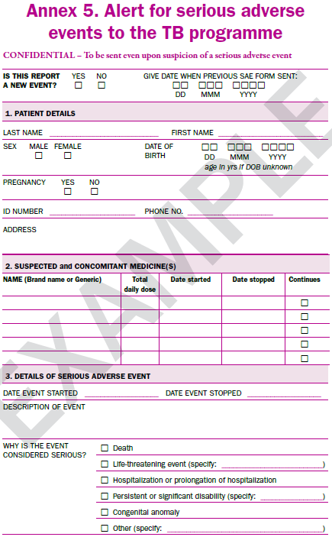
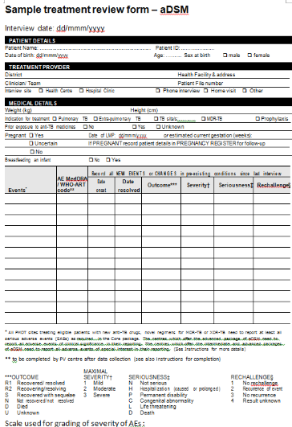
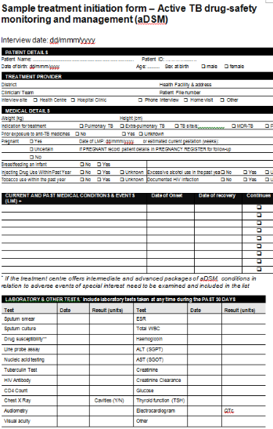
aDSM Report Forms (1) alert, full report
AE or SAE Report Form
Treatment initiation
Patient review
To be adapted to the tools used by the NTP
To be adapted to the tools used by the NTP

Slide 6
aDSM Report Forms (2)
There are 3 instances at which data are expected to be collected and reported:
  Alert of a suspected/confirmed Serious adverse events (SAE)
  Initial detailed report following the alert SAE
  Review detailed report following initial report
  TB programmes may develop separate forms (paper or electronic) for the reporting at these three steps
  Otherwise they may adapt, e.g; Initial detailed report doubles as an alert form, with full details on this form completed later, after the alert

Slide 7
Standard Data Capture
A standard data elements list has been developed comprising of a minimum dataset needed for aDSM data collection in TB treatment programmes
This list enables national TB treatment programmes and software developers to incorporate the standard aDSM data elements in their existing recording and reporting systems

Slide 8
aDSM Core Package Data Elements
The next slides list the aDSM core package data elements
More details (suggested field name, format, category coding and labels) are available in the document available from the global PV database administrator
Separate sections:
  Case & patient identifiers;
  Patient demographics;
  Facility details;
  Patient details at time of event;
  AE description (including action & outcomes);
  Medical treatment;
  Medical history;
  Laboratory assessment

Slide 9
PATIENT ID, DEMOGRAPHICS & FACILITY DETAILS
Variable | Additional information
Case ID number | Case identification number in national database. Automated consecutive number generated by national database
Local Adverse Event identifier | Local identifier for adverse event (optional)
Worldwide unique case identification number | International unique AE case identifier for the ICSR. If case was not assigned an international unique AE case identifier, leave blank.
Country | Country of the primary source
Facility name | Name of the primary source
Site identifier | Site ID number
ID number | Patient ID number in country database.
Sex | Patient’s gender
Date of birth | Birth date in format (DD-MMM-YYYY). Can be stored as 3 different fields (day, month, year) to simplify management of partial date. Full date of birth should only be transferred to central database if allowed by regulation.

Slide 10
PATIENT DETAILS AT TIME OF EVENT
Variable | Additional information
Patient onset age | Age of the patient at the time of the AE/SAE onset
Height | Patient height in cm (rounded, with no decimals)
Weight | Patient weight in kg (rounded, with no decimals)
Pregnancy status at start of event | Indicates whether the patient was pregnant at the time of the onset of AE/SAE.
If pregnant, date of LMP | Start date of Last Menstrual Period (the first day of the most recent menstrual cycle) (DD-MMM-YYYY) Date can be stored as 3 different fields (day, month, year) to simplify management of partial date.
If pregnant, gestation week at start of event | Estimated Gestational Age (expressed in weeks) at start of the event (an approximate calculation of the gestational age of the fetus at start of the event).
HIV Status | Indicates HIV status at the time of the AE onset

Slide 11
AE DESCRIPTION (1)
Variable | Additional information
Adverse Events Description | Verbatim (i.e., investigator-reported term) description of the adverse event
Adverse event coding | Dictionary-derived text description of the adverse event. Equivalent to the Preferred Term (PT in MedDRA).
Date of AE onset | Start date of the AE/SAE using this format (DD-MMM-YYYY). Can be stored as 3 different fields (day, month, year) to simplify management of partial date.
Event End date | AE/SAE stop date. Date that the AE resolved or led to death using this format (DD-MMM-YYYY). If the AE is ongoing, this field should be blank. Can be stored as 3 different fields (da, months, year) to simplify management of partial date.
Intensity | Maximum grade of the intensity of the AE
Action taken | Action taken to manage the AE/SAE
Outcome | Outcome of the event in relation to the subject’s status. Select Death Related to Adverse Event for The termination of life as a result of an adverse event. Select Not Recovered or Not Resolved to indicate that the event has not improved or recuperated. Select Recovered or Resolved if the event has improved or recuperated. Select Recovered or Resolved with Sequelae if the subject recuperated but retained pathological conditions resulting from the prior disease or injury. Select Recovering or Resolving if the event is improving but has not yet fully recovered Select Unknown if the outcome was not known, not observed or not recorded
Event classified as Serious | Indicates whether or not the adverse event is determined to be 'serious'.
Death | If SAE is it: Death? Indicates if a 'serious' adverse event resulted in death.
PT: MedDRA preferred term, MedDRA: Medical Dictionary for Regulatory Activities

Slide 12
AE DESCRIPTION (2)
Variable | Additional information
Autopsy | In case of death: Was an autopsy done?
Life Threatening | If SAE is it: Life Threatening ? Indicates if a 'serious' adverse event was life threatening.
Hospitalisation | If SAE is it: Hospitalisation required or prolonged hospitalisation ? Indicates if a 'serious' adverse event resulted in an initial or prolonged hospitalization.
Disability | If SAE is it: Persistent/significant disability ? Indicates if a 'serious' adverse event was associated with a persistent or significant disability or incapacity.
Congenital anomaly/birth defect | If SAE is it: Congenital anomaly/birth defect? Indicates if a 'serious' adverse event was associated with a congenital anomaly or birth defect.
Other medical important event | If SAE is it: Other medical event considered as important ? Indicates if a 'serious' adverse event is associated with other serious or important medical events.
Report to national PV center | Indicates if the event was reported to the national pharmacovigilance center
Narrative / Additional information | Additional comment (free text)
Do you wish to mark this safety case as nullified? | This item should be used to indicate that a safety case previously recorded should be considered completely void (nullified), for example when the whole case was found to be erroneous.
Why are you nullifying the safety case? | Reason for nullification

Slide 13
MEDICAL TREATMENTS (1)
Variable | Additional information
Drug name | Name of the treatment(s) as originally received or collected. Commercial name(s) if possible, otherwise use generic name(s).
Code for drug name | Name of the treatment(s) in a coded format defined
Daily dose | Total dose(s) taken per day
Dose unit | Unit of dose(s) or amount taken per period recorded (e.g., ng, mg, mg/kg)
Frequency (as days per weeks) | Frequency the treatment(s) was administered in days per week
Route of administration | Record the route(s) of administration (e.g., Intra Venous, ORAL, TRANSDERMAL) If other, specify
Drug start date | Date when administration of the treatment(s) began using this format (DD-MMM-YYYY). Can be stored as 3 different fields (day, month, year) to simplify management of partial date.
Drug stop date | Date when administration of the treatment(s) ended using this format (DD-MMM-YYYY). Can be stored as 3 different fields (day, month, year) to simplify management of partial date.
Drug still ongoing | Indicates if the drug(s) are still taken. It is expected that every reported drug should have either an End Date or the Ongoing field marked 'yes', but not both.

Slide 14
MEDICAL TREATMENTS (2)
Variable | Additional information
Action taken with drug after AE/SAE | Changes made to the drug in response to the adverse event.
Relationship of the drug to the AE/SAE (evaluation made by reporting site) | Reporting site's opinion as to the causal relationship between the drug and the adverse event
Relationship of the drug to the AE/SAE (evaluation made at country central level) | Records the central level opinion as to the causal relationship between the drug and the adverse event
Response to dechallenge | Did the event improve after stopping/ reducing the dose reduced?
Rechallenge | Was the drug reintroduced?
Response to rechallenge | Did the event reappear after rechallenge? Event recurrence on drug re-administration. Unknown indicates that a rechallenge was done but it is not known if the event recurred.

Slide 15
MEDICAL HISTORY
Variable | Additional information
Concurrent medical disorder | Record if there were any relevant past and/or concomitant medical conditions or surgeries, present at the onset of the AE/SAE that may constitute a possible cause or a risk factor?
If yes specify (in local language) | Describe the relevant past and/or concomitant medical conditions or surgeries, present at the onset of the AE/SAE and that may constitute a possible cause or a risk factor. In language used in local database.
If yes specify (in English) | Record all relevant past and/or concomitant medical conditions or surgeries, present at the onset of the AE/SAE and that may constitute a possible cause or a risk factor. In English.
Coding of medical condition | Dictionary-derived text description of MHTERM. Equivalent to the Preferred Term (PT in MedDRA).
Is the medical condition still ongoing? | Indicate if the medical condition is still ongoing at the time of the onset of the AE/SAE
MHTERM: Reported Term for the Medical History

Slide 16
LABORATORY ASSESSMENT
Variable | Additional information
What is the lab test name? | Indicate test name of the lab test performed for the investigation of the patient
Date when lab test is done | Date of test in format (DD-MN-YYYY). Can be stored as 3 different fields (day, month, year) to simplify management of partial date.
Result | Result of the measurement or finding, as originally received or collected.
Unit | Units
Normal low range | Lower Limit Normal
Normal high range | Upper Limit Normal

Slide 17
Alert form for SAE (1)
The alert form is intended to inform the programme about the occurrence of a suspected or confirmed SAE as soon as possible
The primary purpose of the alert form is to trigger action (clinical attention and further investigation)
This form does not include all the data about the event needed for national or global surveillance. Upon receipt of the form, the person responsible for aDSM in the TB programme needs to collect all other necessary details
The shape and content of the alert form depends on the programme needs. A programme may decide to use the same form as
  A sample data collection form incorporating aDSM core package standard data elements is presented in the following slide

Slide 18
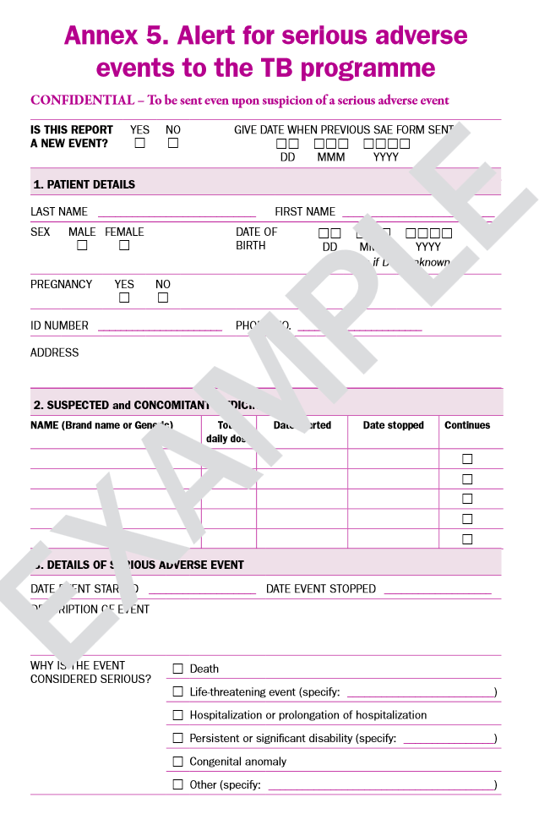
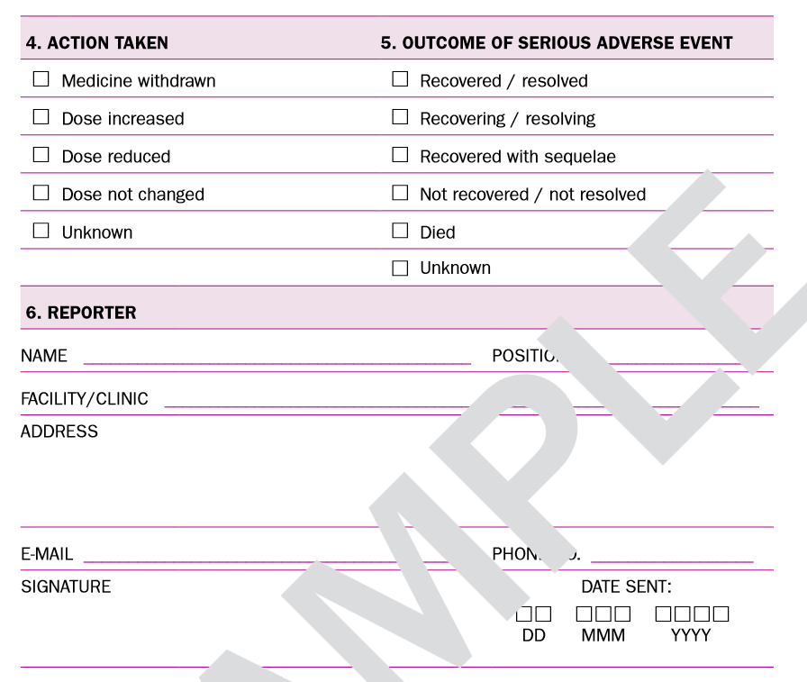
Alert form for SAE (2)
minimum contents of an alert form for SAE
from Active tuberculosis drug-safety monitoring and management (aDSM). Framework for implementation. (WHO/HTM/TB/2015.28). Geneva, World Health Organization; 2015

Slide 19
Incorporate aDSM standard data elements into routine R&R forms (1)
The NTP or aDSM Coordinating mechanism will
Ensure core package standard data elements are incorporated in existing SAE forms
  Or create new SAE forms if appropriate
Select elements from the comprehensive database standard data elements
  As appropriate for intermediate or advanced level of monitoring

Slide 20
Incorporate aDSM standard data elements into routine R&R forms (2)
Integrate data selected from the comprehensive database standard data elements (paper or electronic) into existing data collection tools
Indicate on a source data table where the selected data elements can be found, such as
  Patient medical records
  Laboratory records
  Pharmacy records
  Standard WHO recording and reporting forms
  Existing electronic databases
Prepare pilot data collection forms

Slide 21
Pre-test and Finalize Forms
Choose 3 to 5 SAE cases to pre-test the forms
Make revisions and improvements to the forms as needed
Finalize forms before training data collectors
  Note that data collectors may provide suggestions for improving the forms
  Forms may be finalized after the first training

Slide 22
Conclusions
The data elements required for aDSM at country and global level should allow to record the essential details needed for
  causality assessment,
  signal detection and
  the generation of indicators.
Standardization of the variables collected is important to allow comparison over time and between countries
The data element list should inform the creation or modification of TB recording and reporting systems (paper or electronic)
Alert forms are useful to inform the programme rapidly of suspected or confirmed SAEs in order to take necessary action

Slide 23
Acknowledgements
The development of the aDSM training material was funded by TDR as part of the Access and Delivery Partnership (ADP) with funding from the Government of Japan.
These training materials were put together in 2016 the WHO Task Force on aDSM with technical partners KNCV Tuberculosis Foundation, Management Sciences for Health (SIAPS), MSF, WHO GTB, and TDR.
The materials were updated in 2022-23 by Mahamadou Bassirou Souleymane (TDR consultant) with Marie-Eve Raguenaud (TDR), Branwen J Hennig (TDR), and Corinne Merle (TDR), and reviewed by Linh Nhat Nguyen (WHO/GTB), Medea Gegia (WHO/GTB), and Fuad Mirzayev (WHO/GTB).
We thank all members of the WARN/CARN-TB working group on aDSM who contributed to the development of the aDSM generic guidelines as well as the secretariat, particularly Dr Christ Houessinon: Disadidi Ambrioso, Esse Marius, Adomou Jamal Rouamba Ruffine, Haro Sougrimani, Koumbem Boureima, Nsanzerugeze Josélyne, Tollo Tollo Daniel Alphonse Désiré, Mpaba Minkat Théophile Mistral, Julie Abessolo, Ursule IDOKO, Tijan Baldeh , Wandifa Samateh, Tida S Kinteh, Alieu Wurie, Mardemn Yeasuen, Benjamin K. Quenneh, Cheick Oumar Bah, Kane El Hadj Malick, Aw Idriss, Mamoudou Hama Rachida, Gagara I. M. Assiatou, Katambé Balkissa, Seiyabatou Elh Saidou, Liombo Anastasie, Lunganyu Junior, Kitambala Sentime, Lula Yves , Habimana-Mucyo Yves, Migambi Patrick, dos Santos Brigite, Castro Vânia, Wadson Cruz, Gueye Aminata, Mukeh Fahnbulleh, Bailor Samuel, Manjo Lamin, Saleh Mahareb Abdoulaye, Haroun Saleh Naima, Mouhoudine Yerima, Kpelafia Silifa

