Slide 1



Training package on active tuberculosis drug safety monitoring and management (aDSM)
2023

Slide 2
3.1. Indicators of aDSM implementation and programme management

Slide 3
Learning objectives
By the end of this presentation, the participant is expected to be able to…
Define the standard aDSM indicators for programme management

Slide 4
aDSM indicators (1)
aDSM data serve a number of purposes
Programme indicators
Causality assessment
Signal detection
Drug-safety profiles

Slide 5
aDSM indicators (2)
The programme manager needs measures of process and outcomes, especially in the early phases of implementing aDSM
This is in addition to the analyses needed for causality assessment and signal detection
Five indicators have been proposed to assess coverage and completeness of reporting, and the frequency of SAEs and confirmed ADRs

Slide 6
aDSM indicators (3)
summary
Class | Calculation
1. Coverage | DR-TB patients on new drugs/regimen included in active PV
2. Completeness | Time to stopping new drugs/regimen
3. Serious adverse events | DR-TB patients included in cohort event monitoring with any serious adverse event
4. Adverse reactions associated with target treatment (new drugs / regimen) | Frequency of new drugs/regimen -associated ADRs
5. Adverse reactions associated with target treatment (new drugs / regimen) | Time to development of new drugs/regimen -associated ADRs
ADRs=Adverse drug reactions, DR-TB= Drug resistant Tuberculosis, PV= Pharmacovigilance

Slide 7
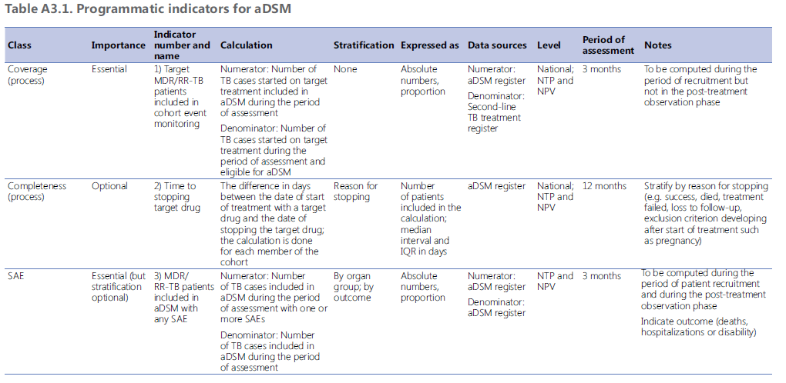
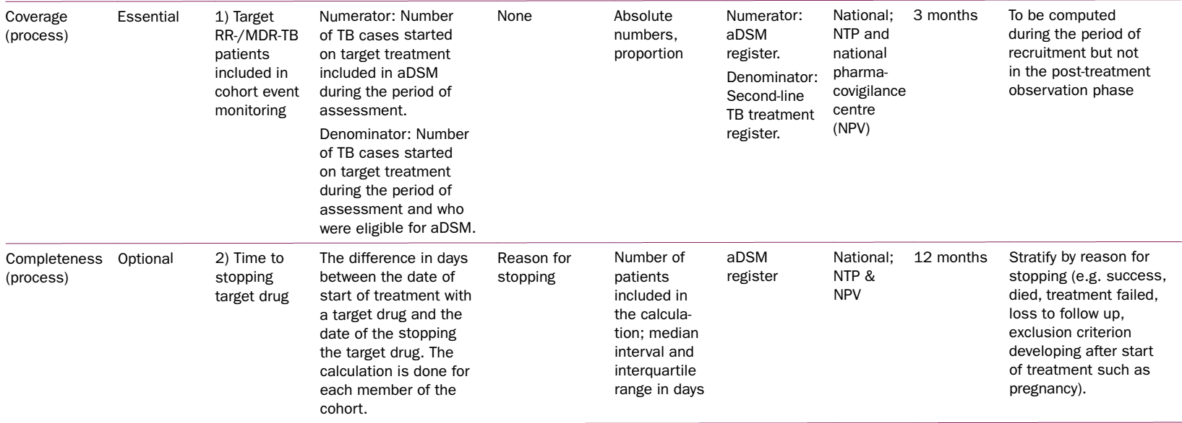
aDSM indicators (4)
ADR: adverse drug reaction; aDSM: active TB drug-safety monitoring and management; IQR: interquartile range; MDR/RR-TB: multidrug-resistant or rifampicin-resistant TB; NPV: national pharmacovigilance centre; NTP: national TB programme; SAE: serious adverse event; TB: tuberculosis.
https://apps.who.int/iris/bitstream/handle/10665/365309/9789240065352-eng.pdf

Slide 8
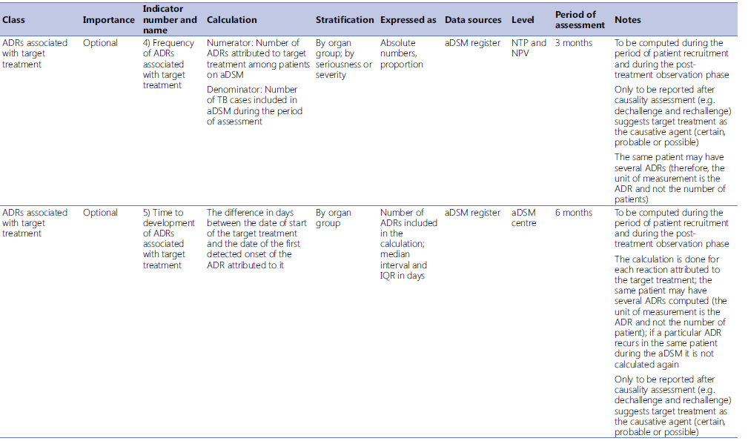
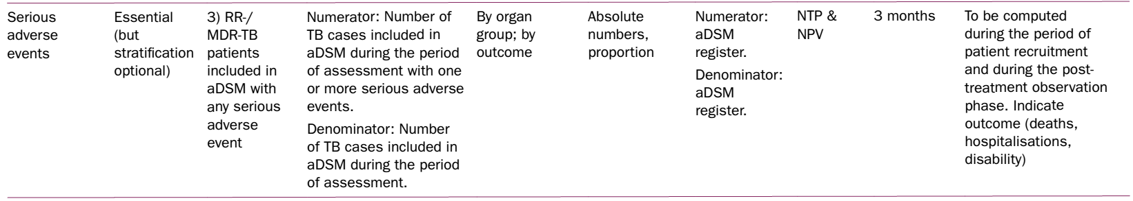
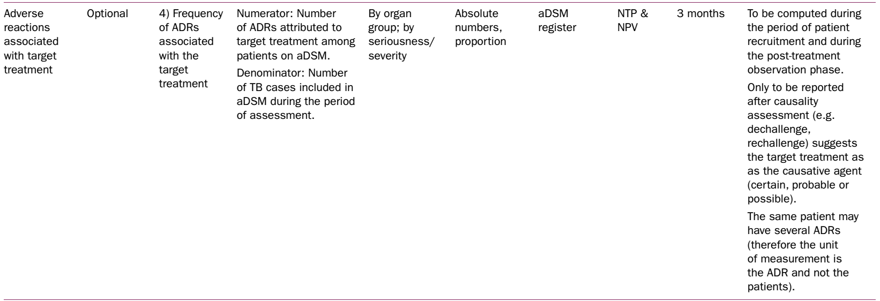
aDSM indicators (5)
ADR: adverse drug reaction; aDSM: active TB drug-safety monitoring and management; IQR: interquartile range; MDR/RR-TB: multidrug-resistant or rifampicin-resistant TB; NPV: national pharmacovigilance centre; NTP: national TB programme; SAE: serious adverse event; TB: tuberculosis.
https://apps.who.int/iris/bitstream/handle/10665/365309/9789240065352-eng.pdf

Slide 9
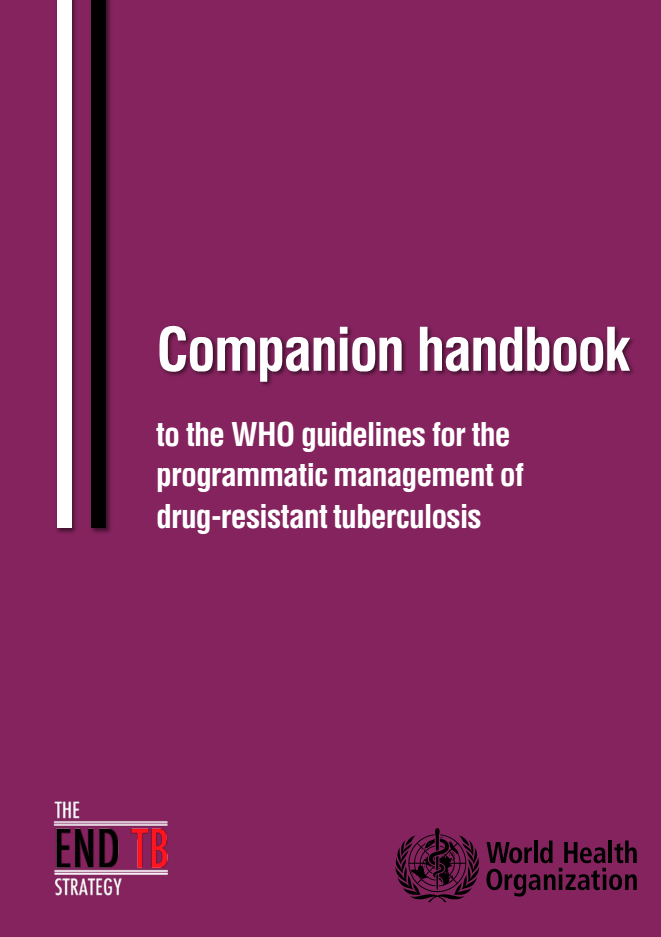
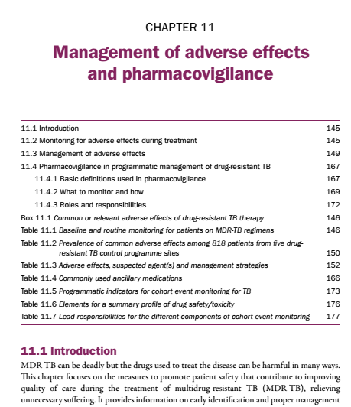
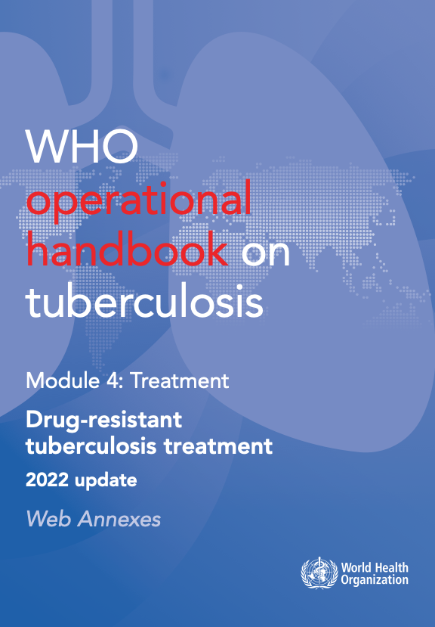
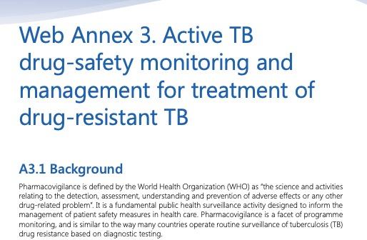
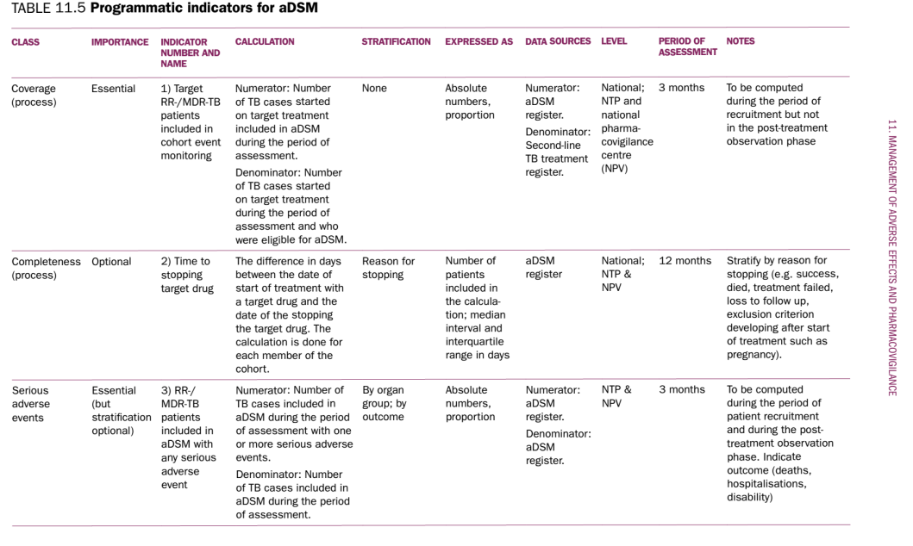
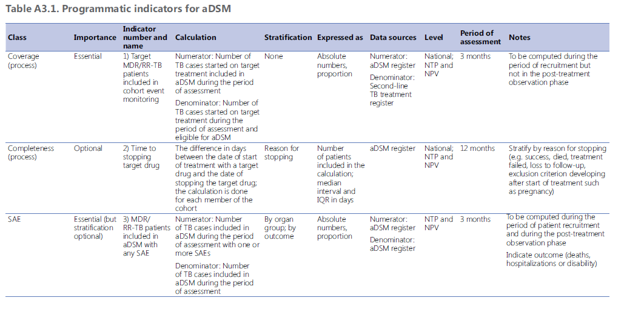
References
Table 11.5, page 177
http://apps.who.int/iris/bitstream/10665/130918/1/9789241548809_eng.pdf
https://apps.who.int/iris/bitstream/handle/10665/365309/9789240065352-eng.pdf

Slide 10
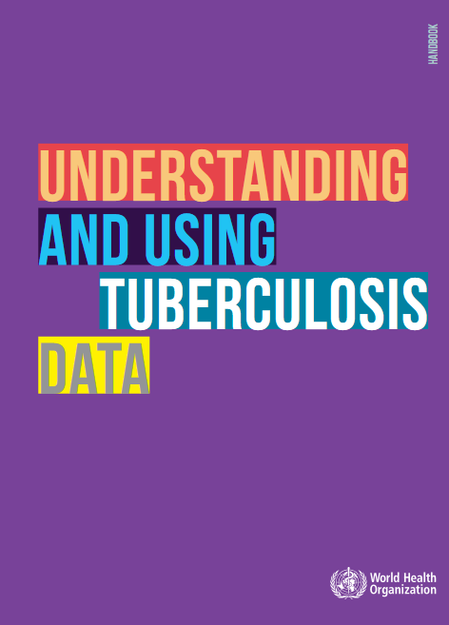
WHO/HTM/TB/2014.09
This book presents the practicalities of standard and advanced analysis of programme TB surveillance data.
The same approaches could have an application for in-depth analysis of aDSM data.
apps.who.int/iris/bitstream/10665/129942/1/9789241548786_eng.pdf

Slide 11
Acknowledgements
The development of the aDSM training material was funded by TDR as part of the Access and Delivery Partnership (ADP) with funding from the Government of Japan.
These training materials were put together in 2016 the WHO Task Force on aDSM with technical partners KNCV Tuberculosis Foundation, Management Sciences for Health (SIAPS), MSF, WHO GTB, and TDR.
The materials were updated in 2022-23 by Mahamadou Bassirou Souleymane (TDR consultant) with Marie-Eve Raguenaud (TDR), Branwen J Hennig (TDR), and Corinne Merle (TDR), and reviewed by Linh Nhat Nguyen (WHO/GTB), Medea Gegia (WHO/GTB), and Fuad Mirzayev (WHO/GTB).
We thank all members of the WARN/CARN-TB working group on aDSM who contributed to the development of the aDSM generic guidelines as well as the secretariat, particularly Dr Christ Houessinon: Disadidi Ambrioso, Esse Marius, Adomou Jamal Rouamba Ruffine, Haro Sougrimani, Koumbem Boureima, Nsanzerugeze Josélyne, Tollo Tollo Daniel Alphonse Désiré, Mpaba Minkat Théophile Mistral, Julie Abessolo, Ursule IDOKO, Tijan Baldeh , Wandifa Samateh, Tida S Kinteh, Alieu Wurie, Mardemn Yeasuen, Benjamin K. Quenneh, Cheick Oumar Bah, Kane El Hadj Malick, Aw Idriss, Mamoudou Hama Rachida, Gagara I. M. Assiatou, Katambé Balkissa, Seiyabatou Elh Saidou, Liombo Anastasie, Lunganyu Junior, Kitambala Sentime, Lula Yves , Habimana-Mucyo Yves, Migambi Patrick, dos Santos Brigite, Castro Vânia, Wadson Cruz, Gueye Aminata, Mukeh Fahnbulleh, Bailor Samuel, Manjo Lamin, Saleh Mahareb Abdoulaye, Haroun Saleh Naima, Mouhoudine Yerima, Kpelafia Silifa

