Slide 1



Training package on active tuberculosis drug safety monitoring and management (aDSM)
2023

Slide 2
2.1. Clinical monitoring of Adverse Events and management of adverse drug reactions

Slide 3
Learning objectives
By the end of this presentation, the participant is expected to be able to:
Understand the main issues in clinical and laboratory monitoring of patients on treatment
Organize monitoring schedules
Detect and manage adverse drug reactions

Slide 4
Basic principles (1)
AEs: frequencies and importance of management
>80% of patients on DR-TB treatment will have adverse events (AEs):
  Even mild and common AEs can affect adherence and treatment outcome (e.g. mild nausea/vomiting every day),
  Some can be fatal or life-threatening (e.g. anemia, QTc prolongation),
  Some cause permanent disability (e.g. optic neuritis).
Timely recognition and management of AEs are important for adherence, treatment outcome, overall treatment tolerance and well-being of patients.
Notes:
Ask 5 examples of adverse events they have observed.

Slide 5
Basic principles (2)
What is needed for clinical monitoring and management of AEs?
Ensure patients have access to diagnostics and treatment for AEs, including ancillary drugs
Implement baseline examinations at initiation of treatment and monitoring during treatment for all MDR-TB patients
Assess availability of clinical examinations tools required. Seek funds to procure if not available
Ensure quick test result feedback, to allow for timely clinical decision making

Slide 6
Basic principles (3)
Most AEs can be identified clinically and are usually volunteered by patients themselves.
  This underlines the importance of close patient follow-up to ensure more complete reporting of Aes
Laboratory evaluation is an integral part of aDSM
  to detect potential harms early and before they manifest themselves clinically
Nonetheless, management of AEs is primarily aimed at the patient and not at the laboratory result
Patients should be counseled early and often about AEs

Slide 7

Basic principles (4)
Symptom-based approach
Clinicians may tend to take a drug-based approach to AEs.
More natural and more straightforward for patients to use a symptom-based approach.
May cause nausea
X% of patients have vomiting
Drugs at the centre
Nausea, mild, after dose, eats very spicy
Vomiting, once in 24 hours
Patient at the center
Notes:
aDSM is about putting the patient in the center, not the drugs or the new TB drugs. Insist on patient’s awareness, mention it is part of informed consent as well.

Slide 8
aDSM: cohort-based approach
Serial testing / screening for AEs
Death
Success
Success
Serious AE
Other event
Lost to follow-up
Change of
treatment
Drug start
Drug exposure
f/u after treatment

Slide 9
Adverse drug reactions frequently associated with TB treatment
Nausea/vomiting
Diarrhoea
Arthralgia
Dizziness/vertigo
Hearing disturbances
Headache
Sleep disturbances
Electrolyte disturbances
Abdominal pain
Anorexia
Gastritis
Peripheral neuropathy
Depression
Tinnitus
Allergic reaction
Rash
Visual disturbances
Seizures
Hypothyroidism
Psychosis
Suicidal ideation
Hepatitis (hepatotoxicity)
Renal failure (nephrotoxicity)
QT prolongation
Source: WHO/HTM/TB/2014.11
Notes:
The first step to develop a good clinical monitoring schedule is to “know your enemies”. Those conditions are common adverse drug reactions, meaning we know they are happening frequently to most patients on DR TB regimen and are very likely to be due to the drugs.

Slide 10
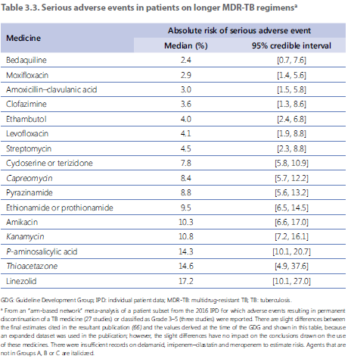
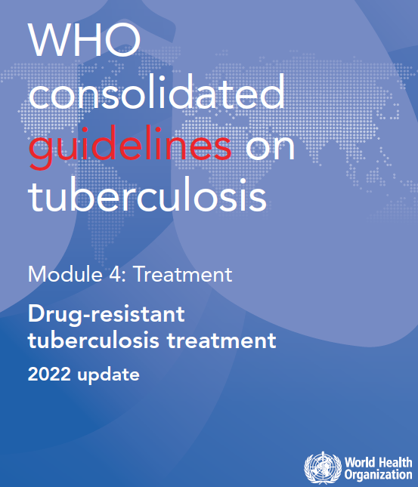
Frequency of adverse reactions in DR-TB treatment
Notes:
If we look at the same in terms of prevalence, we can see (not unexpectedly) that gastrointestinal disorders are the top most common issues with DR TB drugs. Other body systems affected: joints, nervous system, psychiatric disorders, hearing, vision, skin, thyroid, liver, kidneys.

Slide 11
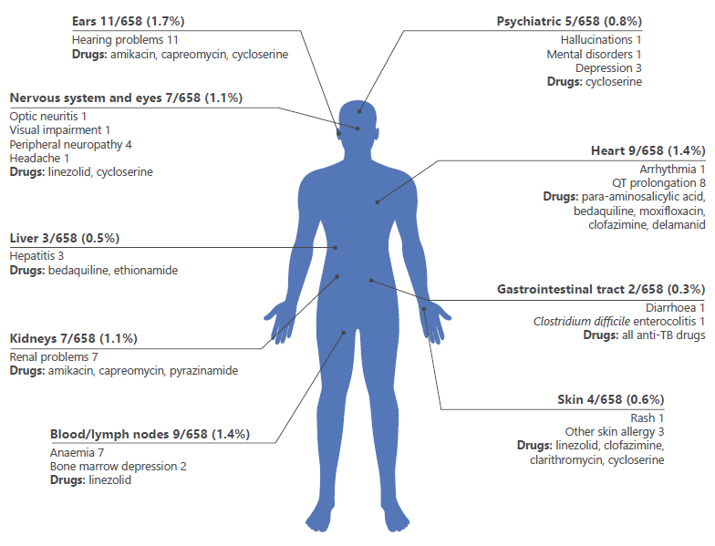
Frequency of adverse reactions in DR-TB treatment
The distribution of 57 SAEs, by organ or system, among 658 patients treated for MDR/RR-TB across 26 countries between 2017 and 2019
Borisov et al. (2019)

Slide 12
How to detect adverse events?
Observe and listen
  Detection of adverse event is primarily dependent upon reporting from patient, nurses, doctors, counsellors, etc.
  All healthcare professionals involved must be trained on adverse event screening
Perform routine clinical assessments (e.g. for treatment adherence and tolerance, psychosocial, psychiatrist, ophthalmologist, HIV specialist, narcologist…)
Schedule regular laboratory screening, even if the patient has no specific complaints (e.g. ECG, liver function tests)
Notes:
Based on the list shown before and the clinical experience of each of you, we can exercise to recognize early the indicating signs of those conditions (give examples). As mentioned in the prior slides, observation and discussion with your patient are key to detection. Those AEs are an incredible burden to patients and they will voice most of them, maybe not to you, but to the counsellor, the DOT nurse, etc. There should be a network working hand in hand to accompany best the patient and who speak to each other.
BUT it is not sufficient !! Only regular screening, physical and lab, ensure you see everything that may be happening. And, again, we know where to look -> next slide.

Slide 13
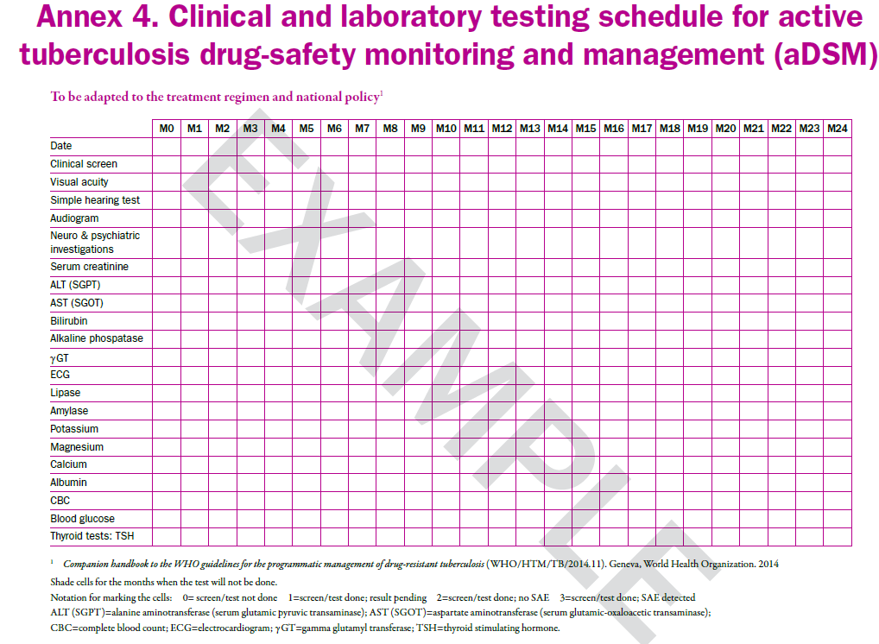
Update this slide using the clinical and laboratory testing schedule from the MDR-TB guide
NB: Audiogram is performed when using a 2nd line injectable in a regime
Notes:
This serves as a basis for development of schedule of assessment, it may be adapted depending on the regimen given to the patient, the national guideline. It is a guidance and shows the very minimum to be done; if your patient presents with very severe hypokalemia, you are not going to wait 1 month to re-test, you are going to test every day until normalisation for example.

Slide 14
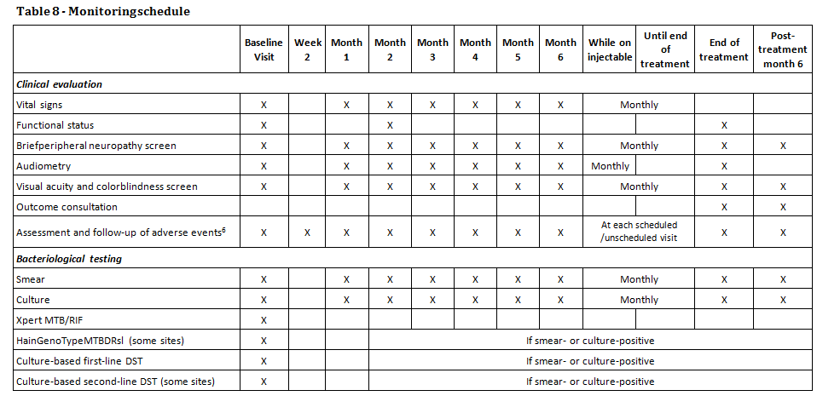
Example of schedule of routine assessments (1)
Update this slide using the clinical and laboratory testing schedule from the MDR-TB guide
endTB Clinical Guideline, MSF&PIH, version 3.2
Audiometry monitoring is schedule only if injectable containing regimen is used!
Notes:
A detailed example – first part: clinical assessments including vitals, functional status (general physical examination), peripheral neuropathy screening (you can use BPNS or other tests), hearing test and vision test. The frequency of assessments must absolutely be increased if needed.
Screening of adverse event during planned consultations, DOT visits, and unscheduled visits is very important. It is not sufficient to just detect adverse events, it is of upmost importance to follow them up at each visit (planned and unplanned) by reviewing the status of all previously detected adverse events.

Slide 15
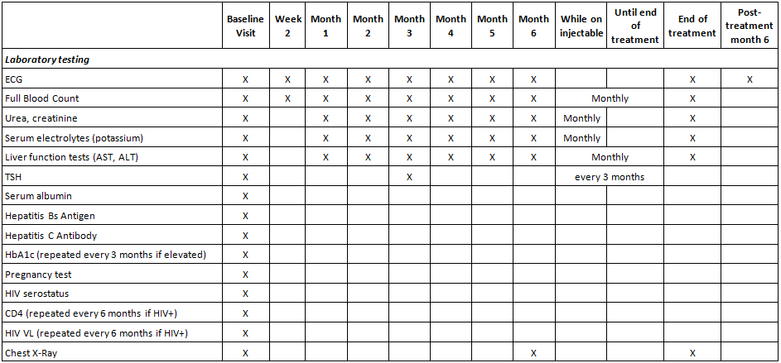
Example of schedule of routine assessments (2)
Update this slide using the clinical and laboratory testing schedule from the MDR-TB guide
endTB Clinical Guideline, MSF&PIH, version 3.2
Notes:
A detailed example – second part lab assessments including EKG, full blood count, renal function (urea, creatinine), electrolytes (at least potassium), liver function (transaminases), and thyroid function. If there is an abnormality, you may repeat those tests as frequently as necessary.

Slide 16
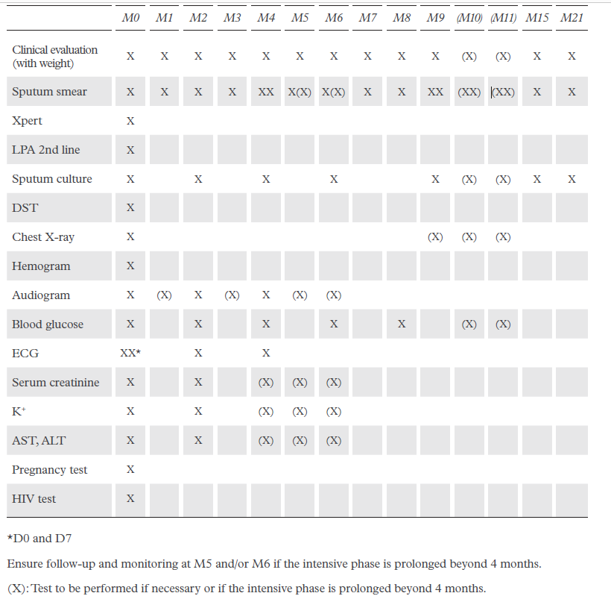
Example of schedule of routine assessments (3)
Update this slide using the clinical and laboratory testing schedule from the MDR-TB guide
NB: Audiogram is only done when an injectable containing regimen is used!

Slide 17
Management of AEs (1)
Early detection of signs and symptoms is key to proper management of adverse drug reactions that significantly impacts:
  Patient well-being,
  Overall treatment acceptance,
  Adherence.
Management includes all measures taken to alleviate the signs and symptoms of adverse reactions, e.g.:
  Medications and other interventions (transfusion, psychological support, etc.),
  Stopping or lowering the dose of the offending drug.
Keep in mind: we treat the patient not the lab result
Notes:
Now that we have a plan to detect AEs, we need to anticipate what can be done to prevent (if possible) and manage those. Remember that management is not only prescribing another medication to alleviate a symptom, management implies looking at the whole patient. We treat the patient not the lab value.

Slide 18
Management of AEs (2)
Case study 1
Example: male 56-year-old, Bdq-Lzd-Amx/Clv-Cfz-Cs-Imp.
Presents QT prolongation and psychosis.
  Should I stop QT prolonging drugs?
  Should I stop cycloserine?
  Should I start anti-psychotics?
  What anti-psychotic should I choose (many are also prolonging QT)?
Notes:
If I focus on psychosis as the main problem of this gentleman, he may end up on 5 anti-psychotic agents all prolonging QT. If I focus on QT prolongation, he may have worsened psychosis, harm himself, harm others. What is the threshold to take an action on the TB drugs?
So… it is about finding the right balance between an efficacious regimen, proper cardiac rhythm, normal mental state, and any other therapeutic agents we may prescribe. With regards to deciding the threshold to take actions, there are some tools that allow for severity grading that may be very useful.

Slide 19
Management of AEs (3)
When is the right time to take action?
Help → Severity grading:
  This exercise allows to classify the AEs according to the lab value and the symptoms into different categories*:
Grade 1 - MILD | Grade 2 - MODERATE | Grade 3 - SEVERE | Grade 4 – LIFE-THREATENING
Transient or mild discomfort (<48 hours); no medical intervention/therapy required | Mild to moderate limitation in activity - some assistance may be needed; no or minimal medical intervention/ therapy required | Marked limitation in activity, some assistance usually required; medical intervention/therapy required, hospitalization possible | Extreme limitation in activity, significant assistance required; significant medical intervention/therapy required, hospitalization or hospice care probable
To be adapted to the system used by the NTP
  From Division of Microbiology and Infectious Diseases (DMID) Adult Toxicity Table (www.niaid.nih.gov/LabsAndResources/resources/DMIDClinRsrch/Documents/dmidadulttox.pdf);
  Other severity grading scales are available (e.g. DAIDS, NCI-CTCAE)

Slide 20
Management of AEs (4)
Assigning severity on a scale
Search for the diagnosis or signs and symptoms in the list :
  e.g. Patient has ALT increase at 100 U/L (normal <40)
e.g. Patient presents vomiting continuously for 2 days, he is dehydrated and has to be hospitalized.
Condition / term | Grade 1 | Grade 2 | Grade 3 | Grade 4
Alanine Aminotransferase (ALT or SGPT) Increased | 1.1 - <2.0 x ULN | 2.0 – <3.0 x ULN | 3.0 – 8.0 x ULN | > 8 x ULN
To be adapted to the system used by the NTP
Condition / term | Grade 1 | Grade 2 | Grade 3 | Grade 4
Vomiting | 1 episode in 24 hours | 2-5 episodes in 24 hours | >6 episodes in 24 hours or needing IV fluids | Physiologic consequences requiring hospitalization or requiring parenteral nutrition
Notes:
Ask which is an SAE. Ask what they should do if they cannot find the AE in the scale they are using.

Slide 21



Severe or Serious ?
Seriousness is different to severity!
  Based on the outcome of an AE
  Determined according to the following conditions
      Death
      Life-threatening experience
      Hospitalization or prolonged hospitalization
      Persistent or significant disability
      Congenital anomaly
Seriousness
  Based on the intensity of the AE
  Determined according to a grading scale (e.g. ANRS, DAIDS)
      Mild
      Moderate
      Severe
Severity

Slide 22
Details on a selected adverse reactions
How to detect and manage a selection of adverse reactions will be detailed in the next sections:
  Peripheral neuropathy
  Myelosuppression
  QT prolongation
  Visual disturbances
  Hepatitis
  Hypokalaemia
  Hypothyroidism
  Acute kidney injury
Notes:
There are several adverse drug reactions identified with TB drugs, this session is going to focus on the following areas of interest, chosen due to their impact on the patient or because they may be challenging to detect and/or manage. These will be further detailed in the next sections. We will see how to detect, how to evaluate severity, how to best manage.

Slide 23
Peripheral neuropathy
Prevalence (DR TB patients) | up to 30% of patients More common with comorbidities such as HIV, DM, alcohol use
How to detect? | Symptomatic Subjective neuropathy scale: ACTG Brief Peripheral Neuropathy Testing
Common causes | Lzd, HD-INH, Cs, Pto/Eto, alcohol S, Km, Cm, FQ, E, d4T, ddI
How to manage? | Consider discontinuation of Lzd, INH, Cs. Physical therapy; sturdy shoes; SSRIs; avoid TCA in persons on Bdq/Dlm
Additional tests/precautions | Prevention: pyridoxine for all patients on INH, Cs. Additional testing: alcohol screening, examine extremities for lesions, sores, loss of function.

Slide 24
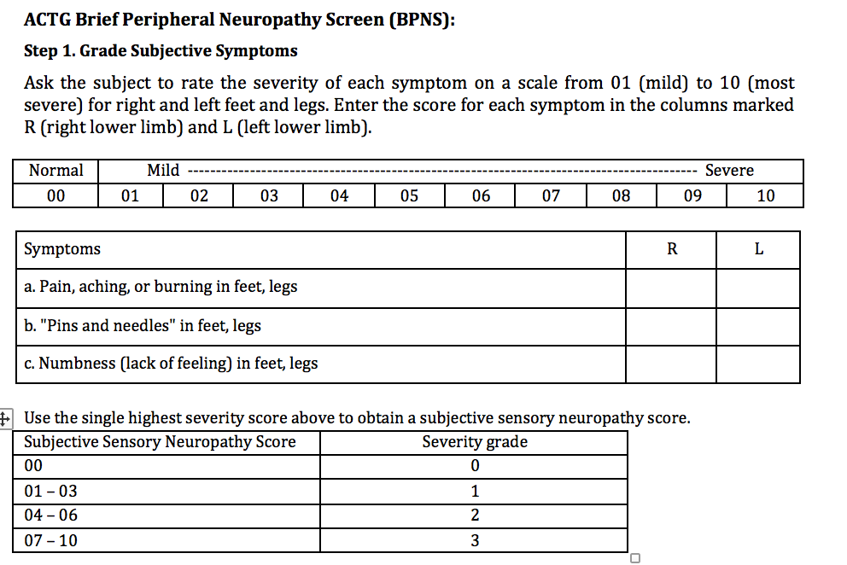
How to detect peripheral neuropathy? (1)

Slide 25
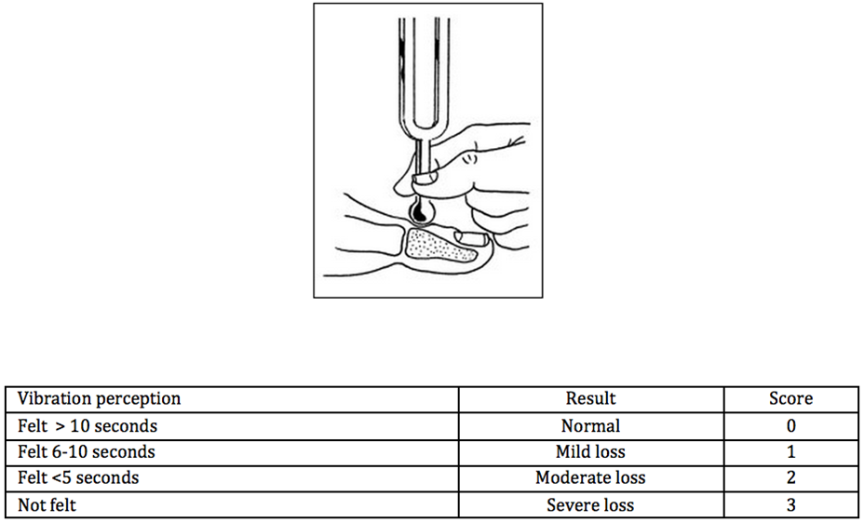
How to detect peripheral neuropathy? (2)
Step 2. Evaluate Perception of Vibration
Notes:
Compress the ends of a 128-Hz tuning fork just hard enough that the sides touch. Place the vibrating tuning fork on a bony prominence on the subject's wrist or hand to be sure that he/she can recognize the vibration or "buzzing" quality of the tuning fork. Again, compress the ends of the tuning fork just hard enough that the sides touch. Immediately place the vibrating tuning fork gently but firmly on the top of the distal interphalangeal (DIP) joint of one great toe and begin counting the seconds. Instruct the subject to tell you when the "buzzing" stops. Repeat for the other great toe. The diagram below illustrates where to place the tuning fork (adapted from International Working Group on the Diabetic Foot, Practical guidelines on the management and prevention of the diabetic, 2007).

Slide 26
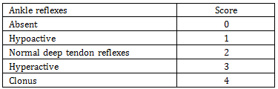
How to detect peripheral neuropathy? (3)
Step 3. Evaluate Deep Tendon Reflexes
A diagnosis of peripheral neuropathy can be made with the combination of a subjective neuropathy grade greater than 0 and at least one bilateral objective finding (abnormal vibratory sense or abnormal deep tendon ankle reflex)
Notes:
With the subject seated, the examiner uses one hand to press upward on the ball of the foot, dorsiflexing the subject's ankle to 90 degrees. Using a reflex hammer, the examiner then strikes the Achilles tendon. The tendon reflex is felt by the examiner's hand as a plantar flexion of the foot, appearing after a slight delay from the time the Achilles tendon is struck. Use reinforcement by having the subject clenching his/her fist before classifying the reflex as absent.

Slide 27
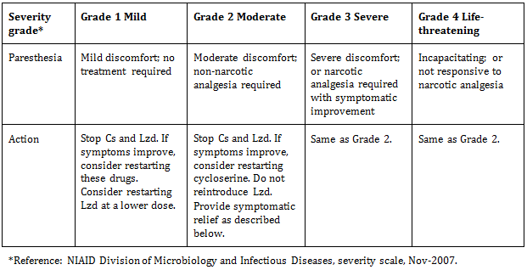
How to manage peripheral neuropathy? (1)
endTB Clinical Guideline, MSF&PIH, version 3.2

Slide 28
How to manage peripheral neuropathy? (2)
Often improved when offending drugs are suspended, especially if symptoms are mild.
Neuropathy with Lzd is common after prolonged use and often extremely painful and irreversible.
  Lzd should be immediately stopped and not reintroduced when ≥grade 2.
  Consider additional anti-TB drugs to reinforce the regimen.
In HIV coinfected patients, avoid use of d4T or ddI in combination with Cs or Lzd.
At least 50 mg of prophylactic pyridoxine daily.
Cs= Cycloserine; ddl= didanosine; d4T=Stavudine; Lzd=Linezolid
endTB Clinical Guideline, MSF&PIH, version 3.2

Slide 29
How to manage peripheral neuropathy? (3)
Symptomatic relief:
  NSAIDs or acetaminophen may help alleviate symptoms.
  Tricyclic antidepressant: start amitriptyline 25 mg at bedtime. Max dose 150 mg daily for refractory symptoms.
  Carbamazepine may be effective in relieving pain and other symptoms. NOT with Bdq or Dlm.
Bdq= Bedaquiline, Dlm= Delamanid, NSAIDs= Non steroidal anti-inflammatory drugs
endTB Clinical Guideline, MSF&PIH, version 3.2

Slide 30
Peripheral neuropathy
Case study 2
TR is a 23 years female who has XDR TB and is on a regimen of Lfx-Z-Cfz-Lzd-Bdq-Cs-PAS. She begins to complain of a “cold sensation” on the bottom of her feet and within a month is tripping and falling.
What additional information should you collect?
How severe is this event?
What management strategies should you try?
Notes:
If there is time, do the BPNS together for this patient. Discuss differentials (“the whole patient” not just thinking about Lzd).

Slide 31
Myelosuppression
Prevalence (DR TB patients) | 18% of patients in a trial with Lzd More common in patients with comorbidity, including HIV, alcohol use
How to detect? | Complete blood count, hemoglobin, platelets, white blood cells
Common causes | TB, Lzd, HIV, ART (AZT), alcohol (low platelets)
How to manage? | Iron supplementation, decrease dose of Lzd, transfusion or EPO if indicated, discontinue other medications.
Additional tests | Additional tests: Pregnancy testing, other co-morbidities, alcohol screening, investigation for possible hemorrhage.

Slide 32
Myelosuppression
Acute blood loss (occult GI bleeding from a peptic ulcer) can cause anaemia.
Other causes of anemia (TB, iron-deficiency, etc.) are possible, but less likely to occur in the middle of treatment, especially if the patient is clinically improving.

Slide 33
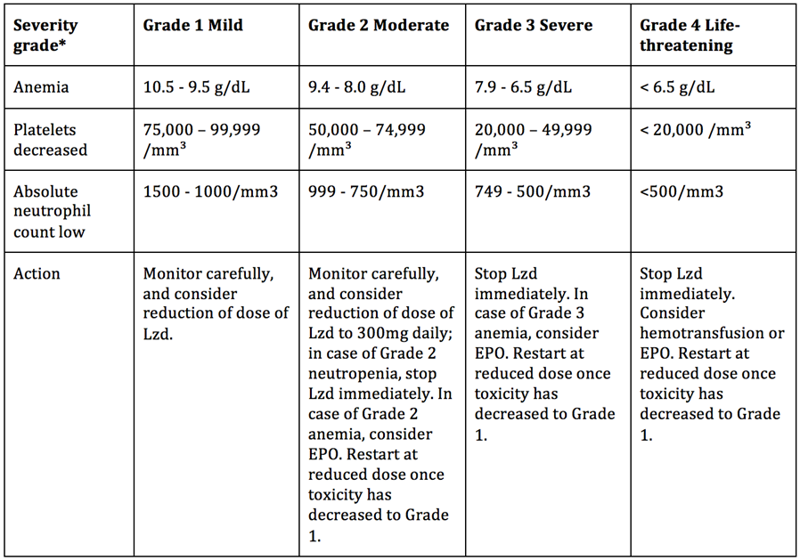
How to manage myelosuppression? (1)
endTB Clinical Guideline, MSF&PIH, version 3.2
Notes:
Ask what if anemia is grade 1 and thrombocytopenia is grade 4 ?

Slide 34
How to manage myelosuppression? (2)
Stop the causative drug immediately.
Monitor full blood counts regularly.
  Monthly is not enough if severe myelosuppression occurs.
Hospitalize the patient and consider transfusion or erythropoietin if the myelosuppression is severe.
  Consider erythropoietin (if accessible) for anemia Grade 2 or 3.
Consider additional anti-TB drugs to reinforce the regimen.

Slide 35
Myelosuppression
Case study 3
FR is a 34 yo male with XDR TB on treatment with Lzd-Bdq-Cfz-Z-PAS-Cs and is now in his 4th month of treatment.
He complains that his gums are bleeding when he brushes his teeth and that he is getting nosebleeds at night due to the “dry air”.
What additional information should you collect?
How severe is this event?
What management strategies should you try?

Slide 36
QT prolongation
Prevalence (DR TB patients) | Can occur in up to 10% of patients
How to detect? | ECG
Common causes | Mfx, Bdq, Cfz, Dlm, Lfx Many other drugs: e.g. erythromycin, clarithromycin, quinidine, ketoconazole, fluconazole, Antipsychotics (all have some risk including haloperidol, chlorpromazine and risperidone), Many anti-nausea drugs (ondansetron/granisetron, domperidone), Methadone, Some antiretrovirals. Genetic causes such as long QT syndrome; hypothyroidism.
How to manage? | Assess for symptoms, repeat to confirm, review all medications; if >500 msec and does not correct, d/c BDQ
Additional tests/precautions | Potassium, TSH

Slide 37
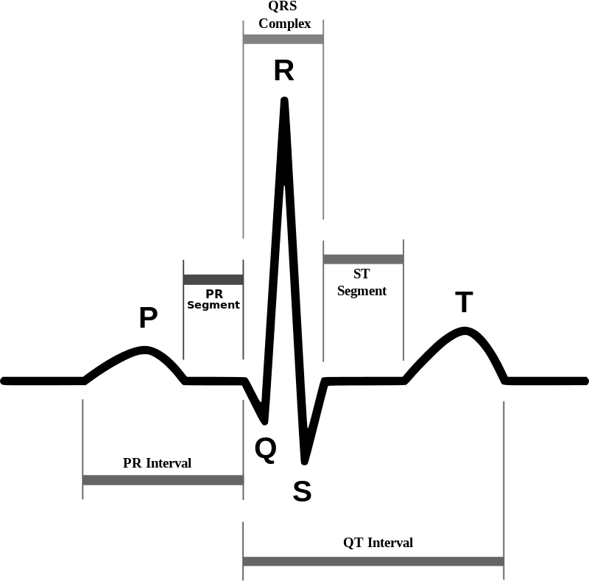
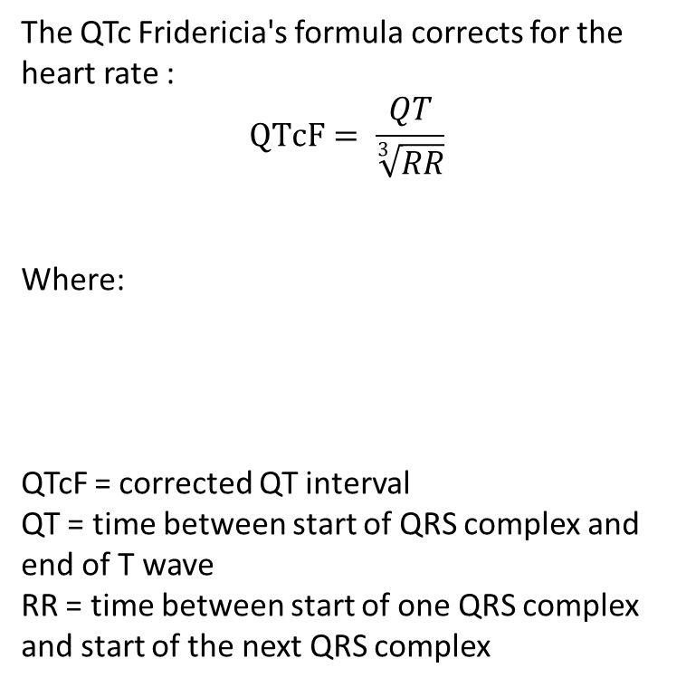
How to detect QT prolongation? (1)
To be adapted to the system used by the NTP
endTB Clinical Guideline, MSF&PIH, version 3.2
Notes:
Show QT, explain there is a correction and Fridericia formula should apply as it is the most accurate in case of slow or fast HR.

Slide 38
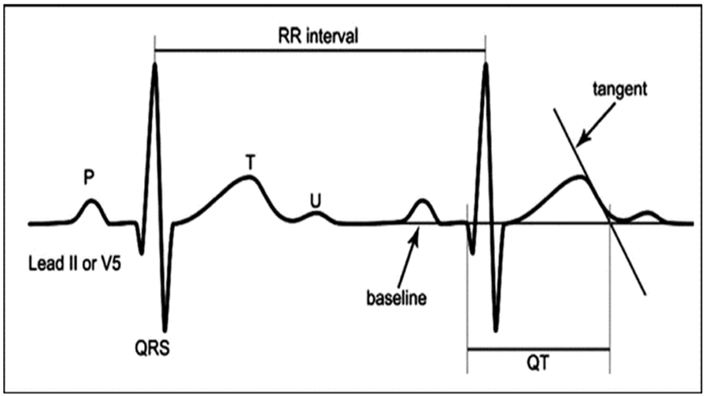
How to detect QT prolongation? (2)
endTB Clinical Guideline, MSF&PIH, version 3.2
Notes:
Explain the 2 component of the QTcF calculation QT and RR.

Slide 39
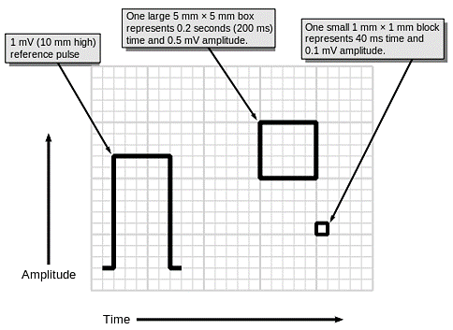
How to detect QT prolongation? (3)
The ECG machine should be calibrated to ensure that the following voltage and speeds apply:
endTB Clinical Guideline, MSF&PIH, version 3.2
Notes:
Very important that they know how to read an actual ECG and that calibration matters. Usually this is old knowledge from medical school, even if there is a cardiologist in the hospital or the project, a TB doctor nowadays needs to be able to do this exercise. Insist on the calibration of the ECG machine.

Slide 40
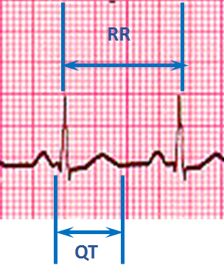
How to detect QT prolongation? (4)
You can count on the ECG display and gets the value for RR and QT?
How much are QT and RR here?
endTB Clinical Guideline, MSF&PIH, version 3.2
Notes:
Calculate together QT and RR.

Slide 41
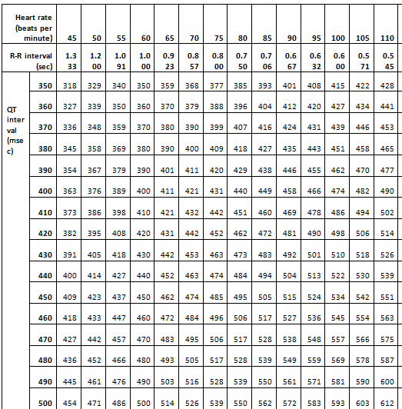
How to detect QT prolongation? (5)
QTcF can be calculated using the formula… OR you just use the nomogram.
Can you find QTcF for the example?
To be adapted to the system used by the NTP
endTB Clinical Guideline, MSF&PIH, version 3.2
Notes:
Ask who remembers the formula. Find the QTcF for the QT and RR from previous slide.

Slide 42
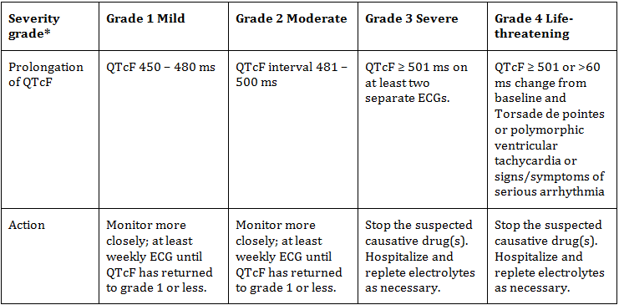
How to manage QT prolongation? (1)
endTB Clinical Guideline, MSF&PIH, version 3.2
Notes:
Ask who has seen QTcF > 500 msec. Insist on grade 4 definition as change from baseline is ALWAYS missed.

Slide 43
How to manage QT prolongation? (2)
Stop all QT prolonging drugs immediately.
ART usually not stopped unless the patient is severely unstable.
Hospitalize and consider continuous ECG monitoring for Grade 3 and above.
  Hospitalization should occur in a facility capable in the management of Torsade de Pointes / arrhythmia.
Check a TSH and treat any hypothyroidism found.
Check electrolytes and manage.
endTB Clinical Guideline, MSF&PIH, version 3.2

Slide 44
How to manage QT prolongation? (3)
Checking and repleting serum electrolytes:
  Serum potassium (K⁺), ionized calcium (ionized Ca⁺⁺), and magnesium (Mg⁺⁺) should be obtained in case of prolonged QT.
  Abnormal electrolytes are most commonly due to the injectable and should be corrected.
  If low K⁺ is detected, urgent management needed with replacement and frequent repeat K⁺ test (daily or multiple times a day) to document K⁺ is improving.
  If K⁺ is low, always check Mg⁺⁺ and Ca⁺⁺, and compensate as needed.
    If unable to check, consider oral empiric replacement doses of Mg⁺⁺ and Ca⁺⁺.
endTB Clinical Guideline, MSF&PIH, version 3.2

Slide 45
How to manage QT prolongation? (4)
Once stable (QTcF <450 and normal electrolytes), drugs can be added back:
  Mfx → consider using Lfx instead.
  Cfz → consider suspending it permanently if not critical to the regimen.
  Bdq or Dlm → if considered critical to the regimen, consider adding back to the regimen while suspending all other QT prolonging drugs (with the exception of stopping ART, which should not normally be suspended in the management of QT prolongation).
endTB Clinical Guideline, MSF&PIH, version 3.2

Slide 46
QT prolongation
Case study 4
PP is a 44 yo male on treatment for XDR TB with Bdq-Cfz-Lzd-Z-Cs-PAS-Eto. Baseline QTcF is 420 msec. He is doing well but on his 8-week visit, he is found to have an increased QTcF at 485 msec. Slightly pale, bradycardia.
What additional information should you collect?
How severe is this event?
What management strategies should you try?
Notes:
! Presenter, there is a trap ! It is very important when you explain to show again the severity table; not just the value that matters but also the difference from baseline. Usually no one gets it right the first time.

Slide 47
Visual disturbances
Prevalence (DR TB patients) | Lzd is by far the most common cause of optic neuritis - 18% of patients in trials, mostly after 4 months of treatment.
How to detect? | Visual acuity, color testing
Common causes | Age, cataract, E, Lzd, Eto/Pto, Cfz, rifabutin, H, S, ddI
How to manage? | Rule out other causes, discontinue or lower dose of E and/or Lzd
Additional tests/precautions | Examination of optic nerve ! Diabetes !

Slide 48
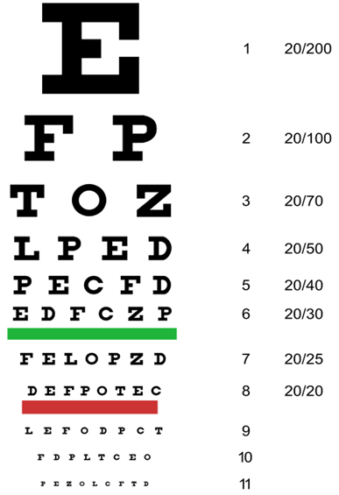
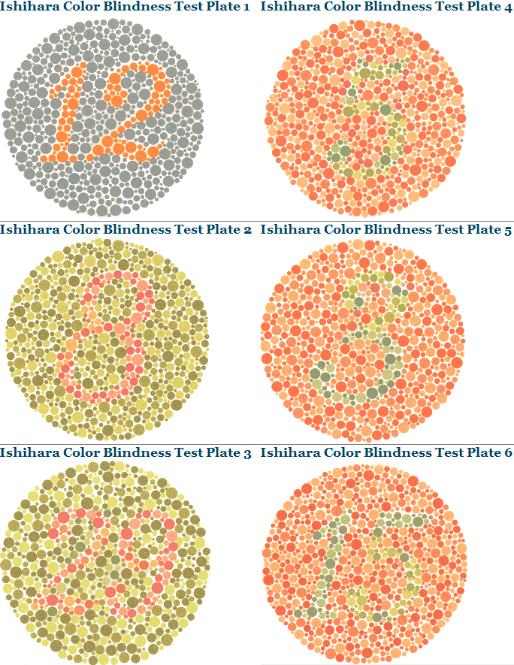
How to detect visual disturbances?
Notes:
Mention the importance to get first hand printing of Ishihara not photocopies from the plate of a colleague.

Slide 49
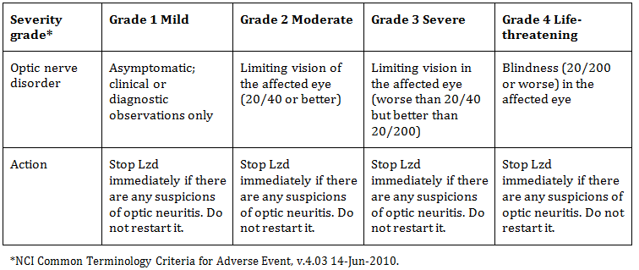
How to manage visual disturbances?
endTB Clinical Guideline, MSF&PIH, version 3.2

Slide 50
Hepatitis
Prevalence (DR TB patients) | Up to 25%
How to detect? | Symptomatic, screening (transaminases) Baseline: screen for hepatitis B and C
Common causes | Viral hepatitis, alcohol, NVP, any of the TB medications Can be very difficult to decide causative agent in multidrug regimen ! cotrimoxazole in HIV patients !
How to manage? | Discontinue medications and serially reintroduce
Additional tests/precautions | Consider serum bilirubin, alcohol screening, hepatitis B and C serology, liver ultrasonography

Slide 51
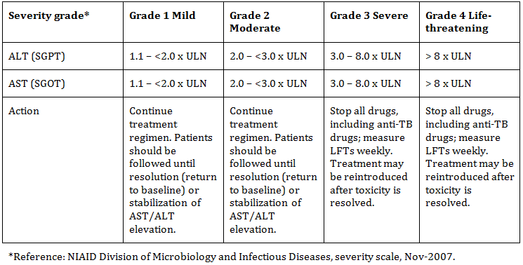
How to manage hepatitis?
endTB Clinical Guideline, MSF&PIH, version 3.2

Slide 52
Hepatitis
Case study 5
NH is a 23 yo male on treatment for XDR TB with Cfz-Z-Lzd-Bdq-PAS-Cs; also on TDF/NVP/FTC. At his month 2 visit, his serum ALT/SGOT is elevated at 3 times the upper limit of normal
What additional information should you collect?
How severe is this event?
What management strategies should you try?

Slide 53
Hypokalaemia
Prevalence (DR TB patients) | Up to 15% More common in patients with vomiting, diarrhea, alcohol use
How to detect? | Serum K+
Common causes | Injectables (TDF rarely)
How to manage? | Replete potassium, replete magnesium, ensure hydration, encourage dietary intake of K+ (banana, orange, etc.) In cases refractory to replacement therapy, amiloride 5 to 10 mg PO daily or spironolactone 25 mg PO daily
Additional tests/precautions | Consider checking calcium if there is QT prolongation, alcohol screening.

Slide 54
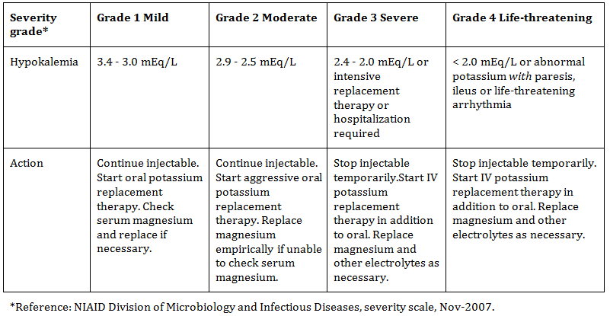
How to manage hypokalaemia? (1)
endTB Clinical Guideline, MSF&PIH, version 3.2

Slide 55
How to manage hypokalemia? (2)
Monitor electrolytes frequently in case of vomiting/diarrhea and when using injectables
Start oral or IV rehydration immediately until volume is normal
Replete K+ and Mg++
Hypokalemia may be refractory if concurrent hypomagnesemia is not corrected
  If Mg++ cannot be checked, give empiric oral replacement therapy in all cases of hypokalemia with magnesium gluconate 1000 mg twice daily
Check ECG in patients with significant electrolyte disturbances
  Drugs that prolong the QT interval should be discontinued in patients with evidence of QT interval prolongation
Electrolyte abnormalities are reversible upon discontinuation of injectable, it may take weeks or months to normalize under maintained replacement therapy
endTB Clinical Guideline, MSF&PIH, version 3.2

Slide 56
Hypothyroidism
Prevalence (DR TB patients) | up to 10% More common in HIV infected
How to detect? | TSH levels (! High TSH = hypo-thyroidism)
Common causes | Pto/Eto, PAS, d4T
How to manage? | Thyroid replacement therapy
Additional tests/precautions | QTc interval

Slide 57
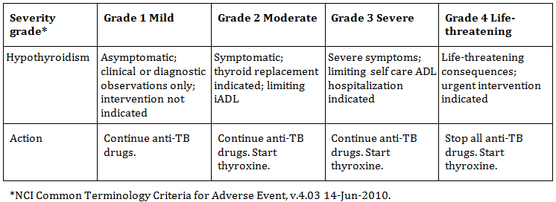
How to manage hypothyroidism?
endTB Clinical Guideline, MSF&PIH, version 3.2

Slide 58
Acute kidney injury
Prevalence (DR TB patients) | up to 10% More common in persons with HIV, Diabetes
How to detect? | Urea, creatinine
Common causes | Injectables (TDF rarely)
How to manage? | Discontinue injectables
Additional tests/precautions | Consider HIV, diabetes investigations, prerenal, intrinsic renal, and postrenal alternative etiologies. Consider strict weight-based dosing of the injectable if the patient's weight <50 kg

Slide 59
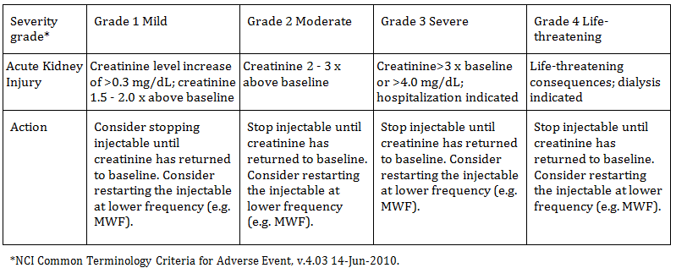
How to manage acute kidney injury?
Nephrotoxicity may be associated with injectable-induced electrolyte wasting.
endTB Clinical Guideline, MSF&PIH, version 3.2

Slide 60
Acute kidney injury
Case study 6
RR is a 62 yo male on treatment for MDRTB with Mfx-Cm-Z-Cs-PAS-Eto.
At his one-month routine visit, he is found to have a serum creatinine that is 1.5 times the upper limit of normal.
What additional information should you collect?
How severe is this event?
What management strategies should you try?

Slide 61
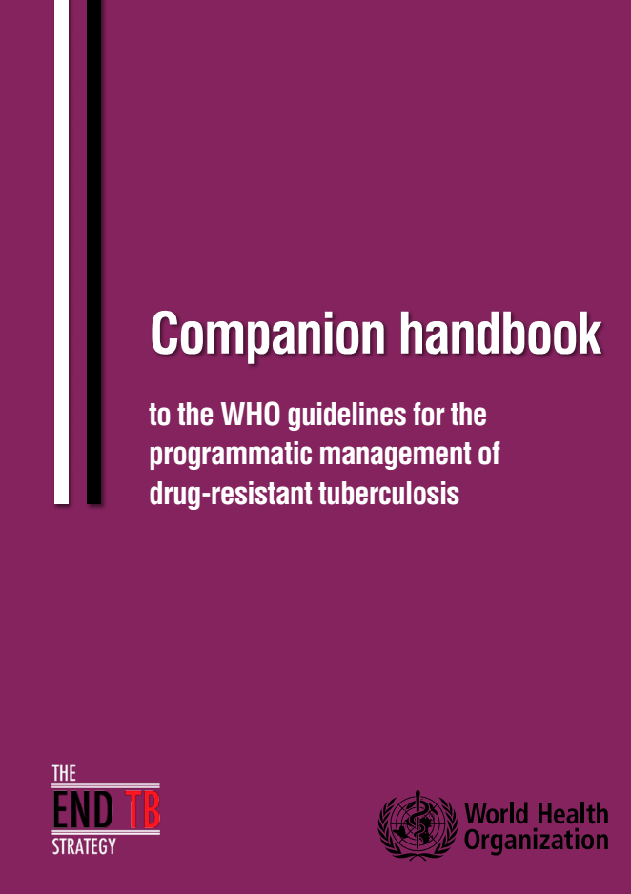
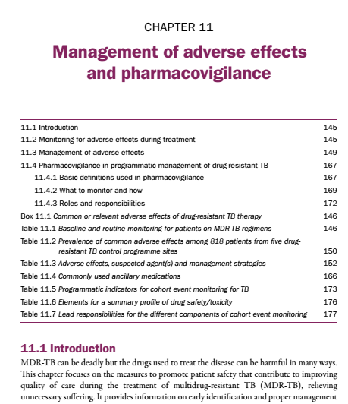
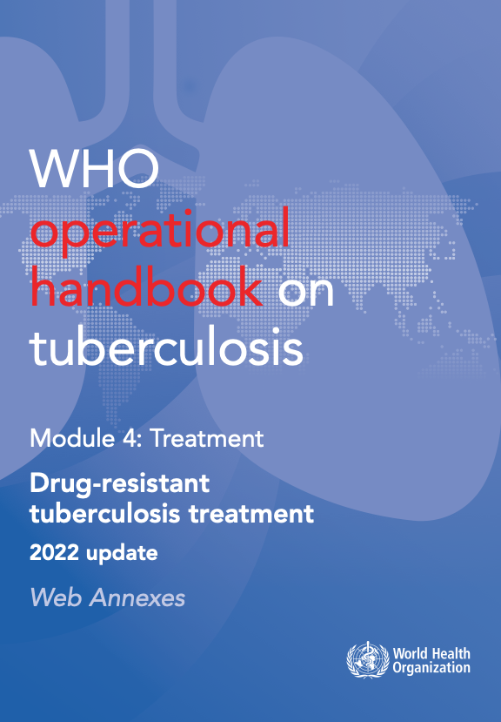
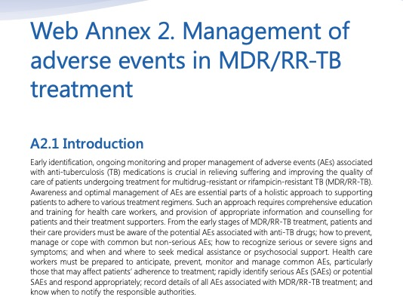
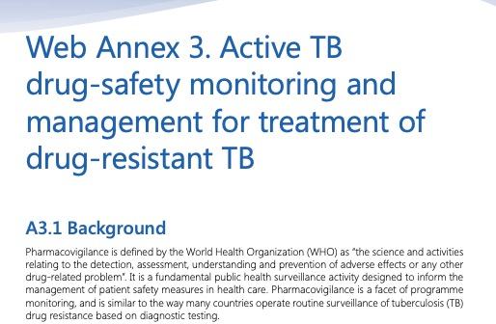
Further references
http://apps.who.int/iris/bitstream/10665/130918/1/9789241548809_eng.pdf
https://apps.who.int/iris/bitstream/handle/10665/365309/9789240065352-eng.pdf

Slide 62
Hearing loss
Prevalence (DR TB patients) | 30% of patients Patients with previous exposure to aminoglycosides may have already sustained a degree of hearing loss.
How to detect? | Monthly audiometry while on injectables
Common causes | Injectable agents
How to manage? | Early identification is key, this is a major cause of permanent disability! → Discontinue injectable
Additional tests/precautions | Consider examination of tympanic membranes. Concomitant use of furosemide, particularly in the setting of renal insufficiency, may exacerbate ototoxic effects of the injectables.
Notes:
Discuss if it is still tolerable nowadays to have patients becoming severely deaf.

Slide 63
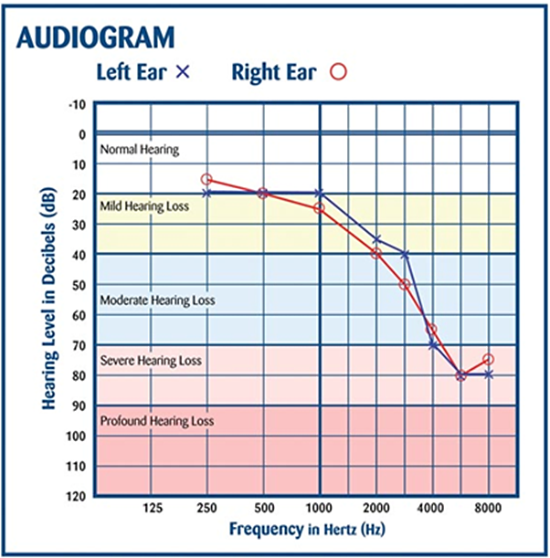
How to detect and manage hearing loss?
Example of high-frequency hearing loss
  Often the 1st sign of ototoxicity due to injectables
Suspending (or substituting) injectable is indicated; this can prevent further loss of hearing
endTB Clinical Guideline, MSF&PIH, version 3.2

Slide 64
Hearing loss
Case study 7
LV is a 55 yo female on treatment for MDRTB with Cm-Mfx-Z-Cs-PAS-Eto. In her first month of treatment, she begins to complain of buzzing in her ears
What additional information should you collect?
How severe is this event?
What management strategies should you try?
Notes:
Again discuss how acceptable it is to have a young female losing her hearing now that we have Bdq/Dlm. It is a “cultural” change for some doctors, very important to emphasize on that.

Slide 65
Conclusions
Adverse events are common and are to be expected during treatment for DR-TB
Routine monitoring is important for all patients on MDR-TB treatment; aDSM is the systematic way of achieving this
Early recognition and optimal management of adverse events is key to ensuring better treatment outcomes
Standard scales can help with severity ratings and finding the appropriate management option
Health care providers need to be trained and supported to provide appropriate care – including management of adverse reactions – to patients

Slide 66
Acknowledgements
The development of the aDSM training material was funded by TDR as part of the Access and Delivery Partnership (ADP) with funding from the Government of Japan.
These training materials were put together in 2016 the WHO Task Force on aDSM with technical partners KNCV Tuberculosis Foundation, Management Sciences for Health (SIAPS), MSF, WHO GTB, and TDR.
The materials were updated in 2022-23 by Mahamadou Bassirou Souleymane (TDR consultant) with Marie-Eve Raguenaud (TDR), Branwen J Hennig (TDR), and Corinne Merle (TDR), and reviewed by Linh Nhat Nguyen (WHO/GTB), Medea Gegia (WHO/GTB), and Fuad Mirzayev (WHO/GTB).
We thank all members of the WARN/CARN-TB working group on aDSM who contributed to the development of the aDSM generic guidelines as well as the secretariat, particularly Dr Christ Houessinon: Disadidi Ambrioso, Esse Marius, Adomou Jamal Rouamba Ruffine, Haro Sougrimani, Koumbem Boureima, Nsanzerugeze Josélyne, Tollo Tollo Daniel Alphonse Désiré, Mpaba Minkat Théophile Mistral, Julie Abessolo, Ursule IDOKO, Tijan Baldeh , Wandifa Samateh, Tida S Kinteh, Alieu Wurie, Mardemn Yeasuen, Benjamin K. Quenneh, Cheick Oumar Bah, Kane El Hadj Malick, Aw Idriss, Mamoudou Hama Rachida, Gagara I. M. Assiatou, Katambé Balkissa, Seiyabatou Elh Saidou, Liombo Anastasie, Lunganyu Junior, Kitambala Sentime, Lula Yves , Habimana-Mucyo Yves, Migambi Patrick, dos Santos Brigite, Castro Vânia, Wadson Cruz, Gueye Aminata, Mukeh Fahnbulleh, Bailor Samuel, Manjo Lamin, Saleh Mahareb Abdoulaye, Haroun Saleh Naima, Mouhoudine Yerima, Kpelafia Silifa

