Slide 1



Training package on active tuberculosis drug safety monitoring and management (aDSM)
2023

Slide 2
1.1. Structure and training objectives
for this course & key references

Slide 3
Structure of this training packages (1)
Background
Overview
Training pack for managers
Training pack for heath care workers
Core modules (Implementing aDSM)
Complementary modules
Core modules
(aDSM in everyday practice)
Complementary modules

Slide 4
Structure of this training packages (2)
Background, Overview, Objectives
1. Training objectives for this course & key references
2. Key definitions
3. Active TB drug-safety monitoring : rationale and mechanisms in the context of TB & MDR-TB treatment

Slide 5
Structure of this training packages (3)
Training pack for health care workers
2.Core modules (aDSM in everyday practice)
1. Clinical monitoring and management of adverse events
2. Train staff on the collection of data
3. National and international reporting of adverse events: mechanisms, routes and resources
4. Records Management & Quality Assurance of Data

Slide 6
Structure of this training package (4)
Training pack for health care workers
3. Complementary modules (aDSM)
1. Indicators of aDSM implementation and programme management

Slide 7
Structure of this training package (5)
Training pack for managers
2.Core modules (Implementing aDSM)
1. The 8 key elements for the implementation of aDSM in a national TB programme
i. Create a national coordinating mechanism for aDSM
ii. Develop a plan for aDSM
iii. Define management and supervision roles and responsibilities
iv. Create standard data collection materials
v. Train staff on the collection of data
vi. Define schedules and routes for data collection and reporting
vii. Consolidate aDSM data electronically
viii. Develop capacity for signal detection and causality assessment
2. National and international reporting of adverse events: mechanisms, routes and resources
3. Indicators of aDSM implementation and programme management

Slide 8
Structure of this training package (6)
Training pack for managers
3. Complementary modules (aDSM)
1. Record management and quality assurance of data
2. Causality assessment: scales & methods
3. Signal detection introduction
4. Overview on risk communication and new knowledge integration
5. Role of national and international technical and funding partners in the implementation of aDSM

Slide 9
Training pack for health care workers training curriculum
  Targets HCWs in charge of DR-TB patients
    at peripheral level (DR-TB facilities)
    clinicians, nurses…
  Focuses on technical components
    Monitoring, clinical management and reporting of aDSM

Slide 10
Learning objectives for HCWs
By the end of the training modules, the participant is expected to be able to…
Identify and understand the key concepts and definitions of aDSM
Correctly identify adverse events and culprit drug(s) during the clinical monitoring of DR-TB treatment
Effectively manage adverse drug reactions during treatment
Properly record adverse events per system affected and by severity (following standard guidelines)
Properly and regularly notify adverse events to NTP or the pharmacovigilance department of the MoH

Slide 11
Training pack for managers training curriculum
  Targets National TB Programme (NTP) and Pharmacovigilance (PV) management staff
    at central management level with knowledge of the PV system and DR-TB management in the country
  Focuses on implementation and coordination aspects for systematic reporting of aDSM to national and international systems
    causality assessment
    signal detection and communication

Slide 12
Learning objectives for managers
By the end of the training modules, the participant is expected to be able to…
Identify and understand the key concepts and definitions of aDSM
Describe how to implement and manage aDSM within a TB programme
Properly summarize AEs and regularly forward results to the pharmacovigilance department of the MoH
Understand key concepts of causality assessment, signal detection and safety risk management

Slide 13
Key references

Slide 14
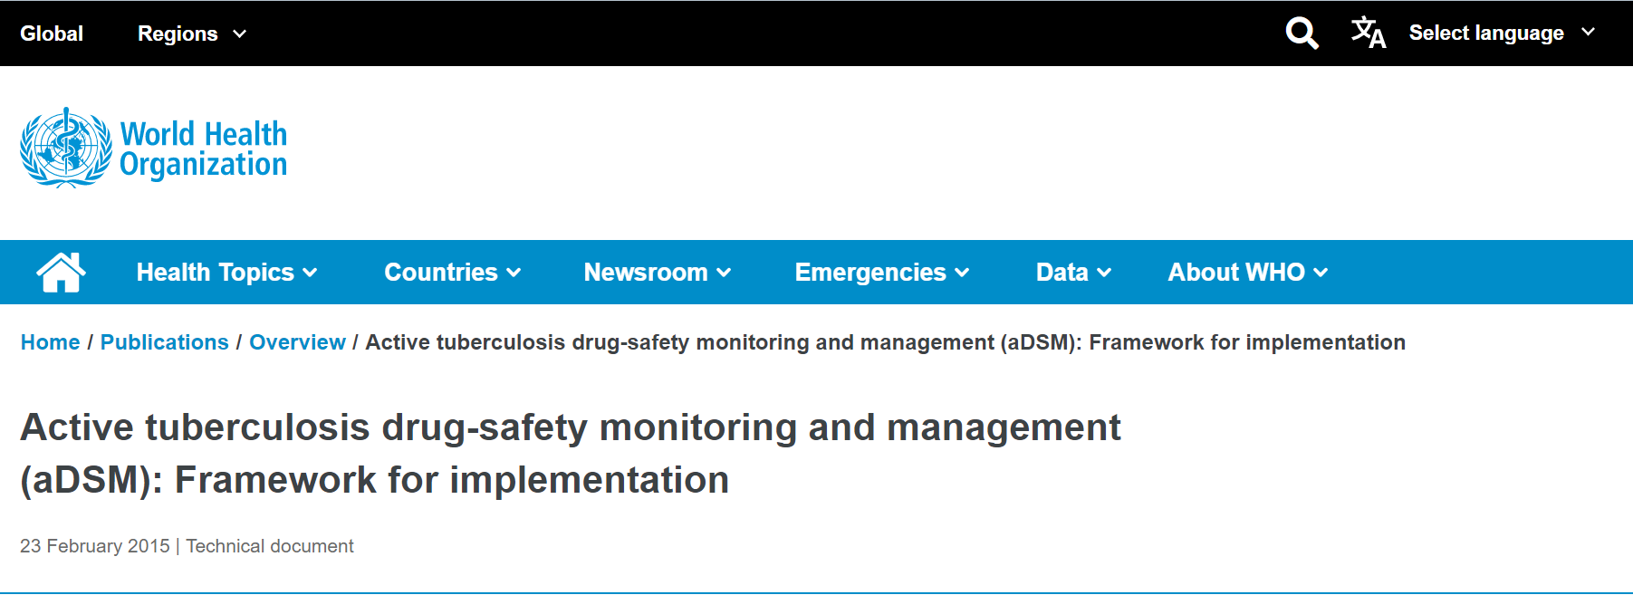
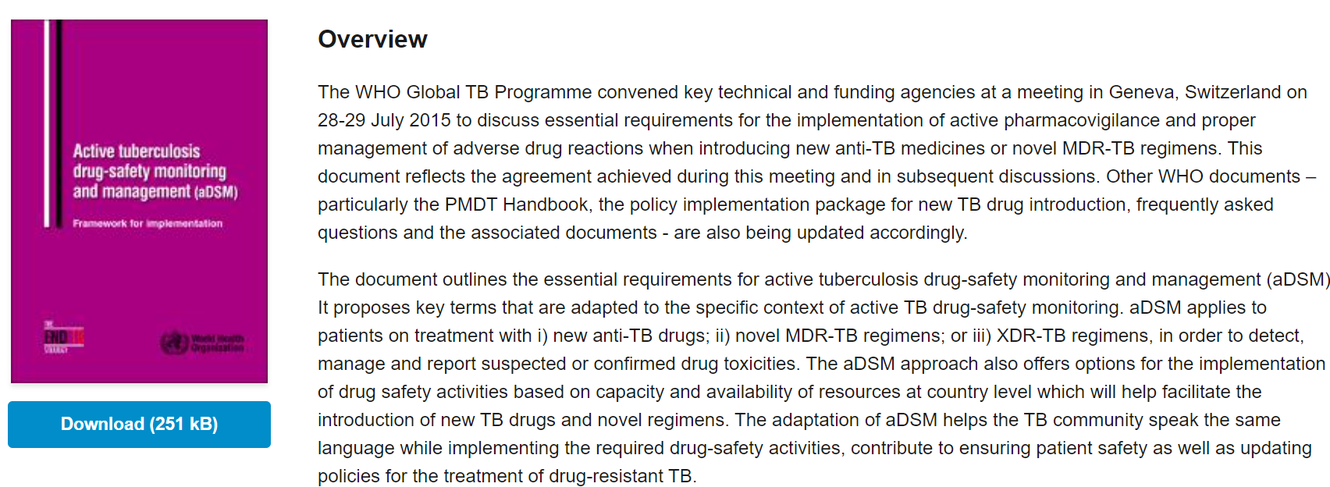
https://www.who.int/publications/i/item/WHO-HTM-TB-2015.28
“active and systematic clinical and laboratory assessment of patients on treatment with new TB drugs, novel MDR-TB regimens or XDR-TB regimens to detect, manage and report suspected or confirmed drug toxicities”
https://apps.who.int/iris/bitstream/handle/10665/204465/WHO_HTM_TB_2015.28_eng.pdf?sequence=1&isAllowed=y
https://apps.who.int/iris/bitstream/handle/10665/365309/9789240065352-eng.pdf?sequence=1&isAllowed=y

Slide 15
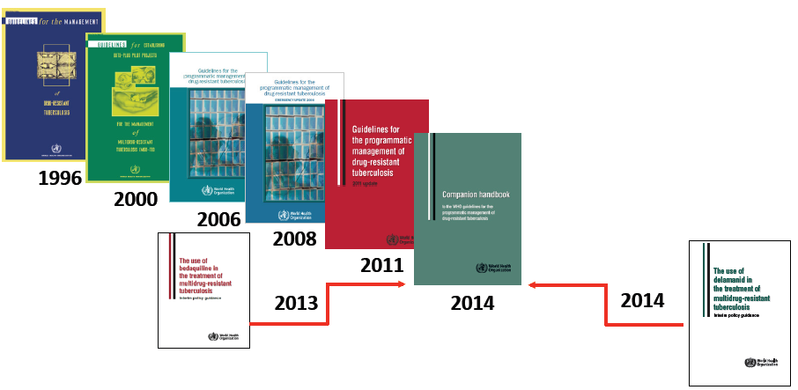
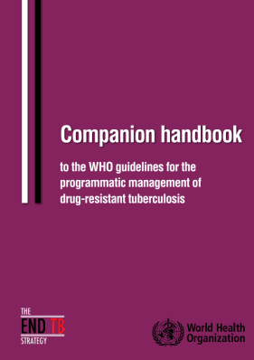

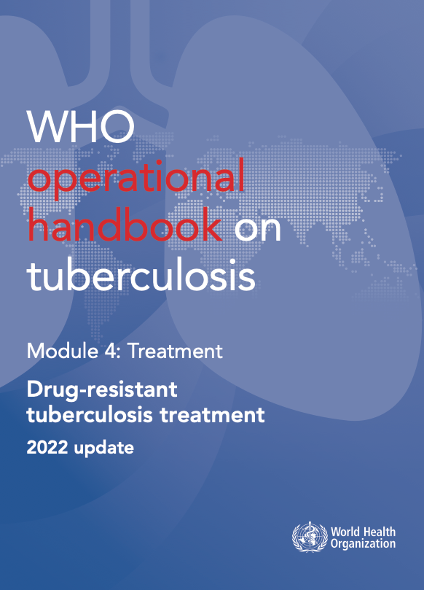
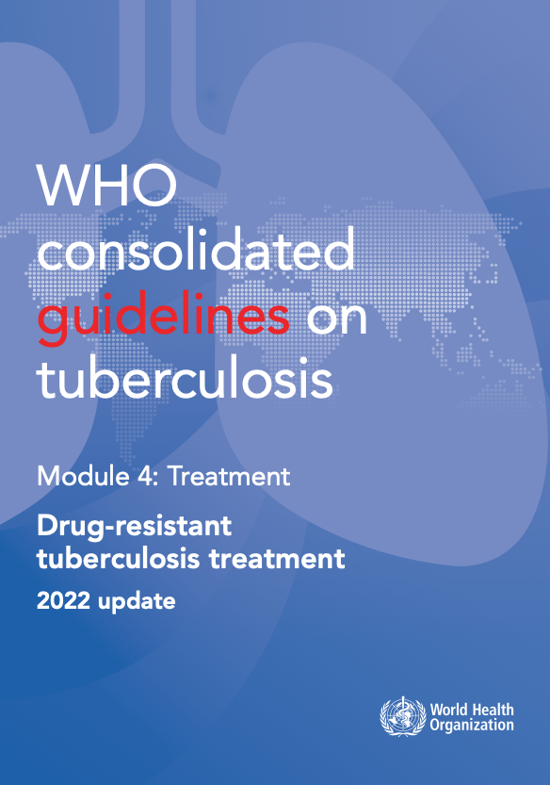
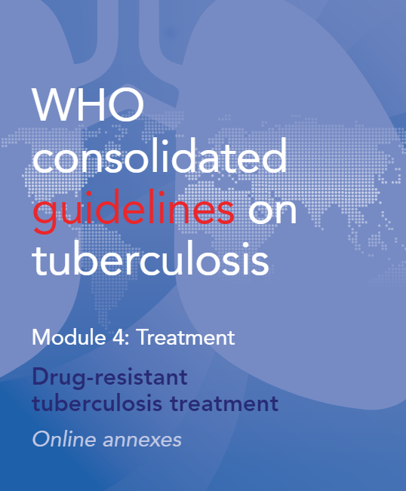
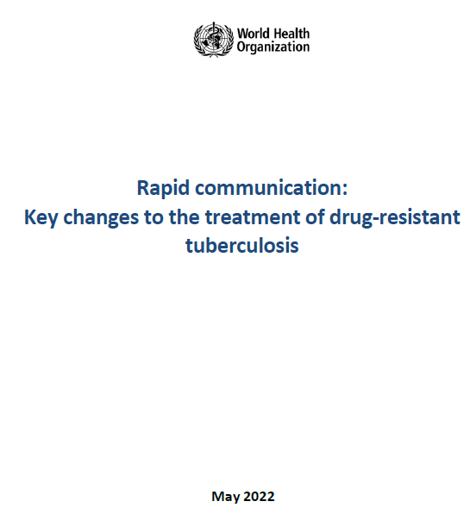
WHO guidance on treatment & management
of drug-resistant TB, 1996-2022
2016
2020
2022
WHO consolidated guidelines on tuberculosis. Module 4: treatment - drug-resistant tuberculosis treatment, 2022 update. Geneva: World Health Organization; 2022.
WHO operational handbook on tuberculosis. Module 4: treatment - drug-resistant tuberculosis treatment, 2022 update. Geneva: World Health Organization; 2022.

Slide 16
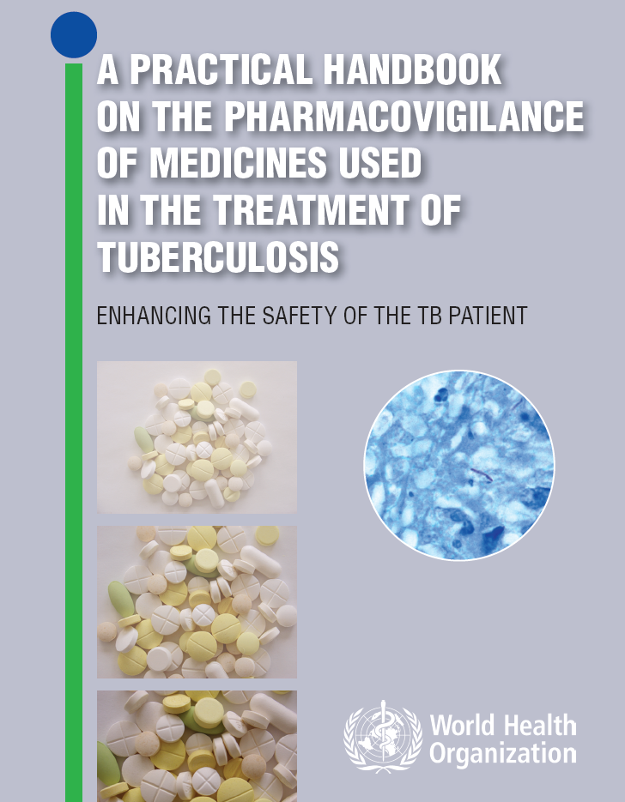
2012
Historically, the first WHO publication specifically focused on the pharmacovigilance of TB medications.
Describes spontaneous and active pharmacovigilance; signal detection, causality assessment between an event and a drug, making decisions and communicating findings
https://apps.who.int/iris/bitstream/handle/10665/336226/9789241503495-eng.pdf?sequence=1&isAllowed=y

Slide 17
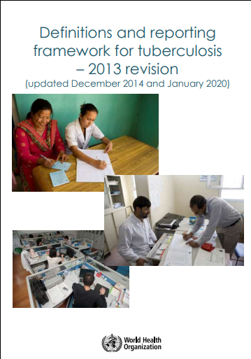
2013
Standardization of definitions and reporting parameters has permitted uniformity in the reporting of performance indicators of national TB programmes for many years
https://apps.who.int/iris/bitstream/handle/10665/79199/9789241505345_eng.pdf?sequence=1&isAllowed=y

Slide 18
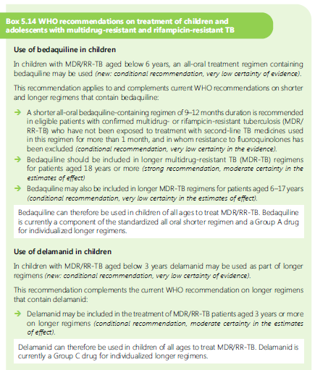
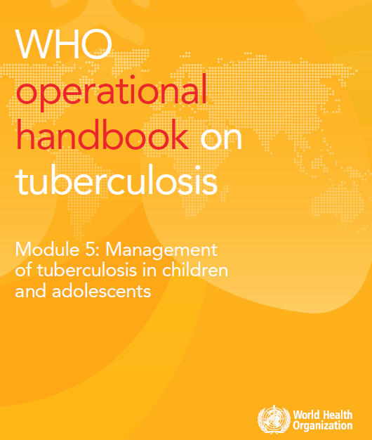
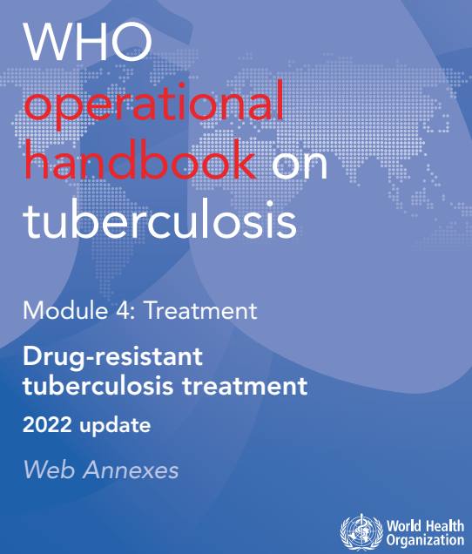
Use of bedaquiline and delamanide
In adults
in children
https://apps.who.int/iris/bitstream/handle/10665/332398/9789240006997-eng.pdf?sequence=1&isAllowed=y
https://apps.who.int/iris/bitstream/handle/10665/352523/9789240046832-eng.pdf

Slide 19

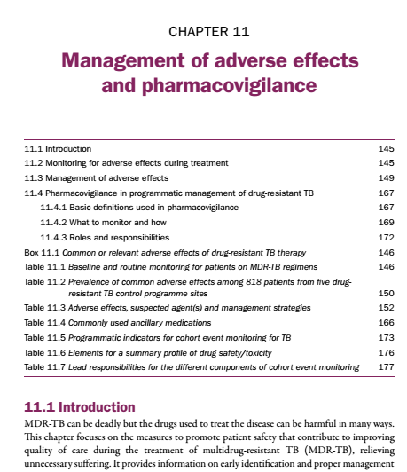
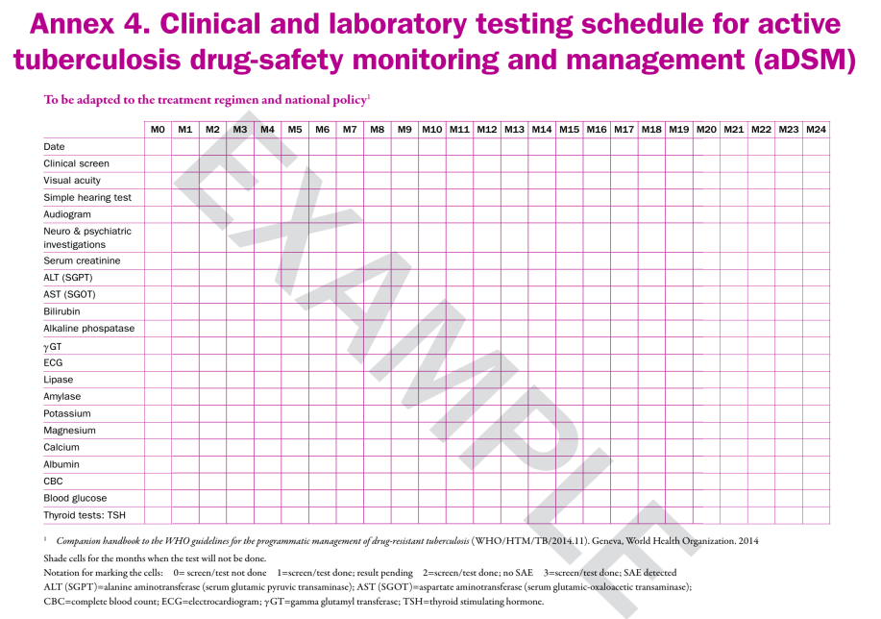
August 2014, updated early 2016
https://apps.who.int/iris/bitstream/handle/10665/130918/9789241548809_eng.pdf?sequence=1&isAllowed=y

Slide 20
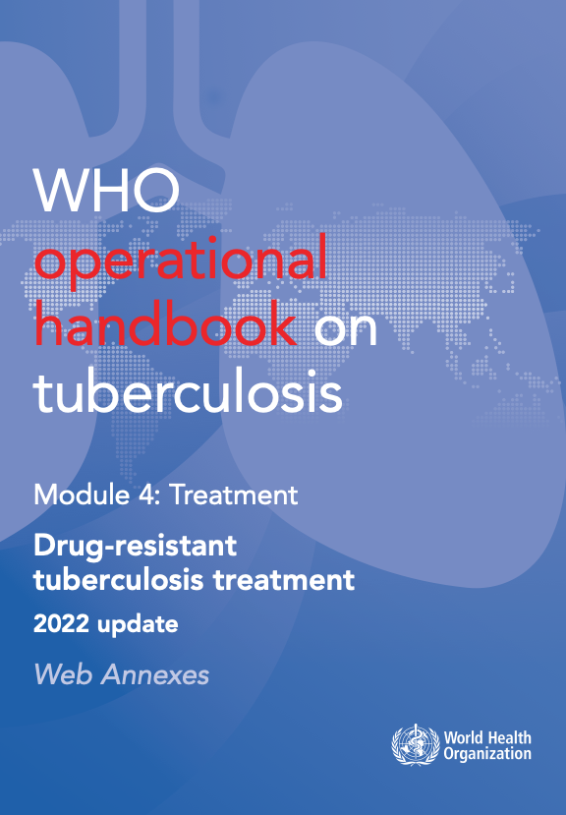
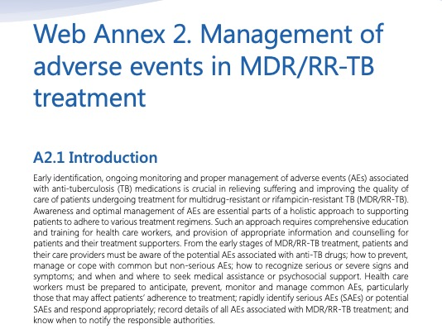
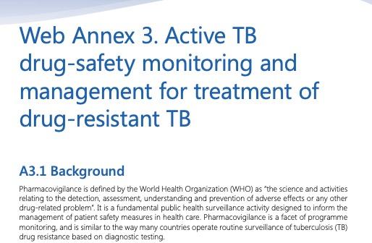
August 2014, updated 2016 and 2022
https://apps.who.int/iris/bitstream/handle/10665/130918/9789241548809_eng.pdf?sequence=1&isAllowed=y
https://apps.who.int/iris/bitstream/handle/10665/365309/9789240065352-eng.pdf

Slide 21


WHO/HTM/TB/2011.22
Adopting electronic recording and reporting is not simply about choosing a piece of software: it is also about changing how people work. This is not a simple undertaking.
This document indicates key questions to be considered and illustrates what the questions, options and recommendations mean in practice by drawing on examples of recent experience from a variety of countries. It is useful for those planning to introduce electronic recording and reporting systems for TB care and control, or to enhance existing systems
whqlibdoc.who.int/publications/2012/9789241564465_eng.pdf
https://apps.who.int/iris/bitstream/handle/10665/259832/9789241513456eng.pdf?sequence=1&isAllowed=y

Slide 22
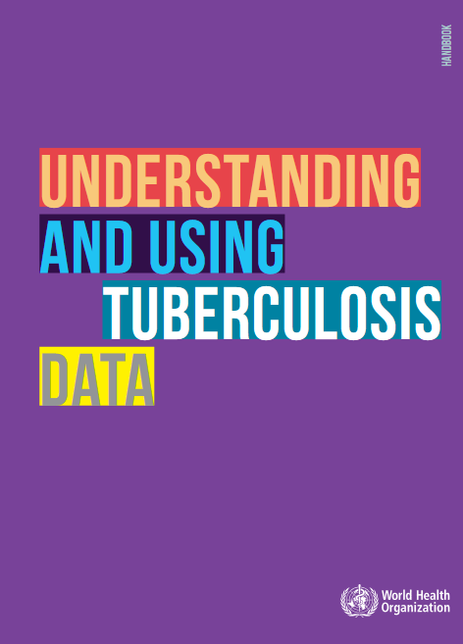
WHO/HTM/TB/2014.09
This book presents the practicalities of standard and advanced analysis of programme TB surveillance data. The same approaches could have an application for in-depth analysis of aDSM data.
http://apps.who.int/iris/bitstream/handle/10665/129942/9789241548786_eng.pdf?sequence=1

Slide 23
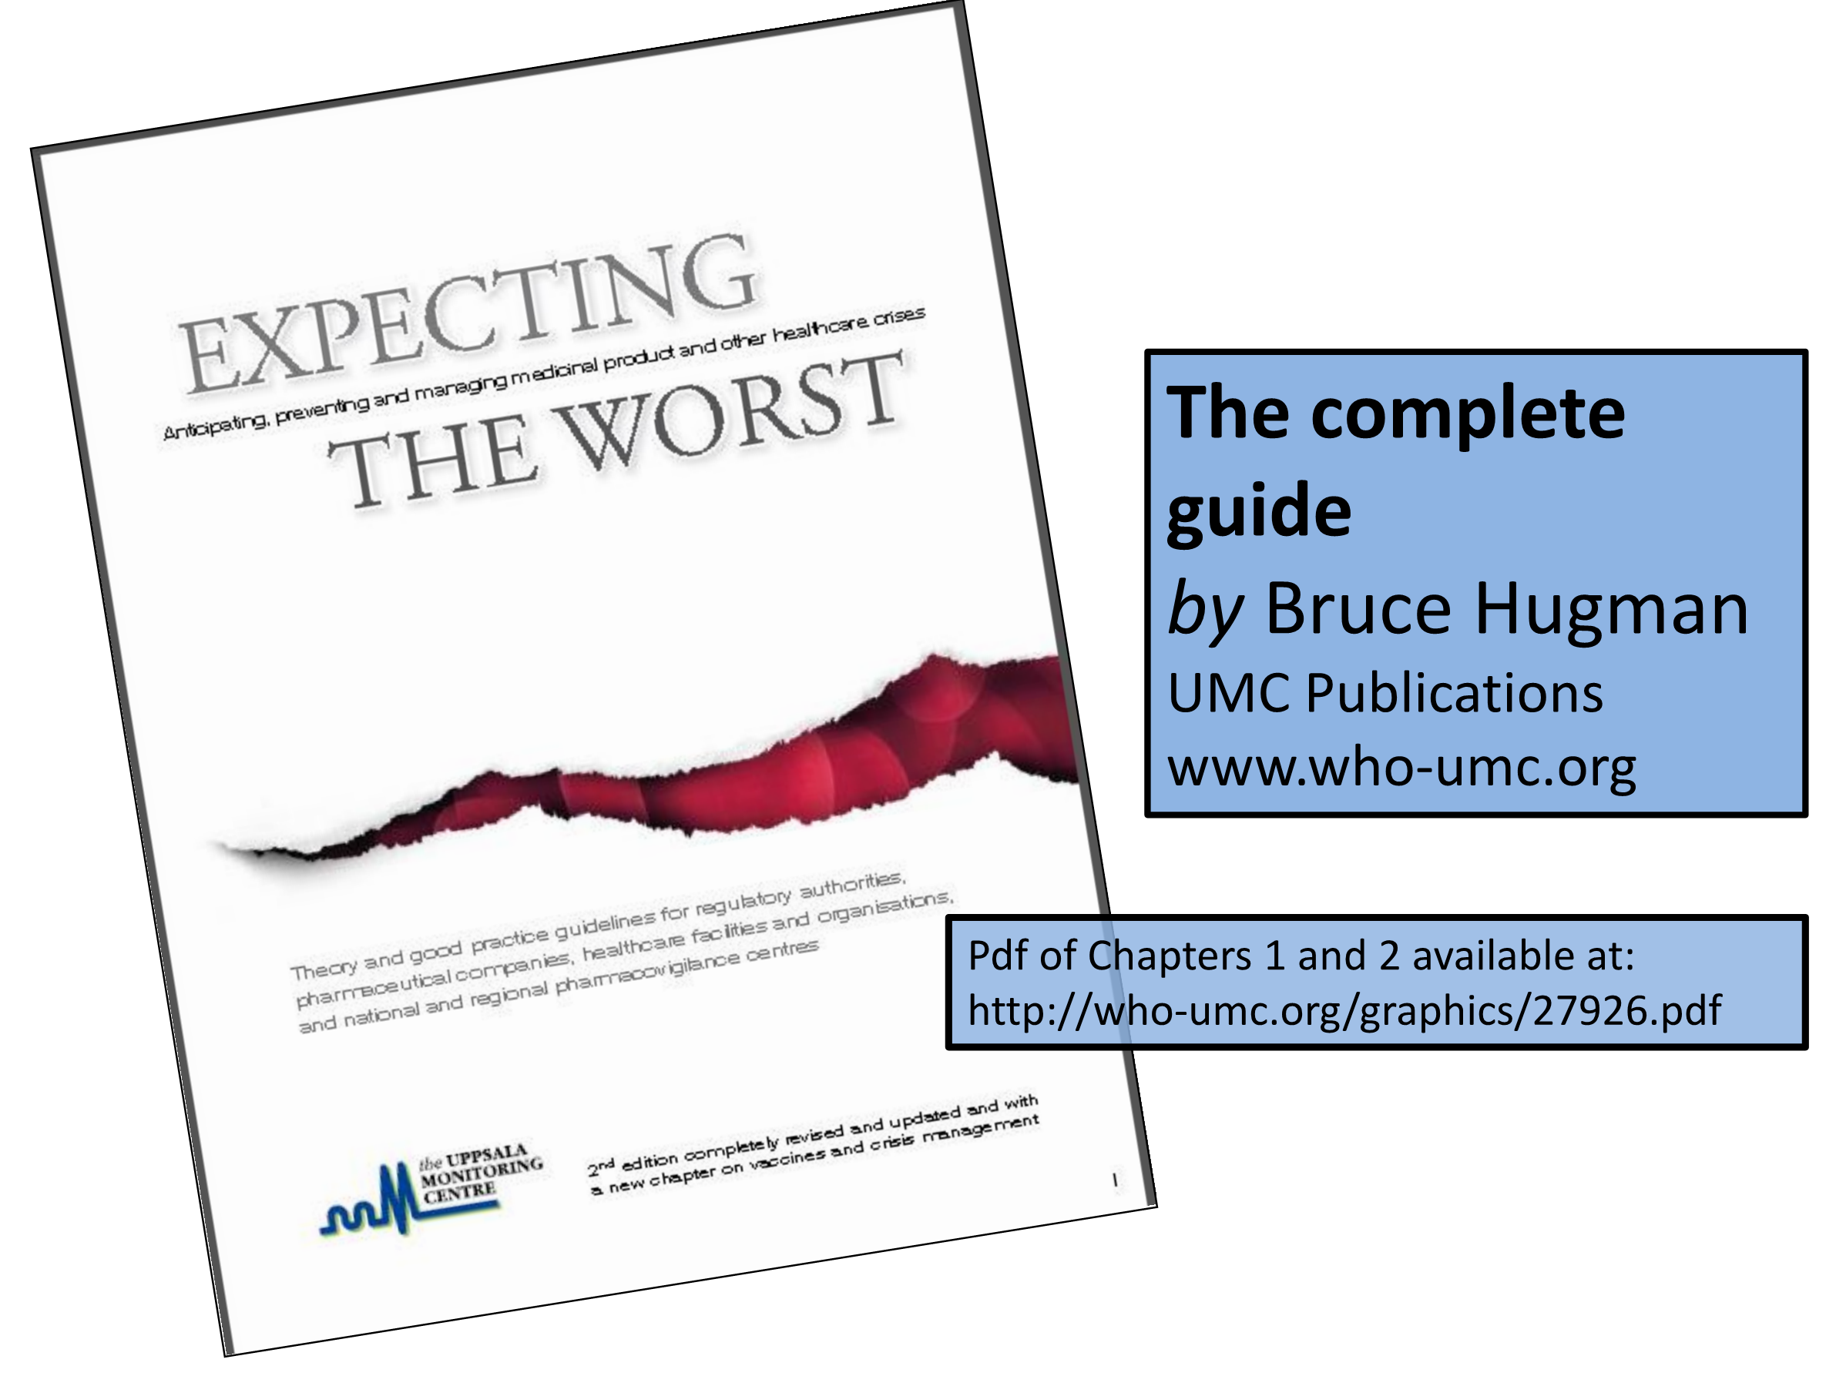

Slide 24

Mann’s Pharmacovigilance, 3rd Edition. Published 2014 by John Wiley & Sons, Ltd.

Slide 25
Acknowledgements
The development of the aDSM training material was funded by TDR as part of the Access and Delivery Partnership (ADP) with funding from the Government of Japan.
These training materials were put together in 2016 the WHO Task Force on aDSM with technical partners KNCV Tuberculosis Foundation, Management Sciences for Health (SIAPS), MSF, WHO GTB, and TDR.
The materials were updated in 2022-23 by Mahamadou Bassirou Souleymane (TDR consultant) with Marie-Eve Raguenaud (TDR), Branwen J Hennig (TDR), and Corinne Merle (TDR), and reviewed by Linh Nhat Nguyen (WHO/GTB), Medea Gegia (WHO/GTB), and Fuad Mirzayev (WHO/GTB).
We thank all members of the WARN/CARN-TB working group on aDSM who contributed to the development of the aDSM generic guidelines as well as the secretariat, particularly Dr Christ Houessinon: Disadidi Ambrioso, Esse Marius, Adomou Jamal Rouamba Ruffine, Haro Sougrimani, Koumbem Boureima, Nsanzerugeze Josélyne, Tollo Tollo Daniel Alphonse Désiré, Mpaba Minkat Théophile Mistral, Julie Abessolo, Ursule IDOKO, Tijan Baldeh , Wandifa Samateh, Tida S Kinteh, Alieu Wurie, Mardemn Yeasuen, Benjamin K. Quenneh, Cheick Oumar Bah, Kane El Hadj Malick, Aw Idriss, Mamoudou Hama Rachida, Gagara I. M. Assiatou, Katambé Balkissa, Seiyabatou Elh Saidou, Liombo Anastasie, Lunganyu Junior, Kitambala Sentime, Lula Yves , Habimana-Mucyo Yves, Migambi Patrick, dos Santos Brigite, Castro Vânia, Wadson Cruz, Gueye Aminata, Mukeh Fahnbulleh, Bailor Samuel, Manjo Lamin, Saleh Mahareb Abdoulaye, Haroun Saleh Naima, Mouhoudine Yerima, Kpelafia Silifa

